Slide 1

Primary 1 Numeracy
Week Beg 7th Feb
07.02.21
(Only 4 days this week!)

Slide 2
Monday 08.02.21
There are 2 tasks today.
Number work : Counting Collections to 20 in rows
Number Line: I can use the number line to help identify the missing number.

Slide 3
Monday 08.02.21
LI : I can count collections within 20 in rows.
We want to count the collections to 20 and describe what we see.
E.G
Here I can see 10 stars.
I can see 2 rows of stars and each row has 5 stars.

Slide 4
Monday 08.02.21: Your turn
Example 2
Example 2
I can see 12 suns altogether.
I can see 3 rows.
Each row has 4 suns.
3 rows of 4 suns.

Slide 5
Monday 08.02.21

Slide 6
Monday 08.02.21
Task 2 :
Find the missing number on the number line
0
10
0
10
10
20

Slide 7
Tuesday 09.02.21
There are 2 tasks today
1. LI: I can use a number line to complete addition sums.
2. Topmarks – Addition Game

Slide 8

3 + 4 =

Slide 9
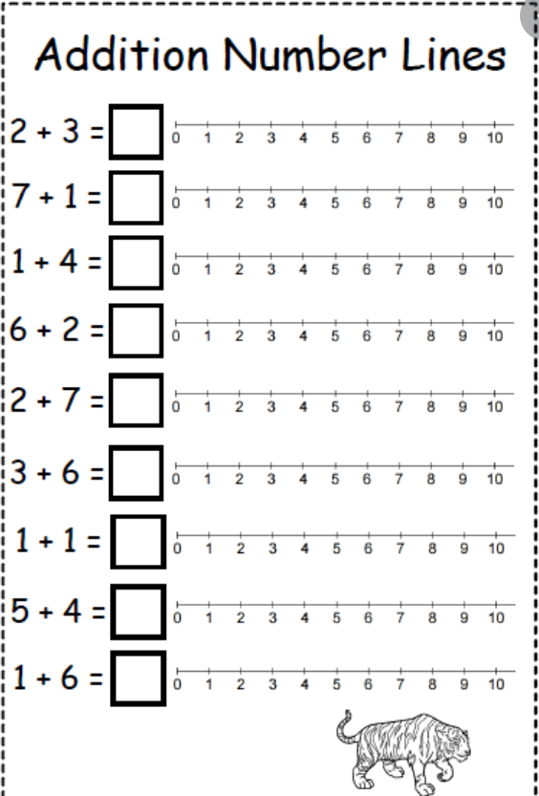
Look at the sums and use the number line to complete the sums.
Remember the first number tells us where to start, the second number tells us how many jumps to do.
The number we land on is our answer.

Slide 10
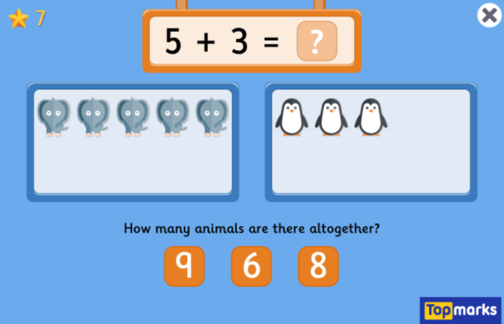
Task 2 : Online Game
https://www.topmarks.co.uk/addition/addition-to-10

Slide 11
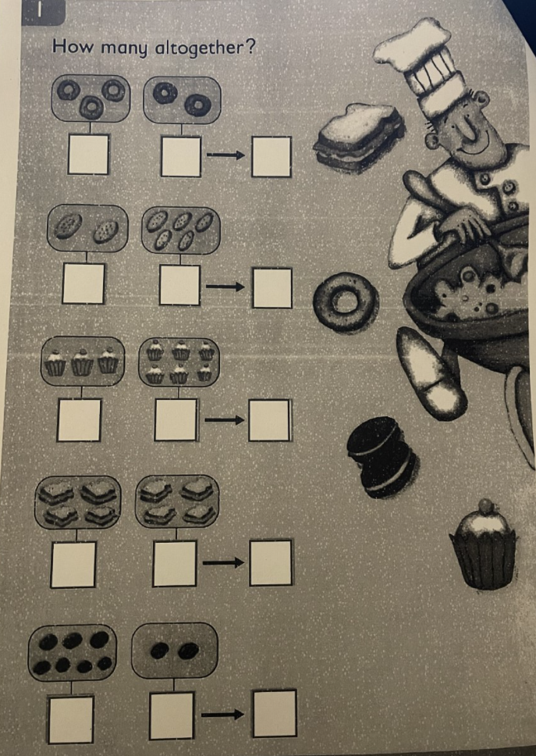
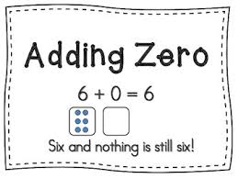
Wednesday 10.02.21
There are 2 jobs today:
1. How many altogether? Page 5 of your snake number booklet.
2. Adding zero.

Slide 12
Task 1
Count how many of each item you see and write it in the box underneath. The final box is where you write the TOTAL number of each delicious treat you can see.

Slide 13
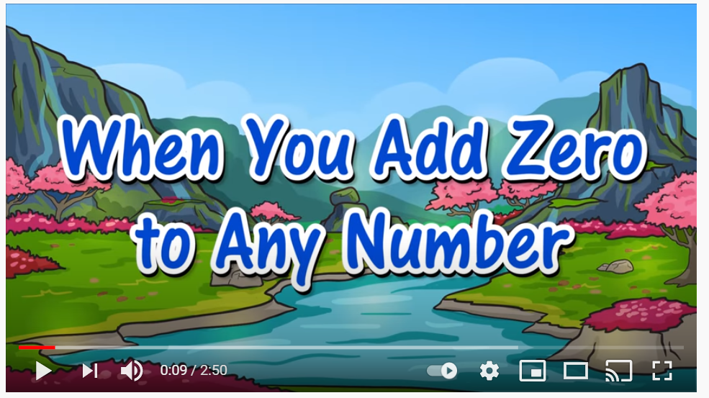
Adding 0 to any number
https://www.youtube.com/watch?v=wy389QGYe4I&safe=active

Slide 14
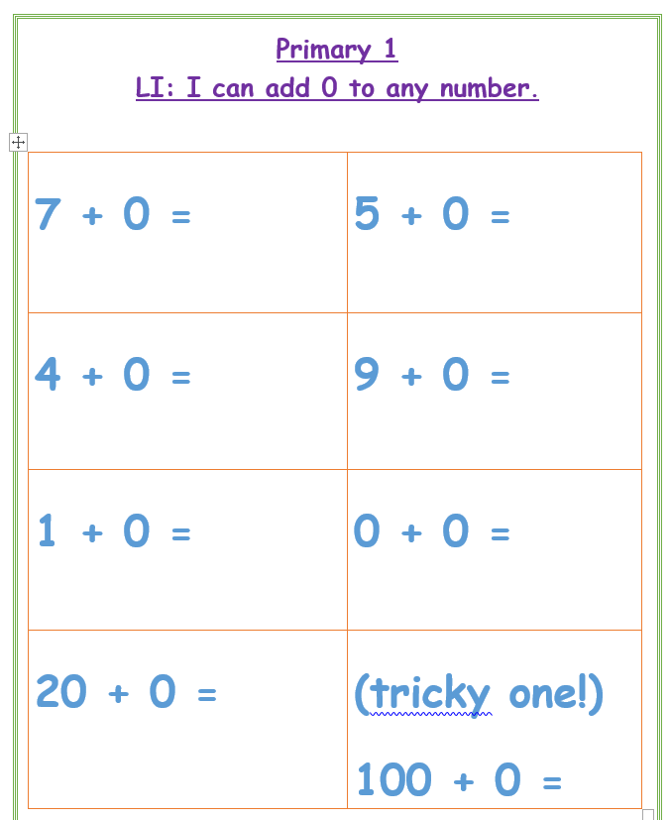
Adding 0 to any number
Can you complete these sums? Don’t let them trick you!
The last one is super tricky – good luck !! :D

Slide 15

Thursday 11.02.21
There are 2 tasks today.
1. Putting the numbers in the correct order.
2. Different ways of making a given amount within 10p.

Slide 16
Thursday 11.02.21
Can you put these numbers in the correct order?
13 9 7 19 1
20 5 10 18 7
14 8 17 3 12
Smallest
Biggest

Slide 17
Money Online Game
A fun money video to get us warmed up today!
https://www.bbc.co.uk/teach/supermovers/ks1-maths-money/zht4nrd
Our game today asks us to use more that 1 coin to be able to pay for each item. This is when our addition practise will come in handy!
https://www.topmarks.co.uk/money/toy-shop-money

Slide 18
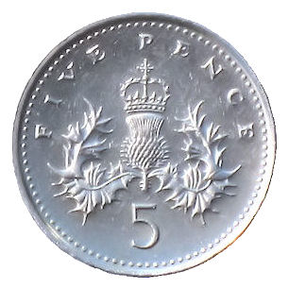
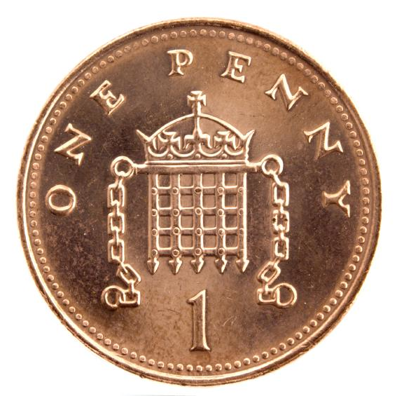
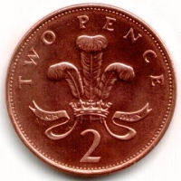
More Money Investigating.
Today, we are investigating money and trying to find lots of ways to use our coins to make different totals.
Let’s start with 5p.
 | 5p
 | 5p
 | 5p

Slide 19
Your Turn
On the next slide you will see some items for sale, then you will see the cost of each item. Your job is to use your coins at home and find 2 possible ways of paying for each item.
You can put your coins beside the item or you can write which coins you are using, don’t forget to write ‘p’.

Slide 20

Item | Cost | Coins used to pay
 | 7p
 | 8p
 | 4p
 | 10p

Slide 21

Friday 12.02.21
H O L I D A Y

