Slide 2
1. Say the sound
2. Blend the word
3. Tricky word

Slide 3
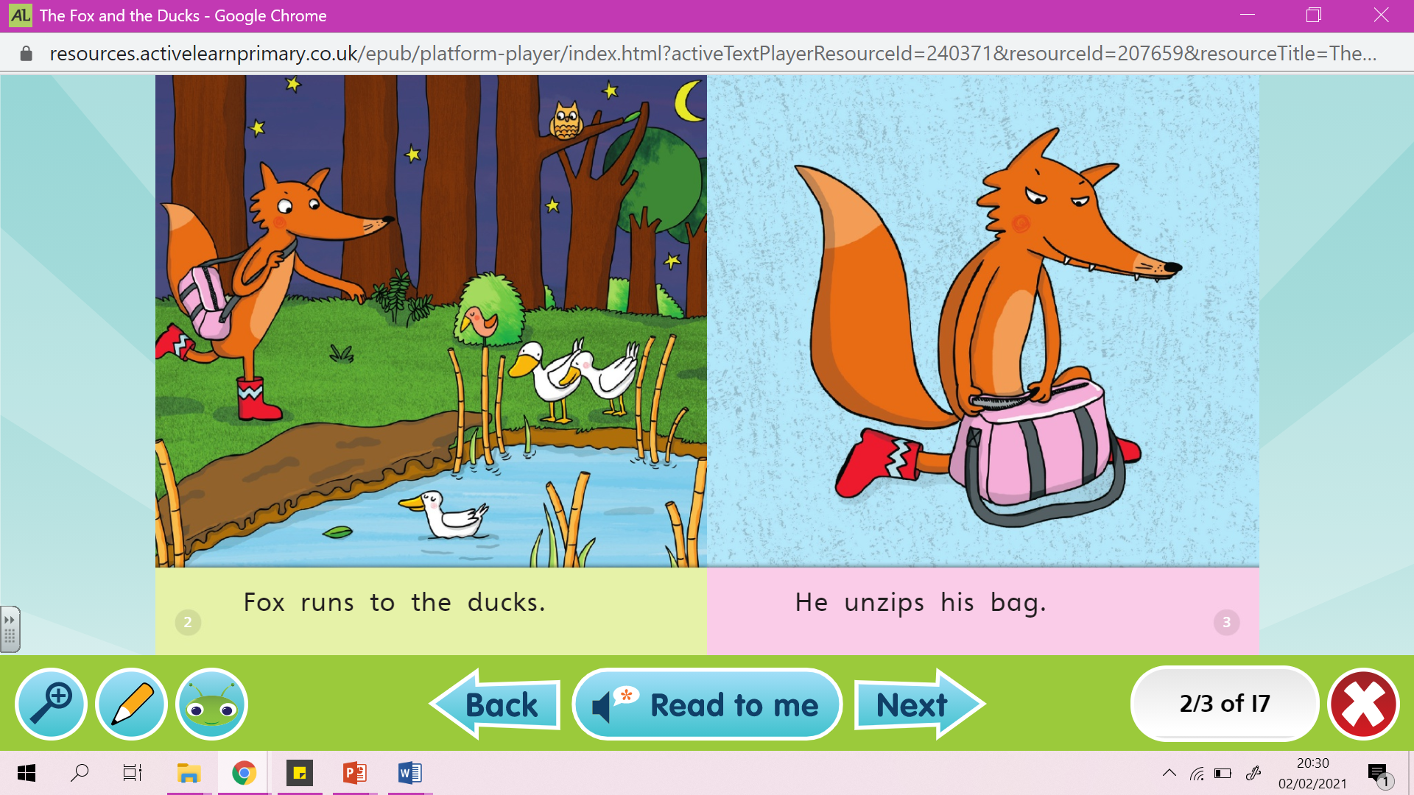

Slide 4
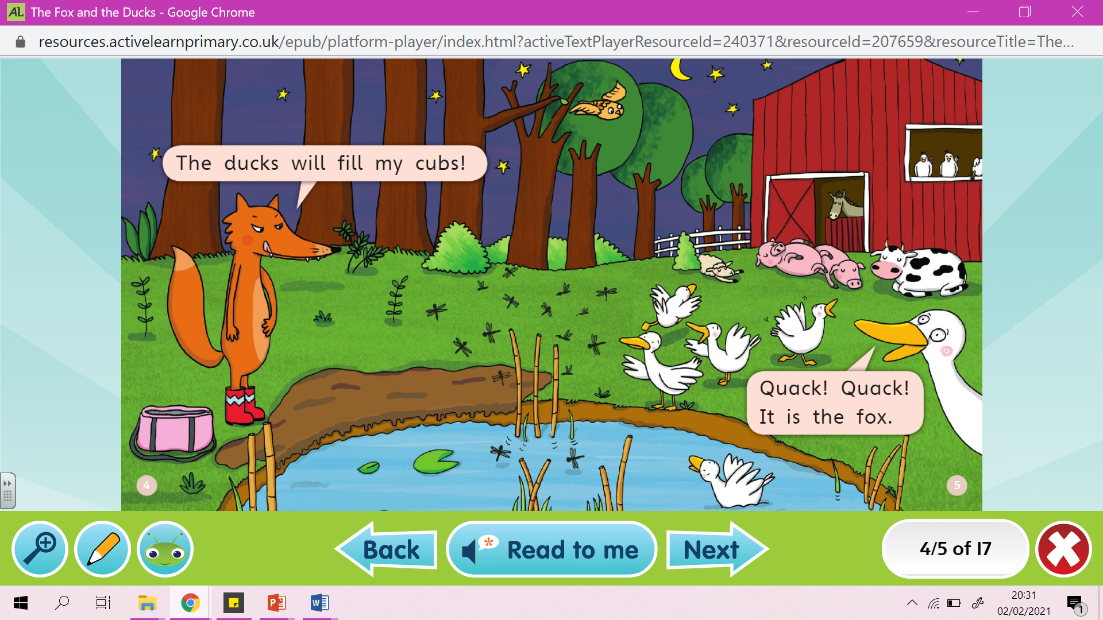

Slide 5
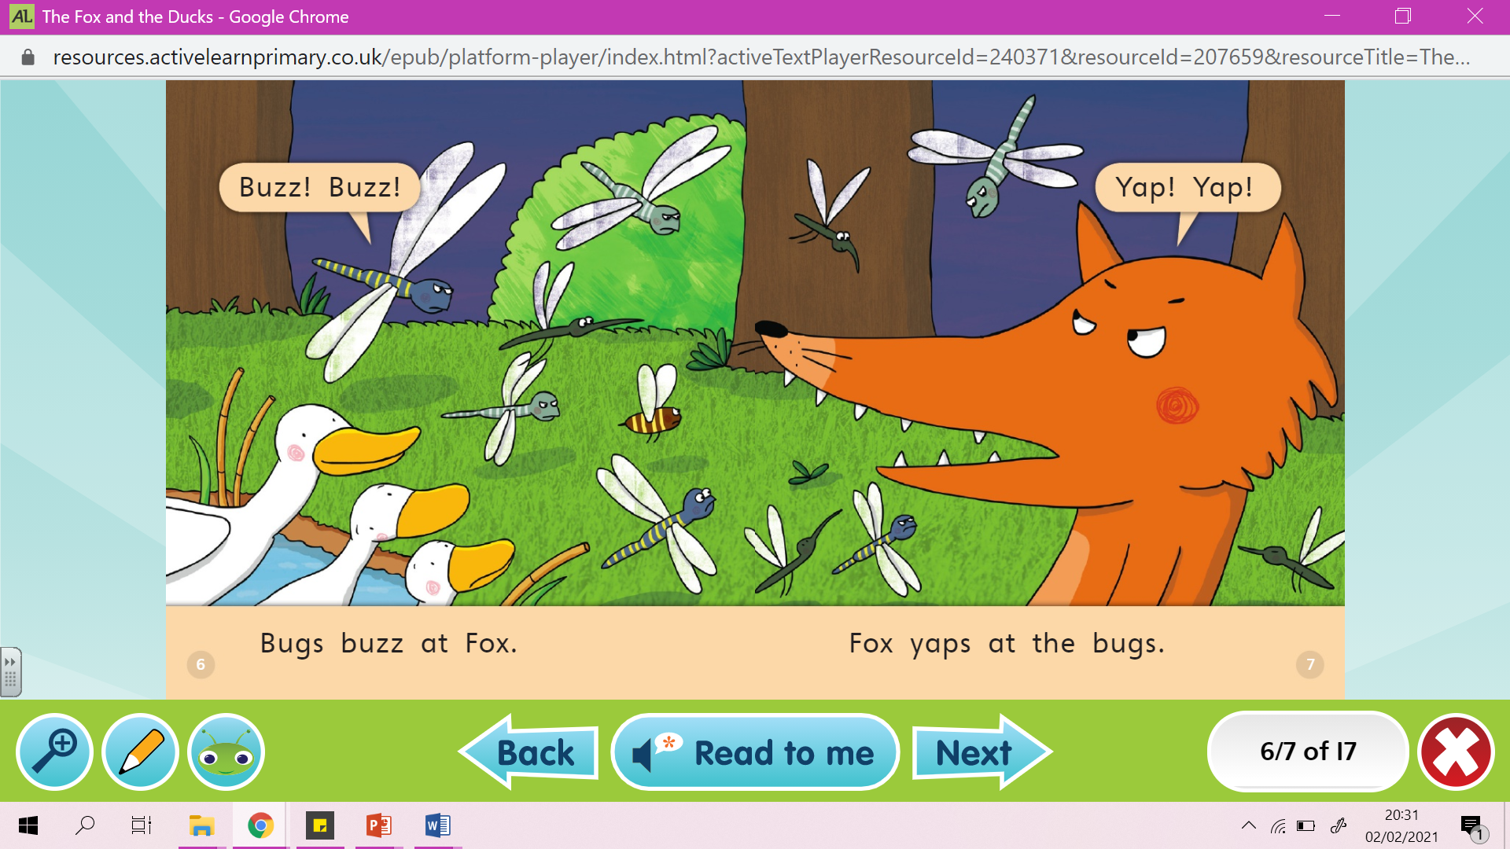

Slide 6
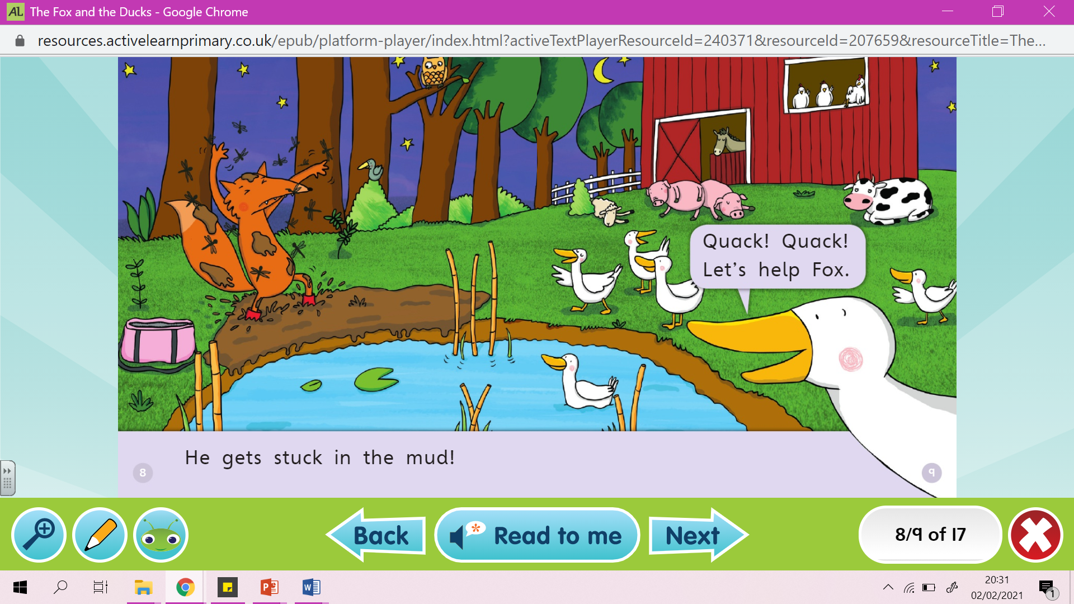

Slide 8
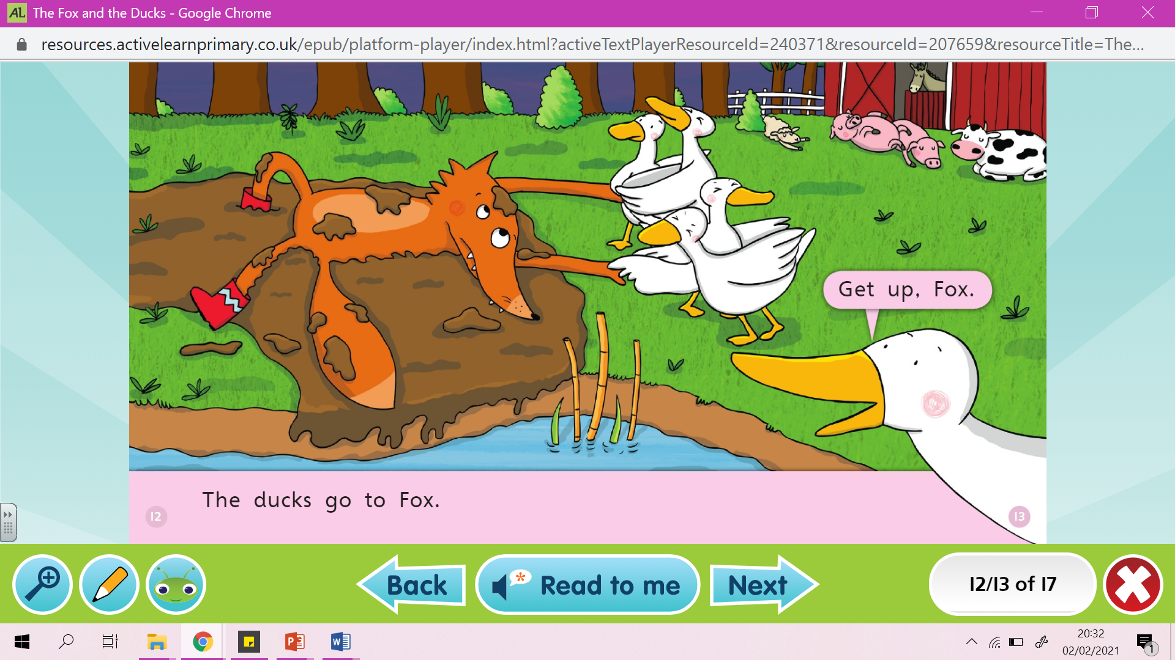

Slide 9
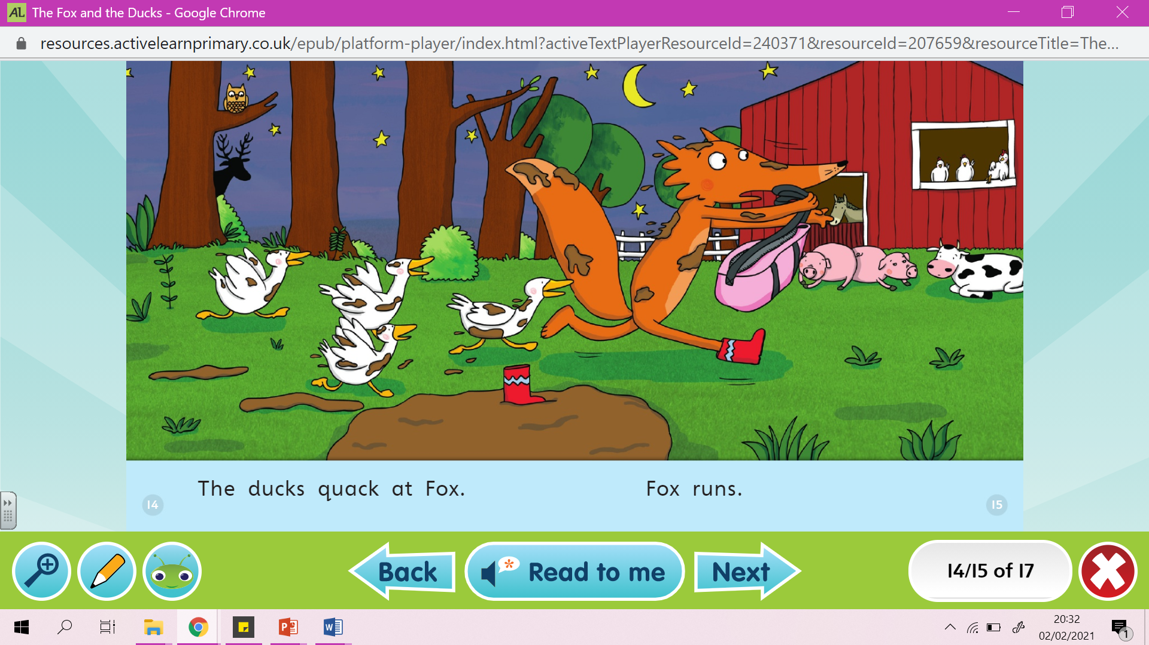

Slide 11
Questions
What are fox cubs?
What sort of noise is a ‘yap’?
On page 8 &9 who is duck talking too?
What order do you put the sounds to make the word?
a
ck
qu

Slide 12
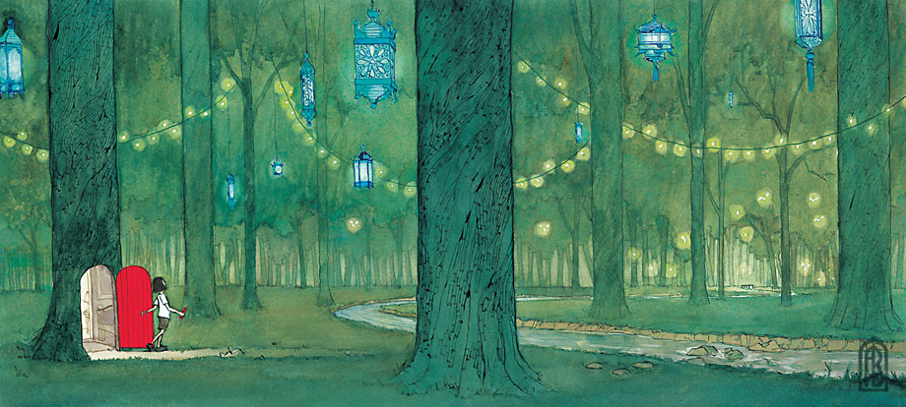
Prediction

Slide 13
Prediction Questions
What’s on the other side of the door?
What is the girl holding in her hand? Why?
How did she get to the forest?
Where is this?
Who hung the lanterns in the trees?
Where does the stream lead?
Will the girl go back through the door or stay in the forest? Predict what will happen next.

