Slide 1
Character Description
L.I. To describe what a character looks like.

Slide 2
Success Criteria
To describe what the character looks like
To describe a character inner traits
To use my sounds to help write new words.
To use capital letters
To use finger spaces
To use full stops

Slide 3
Number
Position
Size
Doing
Writing Bubbles
Colour
Shape
Texture

Slide 8
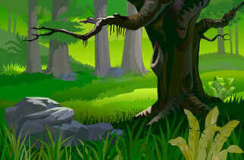
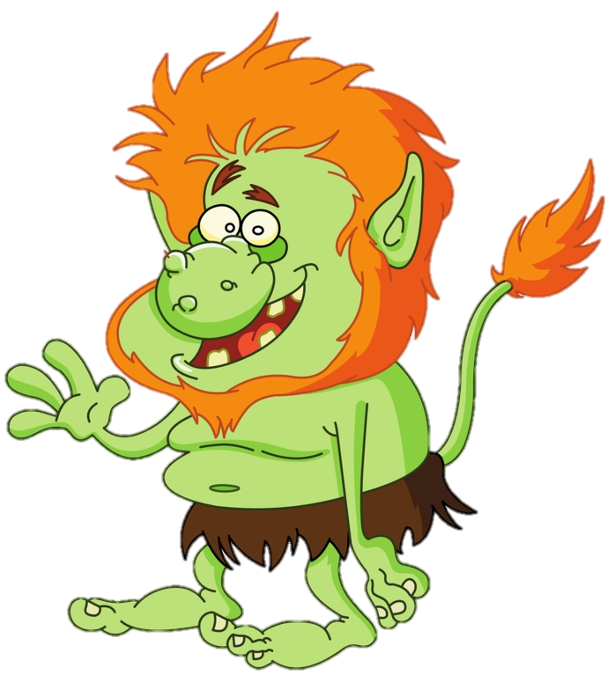
Toby the troll has a big head with orange hair.
.
He is as small as a sheep.
is lime green.
Toby is round like a ball.
is hairy all over.
He likes to pick his nose.
lives in an underground cave.
Lastly, he is kind and likes warm hugs.

Slide 9
Toby The Troll
Number
Toby the troll a big head with orange hair.
He is as small as a Sheep and is lime green.
Toby is round like a ball and is hairy all over.
He likes to pick his nose and lives in an underground cave.
Lastly, he is kind and likes warm hugs.
Size
Colour
Shape
Texture
Doing
Position
Personality

Slide 10
Toby The Troll
Toby the troll has 2 brown eyes and a big head with orange hair.
He is as small as a sheep and is lime green.
Toby is round like a ball and is hairy all over.
He likes to pick his nose and lives in an underground cave.
Lastly, he is kind and likes warm hugs.

Slide 11
Great work everyone!
I can’t wait to read your story.
☺

