Slide 1
Phase 3 Phonics
New sounds

Slide 2
Monday 8th February 2020 L.I. To learn new sound patterns
Can you remember the sound we were looking at yesterday?
‘ai’
Can you remember any words that had the ai sound either at the start or at the end?
Today we are going to be learning about the ee sound.

Slide 8
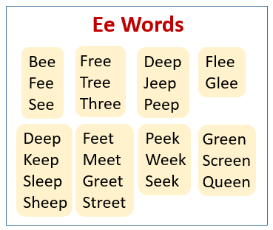

Slide 9
Click here for answers

Slide 10
Importance of ee
feet
meet
jeep
week
fet
met
jep
wek

Slide 11
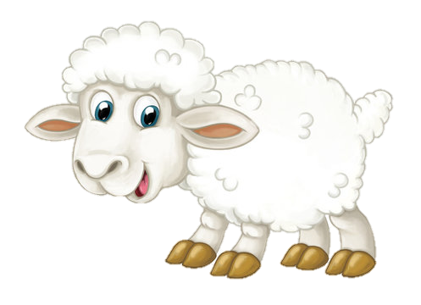
Monday 9th February 2020
sheep
ee
ee
ee
ee
sheep
sheep
sweet
sweet
A queen bee.

Slide 12
Sentence
I see wee sheep when I am in a deep sleep.

Slide 15
That’s all for today!
Well done everyone, keep up your hard work!
See if you can find words with ee in books or around you!
Great job!

