Slide 1
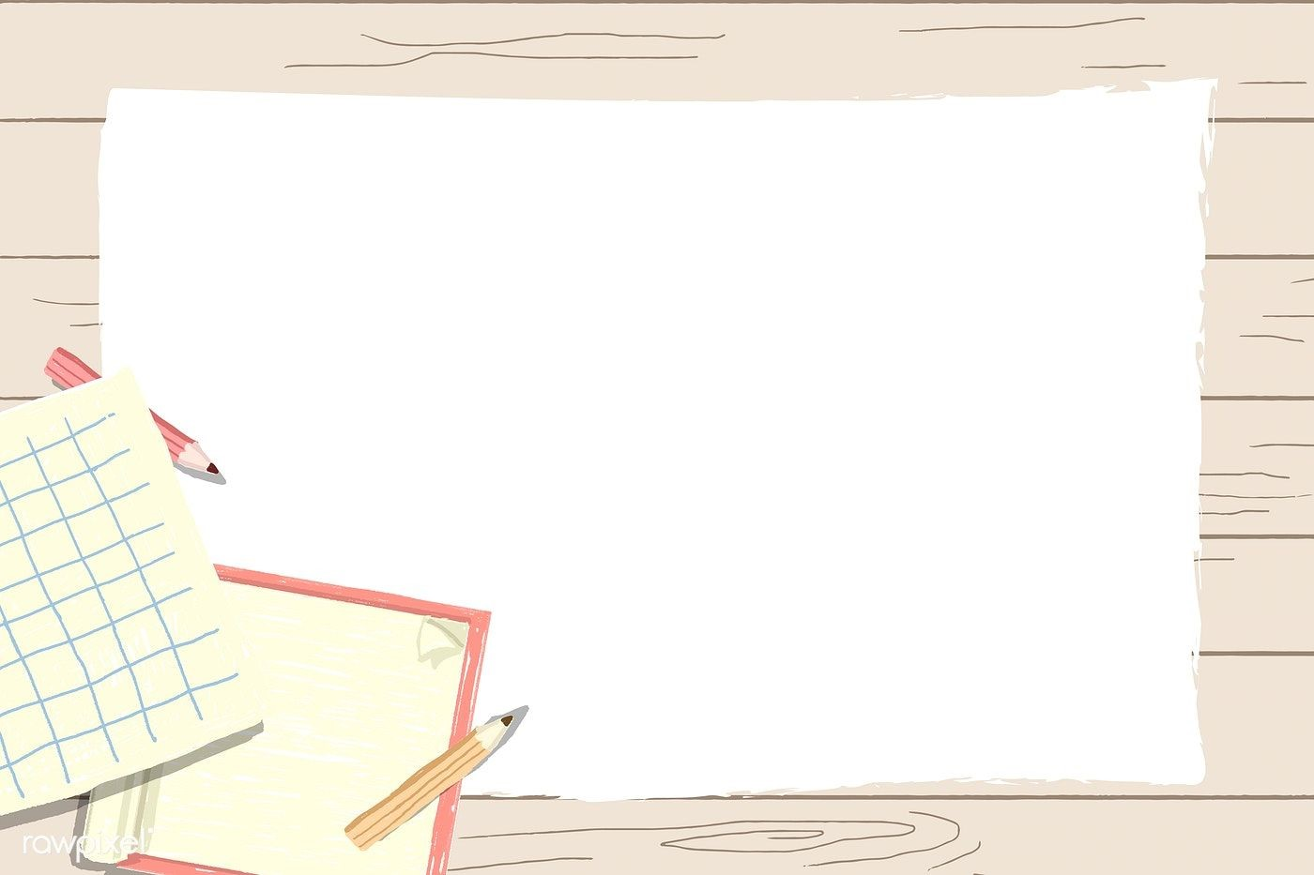
Primary 1
Numeracy Tasks
Week 01.02.21

Slide 2
Thursday 04.02.21Count to 100 video

Slide 3
Thursday 04.02.21
Task : To add the correct amount of pennies to the jar.
Look at the PowerPoint on the blog

Slide 4
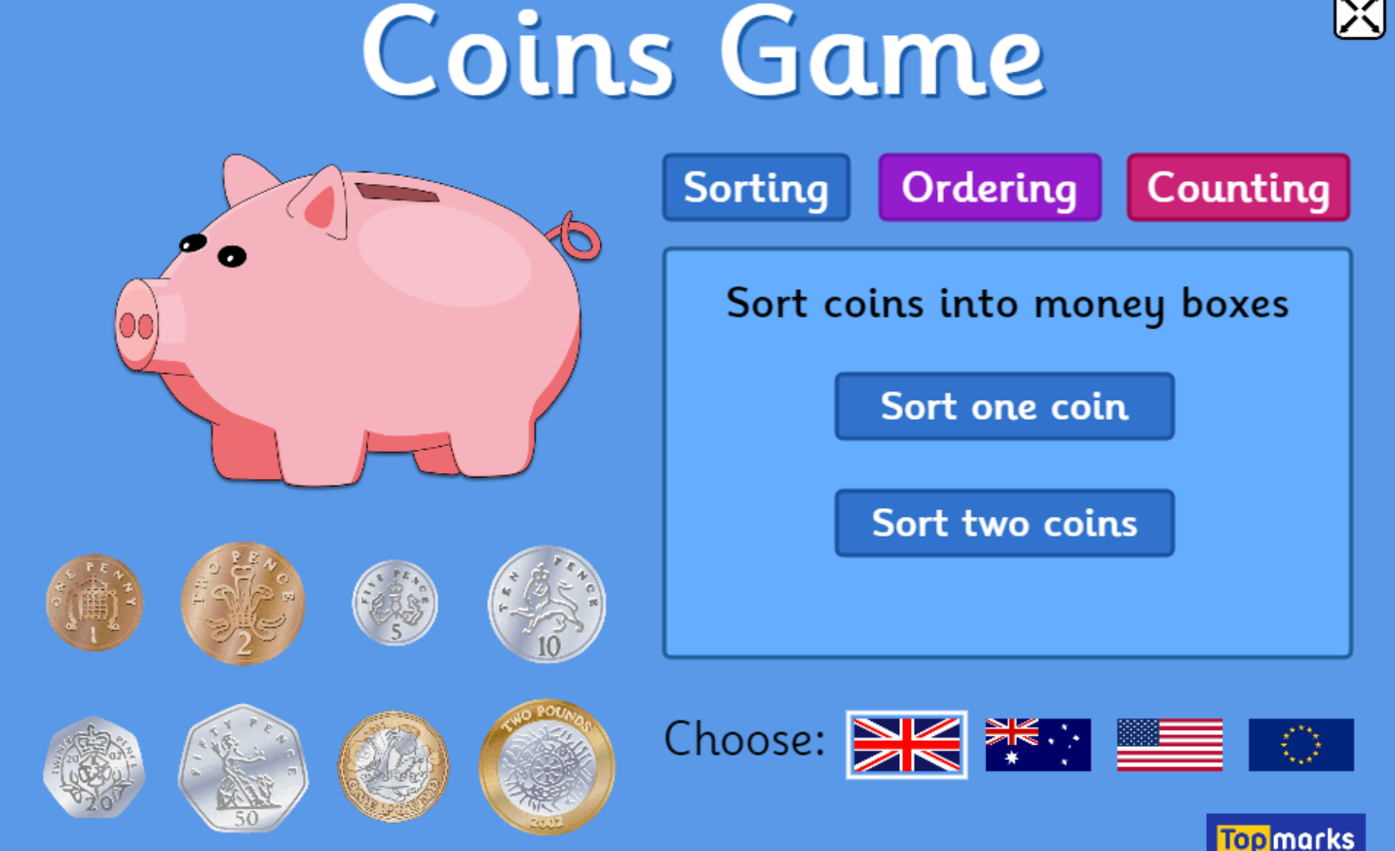
Thursday 04.02.21
https://www.topmarks.co.uk/money/coins-game

Slide 5
Super Effort! YOU ROCK!

