Slide 1
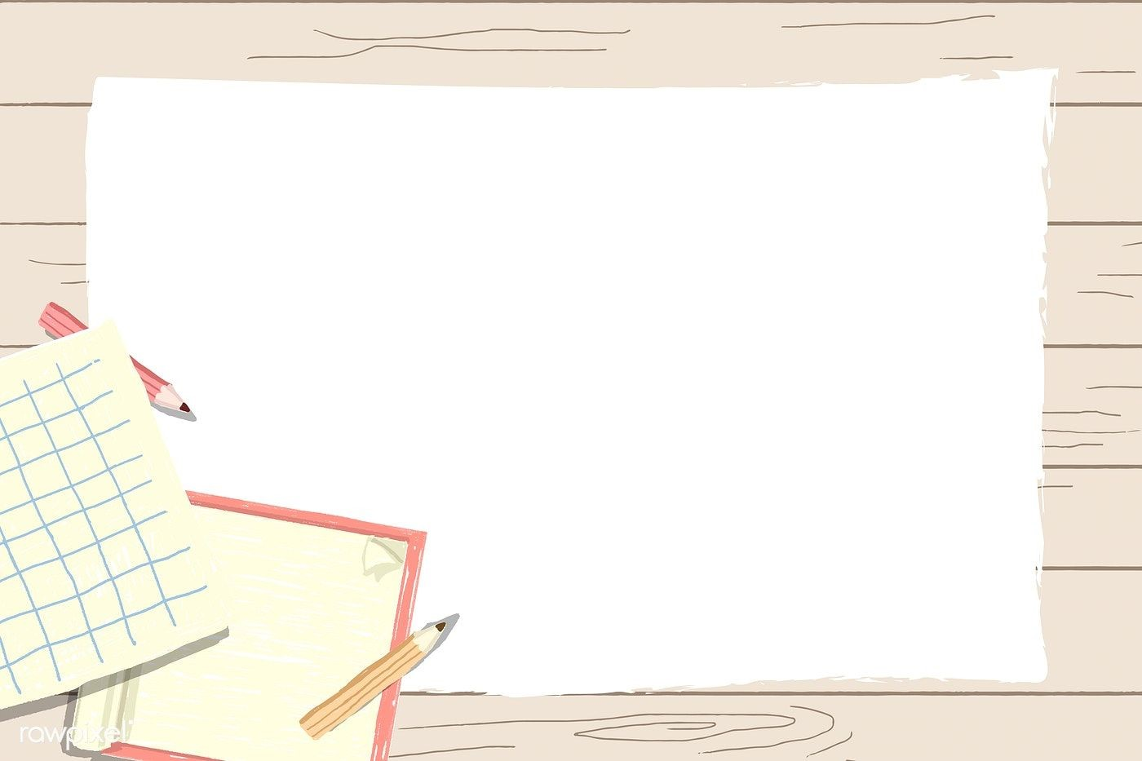
Primary 1
Numeracy Tasks
Week 01.02.21

Slide 2
Tuesday 02.02.21Count to 100 video

Slide 3
Ten Frames Number Bonds to 10 Can you tell me what the sum is?
10 + 0 =10
1 + 9 =10
2 + 8 =10
3 + 7 =10

Slide 4
Tuesday 02.02.21
Task :L.I. To find the missing number to complete an addition sum.
Today we are looking at finding the missing number to complete the answer. Looking at the videos on the next slide to help you.

Slide 5
Good job everyone, keep up your hard work!

