Slide 1
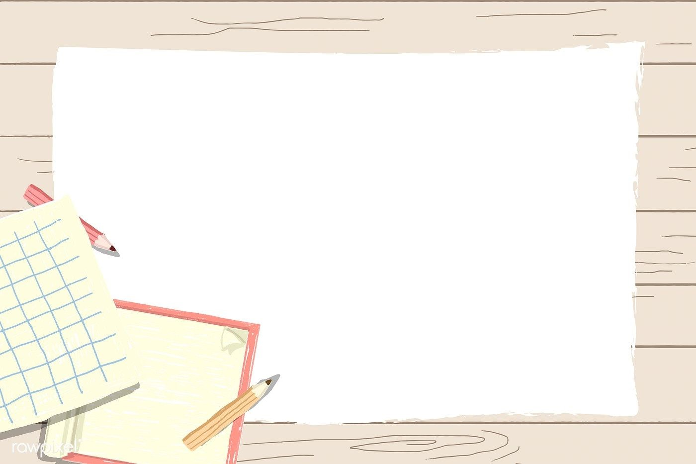
Primary 1
Numeracy Tasks
Week 01.02.21

Slide 2
Monday 01.02.21
LI: I can count forwards and backwards to 20.

Slide 3
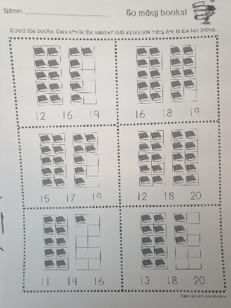
Monday 01.02.21
LI: To use a ten frame to identify an amount.
Task 1 : Counting collections to 20 using ten frames. Complete the next page in your ‘Number to 20’ workbook.

Slide 4
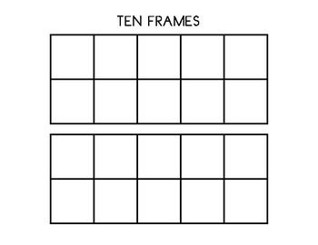
Monday 01.02.21
Maths Games – using anything you have at home eg. Bottle caps, Playdoh, Blu tac, LOL or Lego pieces have a go at making your own 10 frame sums. Eg. 10+8=18
You can just draw the boxes out on a piece of paper.

Slide 5
That’s all for today folks!
Good work everyone

