Slide 1
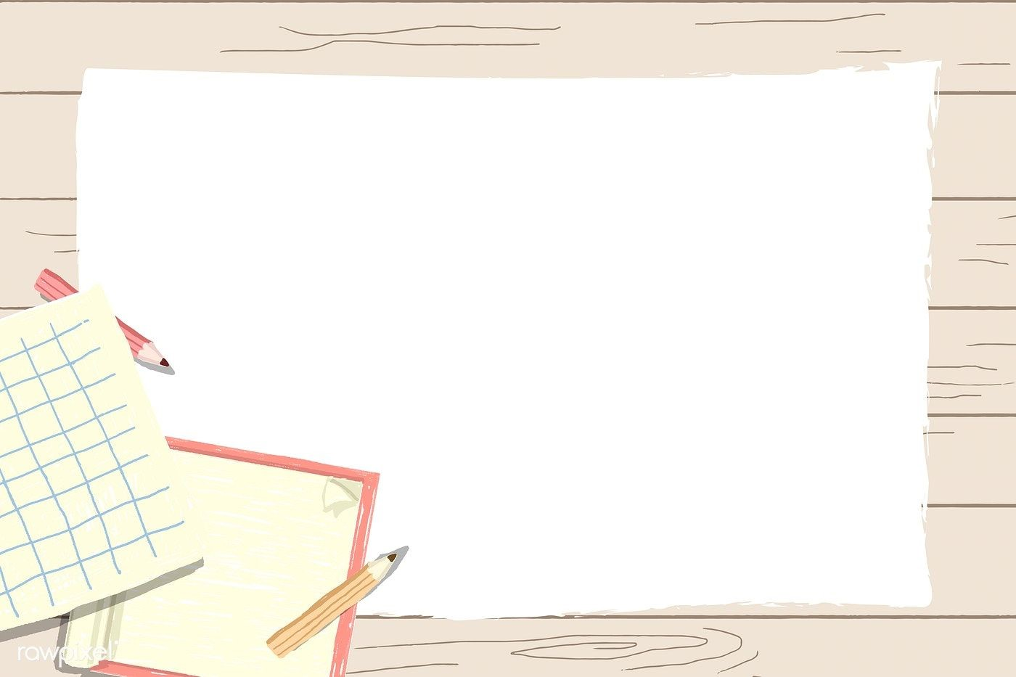
Primary 1
Numeracy Tasks
Week 01.02.21

Slide 2
Wednesday 03.02.21Count to 100 video

Slide 3
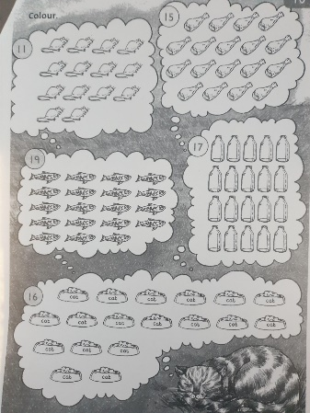
Wednesday 03.02.21
Task : Colour in the right amount of objects
Snake booklet – page 4 You can colour them in or mark or circle them.
Counting Pennies PPT count out the right amount of pennies

Slide 4
Wednesday 03.02.21
Maths Games – Topmarks Money
https://www.topmarks.co.uk/money/toy-shop-money

Slide 5
great work again everyone!

