Slide 1
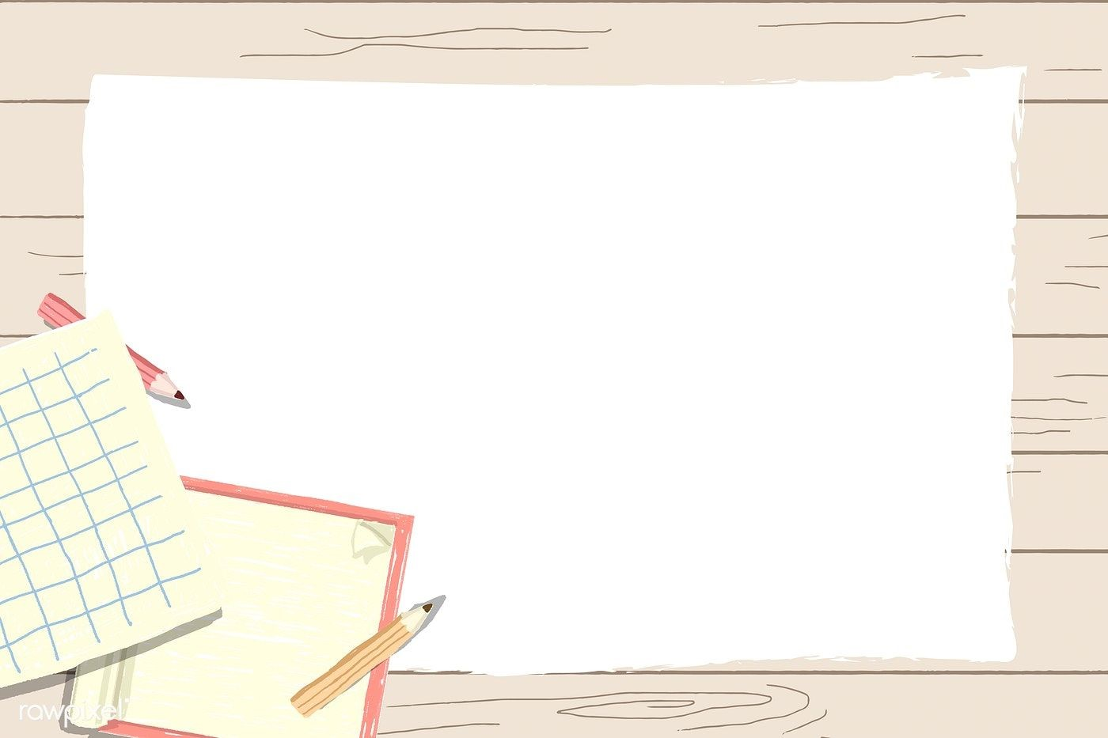
Primary 1
Numeracy Tasks
Week 01.02.21

Slide 2
Friday 05.02.21 Count to 100 video

Slide 3
Friday 05.02.21
Task : Money challenges!
Choose the challenge you feel more comfortable with. Remember you can use a ten frame to help you.

Slide 4
Friday 05.02.21
Maths Video – Recognising and adding money
https://www.youtube.com/watch?v=mHB21-bEJvw&safe=active

Slide 5
WoooHooo! You did it!

