Slide 1
Money… Money… Money!
Work your way though the money challenges on each page.
Chilli Challenge allows you to choose the difficulty.

Slide 2
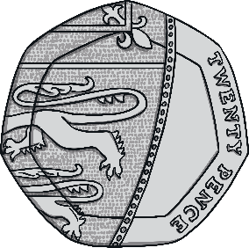
Answers
Answers
Answers
What coin is this?
What coin is this?
What coin is this?
2p
20p
£2

Slide 3
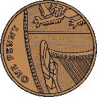
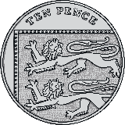
Answers
How much altogether?
6p
Answers
How much altogether?
10p
Answers
How much altogether?
13p

Slide 4
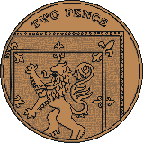
Answers
Answers
What coins could you use to buy this football?
What coins could you use to buy this rugby ball?
3p
8p
Did you have any other answers?
Did you have any other answers?
Answers
What coins could you use to buy this basketball?
Did you have any other answers?
14p

Slide 5
Answers
How much would these items cost altogether?
3p
2p
5p
Answers
How much would these items cost altogether?
4p
5p
9p
Answers
How much would these items cost altogether?
6p
7p
13p

Slide 6
Answers
Answers
How much change would I get if I bought this teddy bear using a 5p coin?
How much change would I get if I bought this toy car using a 10p coin?
3p
6p
2p
4p
How much change would I get if I bought this teddy bear and toy car using a 10p coin?
Answers
3p
6p
1p

