Slide 1
Early Level
Notes:
Start your mornings with this lovely Maths PowerPoint, focusing on addition and subtraction. There is one slide a day for five days, with three questions for each day. The three questions are on the same topic but have different degrees of challenge and are indicated by the chillies next to the questions; yellow chilli shows the least challenge, red chilli the middle and green chilli the most challenge.

Slide 2
Contents
Day 1
Day 2
Day 3
Day 4
Day 5

Slide 3
Week 1 Day 1
<
Menu
Answers
Answers
Which number does this dice show?
Which number do these dice show?
7
5
Which number do these dice show?
Answers
13

Slide 4
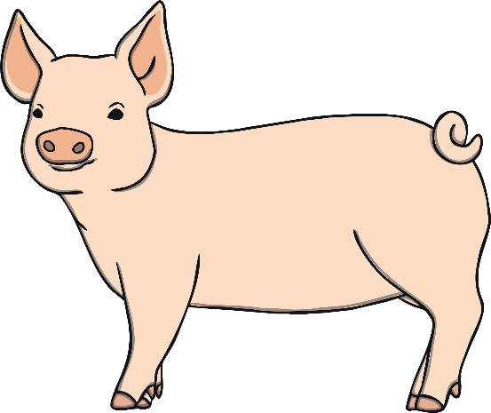
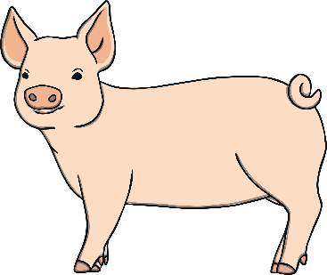
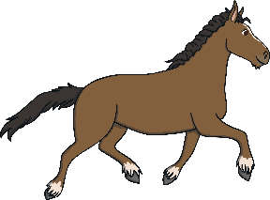
Week 1 Day 2
<
Menu
Answers
How many altogether?
5
Answers
How many more pigs are needed to make 10?
6
Answers
How many more horses are needed to make 18?
11

Slide 5
Week 1 Day 3
<
Menu
Answers
Answers
Answers
:
2+3=
2+2=
Complete these sums
Complete these sums
Complete these sums
9 + 6 =
5
5 + 4 =
15
9
4
12 + 7 =
8 + 2 =
19
10

Slide 6
Week 1 Day 4
<
Menu
Answers
Answers
What is half?
What is half?
Answers
What is half?

Slide 7
Week 1 Day 5
<
Menu
Answers
Answers
Count out 3 cubes. Take 1 away. How many are left?
Count out 20 cubes. Take 16 away. How many are left?
2
Count out 4 cubes. Take 3 away. How many are left?
4
1
Answers
Count out 7 cubes. Take 4 away. How many are left?
Count out 20 cubes. Take 8 away. How many are left?
3
Count out 10 cubes. Take 6 away. How many are left?
12
4

