Slide 1
Primary 1 Numeracy Powerpoint.
Week Beg 25.1.21

Slide 2
Monday 25.01.21
LI: I use a number line to 20. I can use 1-1 correspondence when counting.
Task 1 : Counting collections to 20. Complete the next page in your ‘Number to 20’ workbook.

Slide 3
Monday 25.01.21
LI: I can fill in the number on a blank number line.
Task 2 : On the next slide you will see some empty number lines. By looking at the first and last number, you need to guess which number the green arrow is pointing to.
0
10

Slide 4
Guess the Number on the Line
0
10
5
15
10
20
15
20

Slide 5
Guess the Number on the Line
5
0
10
8
5
15
17
10
20
16
15
20

Slide 6
Tuesday 26.01.21
LI: I can recognise an add sign +. I can begin to add 2 small amounts together to make a bigger amount.
Remember this sign means to ‘add’. Adding is when we count how many there is ALTOGETHER. When 2 amounts join together to make 1 bigger amount.

Slide 7
Tuesday 26.01.21
Let’s do some adding examples
2 + 3 =
4 + 2 =

Slide 8
Tuesday 26.01.21
https://www.youtube.com/watch?v=WT_wvvEvkw4&safe=active
When You Add with a Pirate

Slide 9
Tuesday 26.01.21
Task: Complete the addition worksheet. Count how many are on each side of the addition sign and write the number underneath, this helps you to create you own sum.

Slide 10
Some More Addition Examples
https://www.topmarks.co.uk/addition/addition-to-10

Slide 11
Wednesday 27.01.21
LI: I can order numbers to 20. These numbers are all muddled up and it’s your job to try and put them in the right order! There will be some numbers missing but try and put the numbers given in order from smallest to biggest.

Slide 12
Wednesday 27.01.21
https://www.topmarks.co.uk/ordering-and-sequencing/coconut-ordering

Slide 13
Thursday 28.01.21
LI: I can sort coins that looks the same. I can begin to recognise coins to the value of £1.
If you have some coins at home it would be great to get them out to investigate. Can you sort them in to piles? Can you put them in order from smallest to tallest.
TASK: Try to draw around some coins and copy them.
https://www.youtube.com/watch?v=vs8F_g3MGtM&safe=active

Slide 14
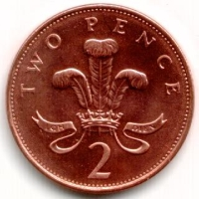
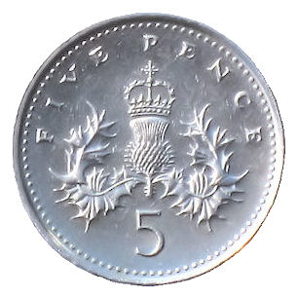
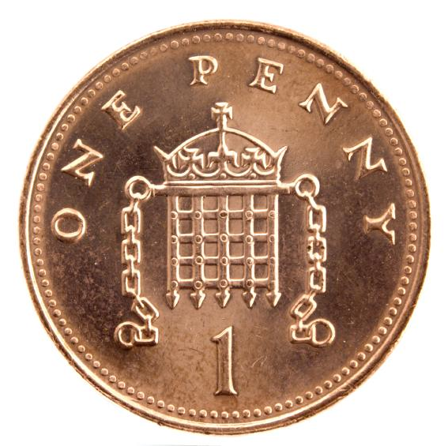
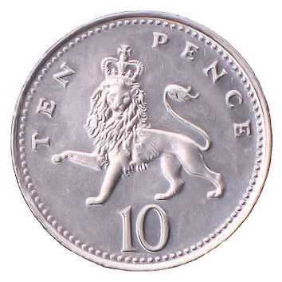
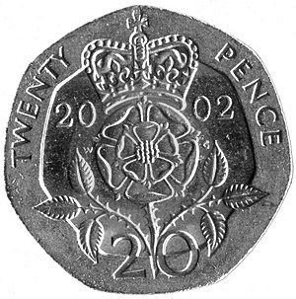
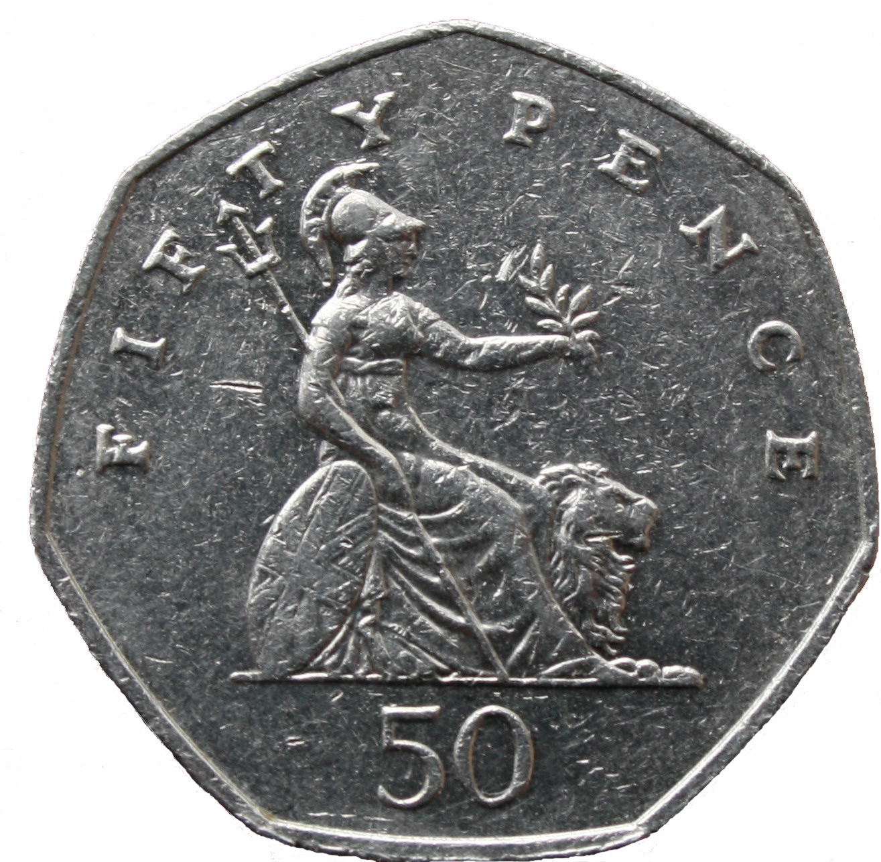
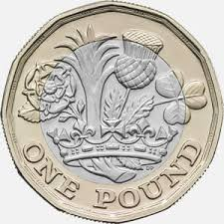
1p
2p
5p
10p
20p
The ‘p’ after each number is very important. It means ‘pence’. When we are writing down value of coins we must always write ‘p’.
50p
£1

Slide 15
100 pennies is the same as £1
= £1

Slide 16
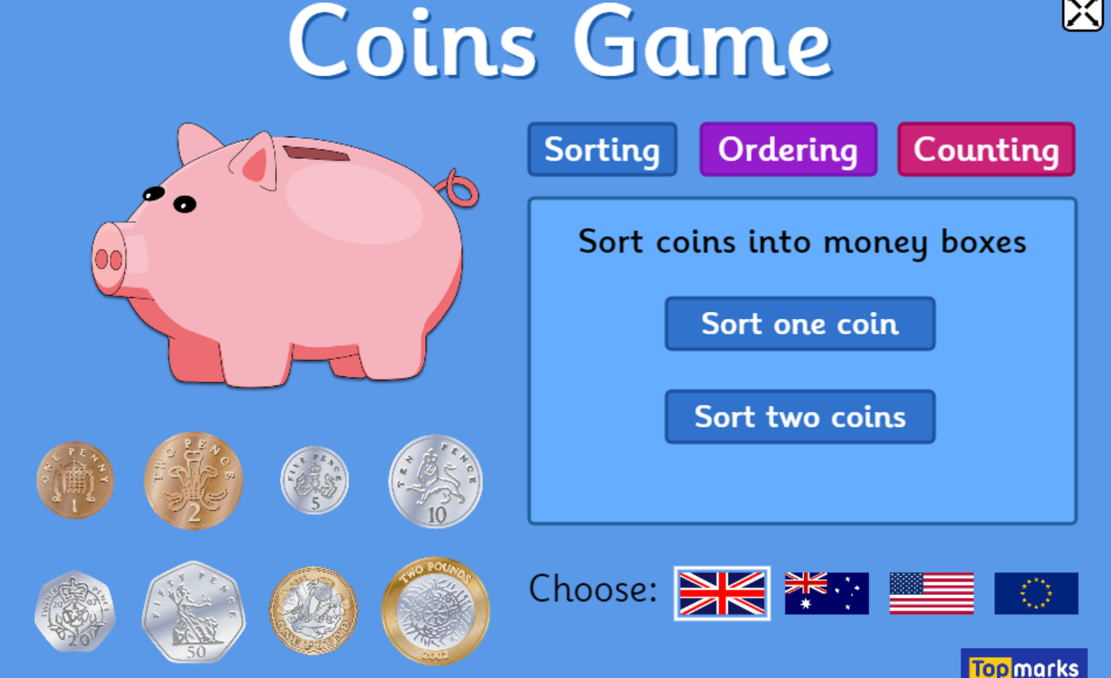
Thursday 28.01.21
https://www.topmarks.co.uk/money/coins-game

Slide 17
Thursday 28.01.21
Another game you can log on and try and play.

Slide 18
Friday 29.01.21
I can count out 10p using 1p coins.
5p
1p + 1p + 1p + 1p + 1p = 5p

Slide 19
Friday 29.01.21
Task: Your job today is to find out how much each item in the toy shop costs. Count up the number of 1p coin, the total number of 1p is the cost of each item. Don’t forget the ‘p’ after! This is very important.

Slide 20
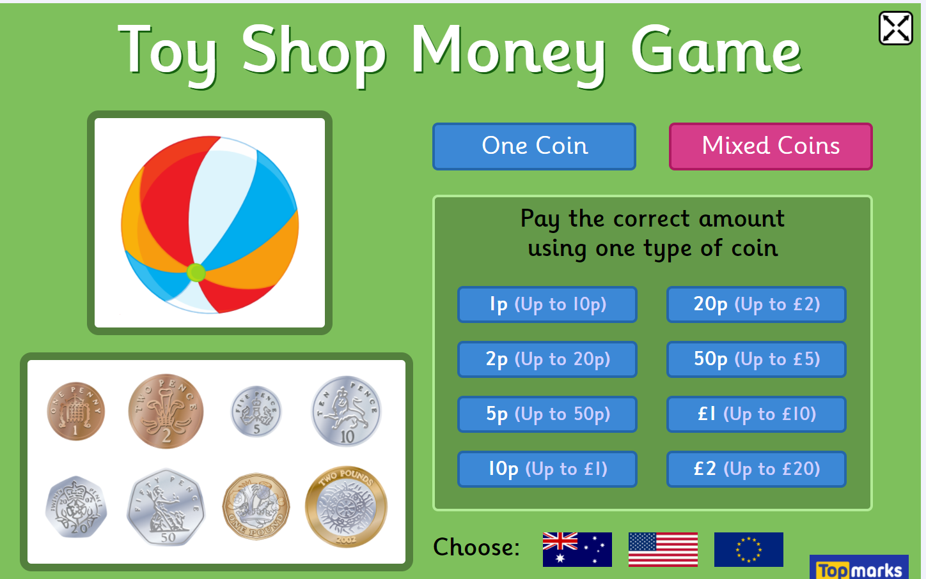
Friday 29.01.21
https://www.topmarks.co.uk/money/toy-shop-money
LI: I can make up to the value of 10p using 1p coins.

