Slide 1
Phase 3 Phonics
New sounds

Slide 2
Revision - Friday 29th January 2020

Slide 3
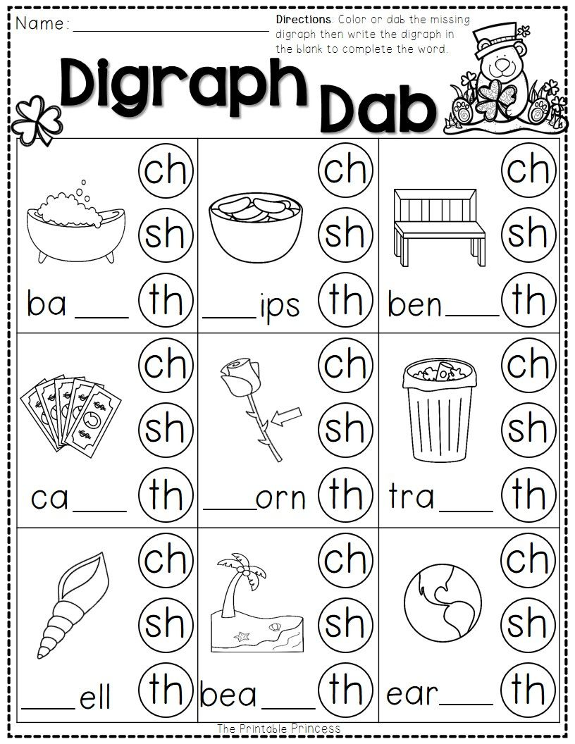
Click for answers

