Slide 1
Phase 3 Phonics
New sounds

Slide 2
Wednesday 27th January 2020
Can you remember the sound we were looking at yesterday?
‘sh’
Can you remember any words that had the sh sound either at the start or at the end?
Today we are going to be learning about the th sound.

Slide 6
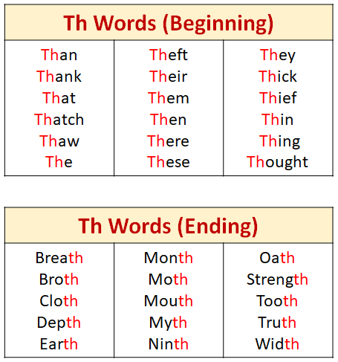

Slide 7
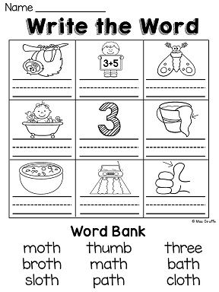

Slide 10
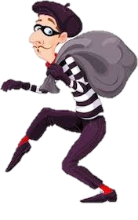
Wednesday 27th January 2020
thief
th
th
th
th
thief
thief
thief
Earth
Earth
tooth tooth

Slide 12
That’s all for today!
Thank you everyone for looking through todays PowerPoint.
I thought this made you think!
See if you can find words with th in books or around you!
Great job!

