Slide 1
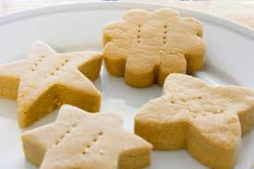
How to make shortbread
L.I. To make a set of instructions to make Shortbread

Slide 4
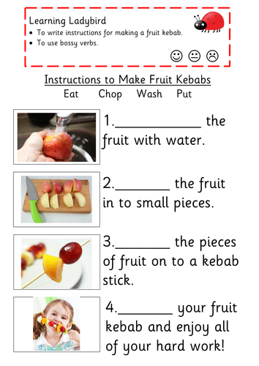
Wash
Chop
Put
Eat

Slide 10
Success Criteria
Success Criteria

Slide 11
1
Heat the oven
and mix the butter and sugar together.
2
3
4
5

Slide 12
Good work everyone!
I can’t wait to see your instructions for making Shortbread!
Remember to use your 5 star colouring in!

