Slide 1
Primary 1
Guided Reading
Week Beg 25.01.21

Slide 3
LI: I can use my phonics to decode new words.
I will look for words that I already know.
I will use my sounds and blend sounds together to help me read words.
I will use the picture to help me read new words.

Slide 4
Sounding out words:

Slide 5
Tricky Words Check
Daisy
Zac
Fish

Slide 6
Word Check
in
got
a
the
not
get

Slide 7
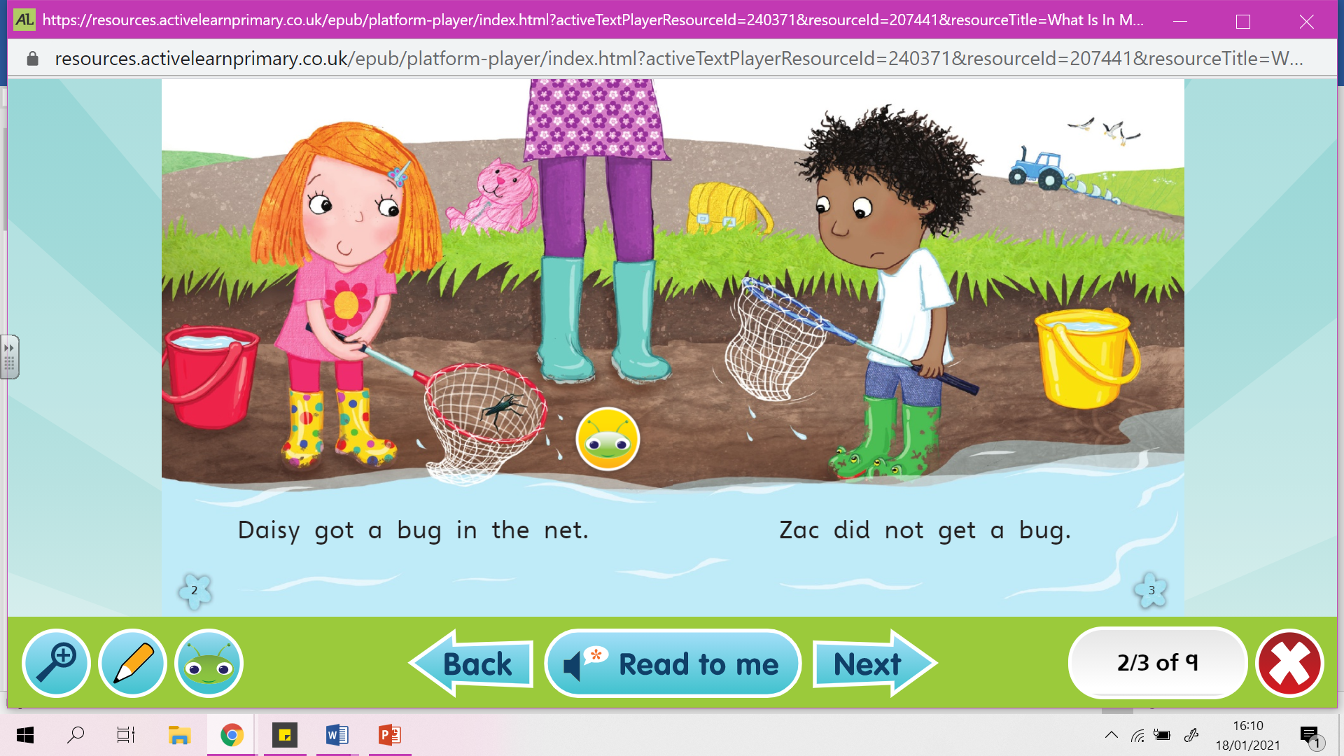

Slide 8
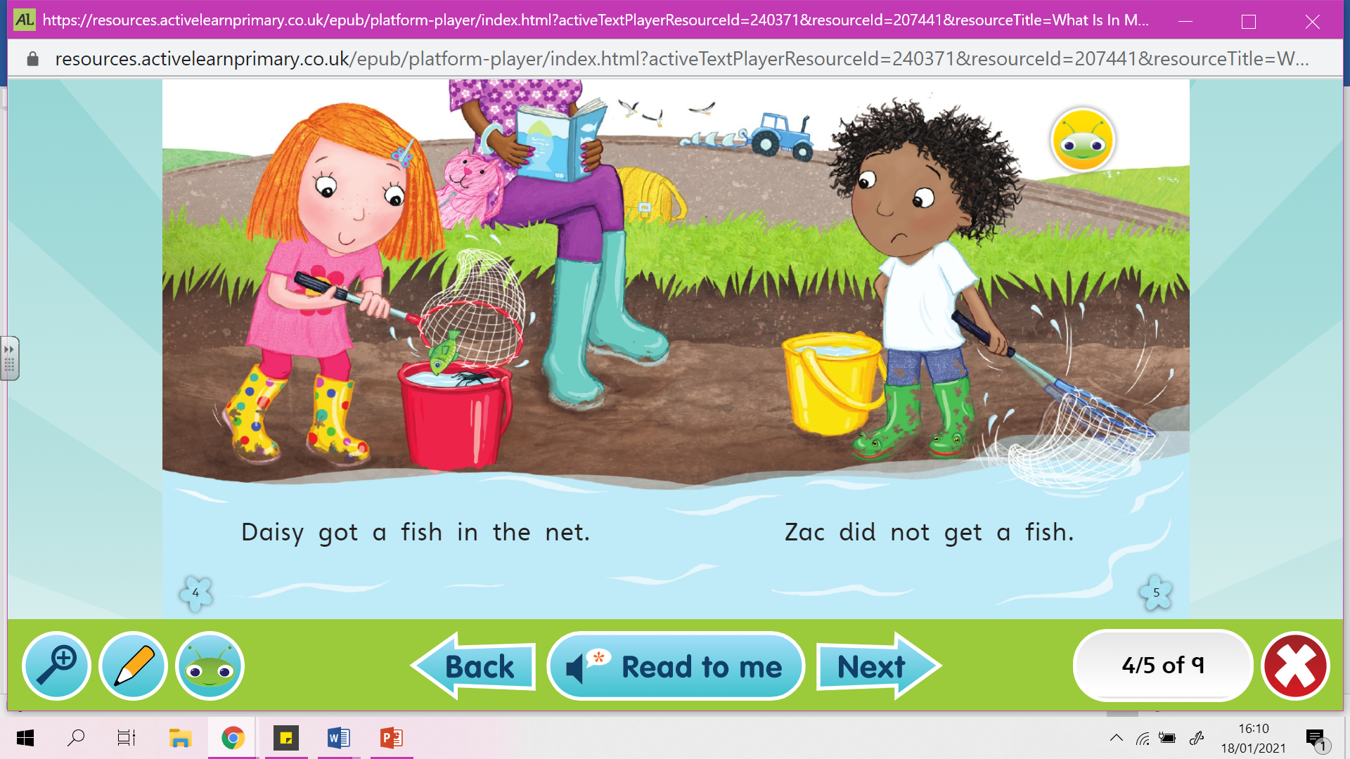
Notes:
See and under

Slide 9
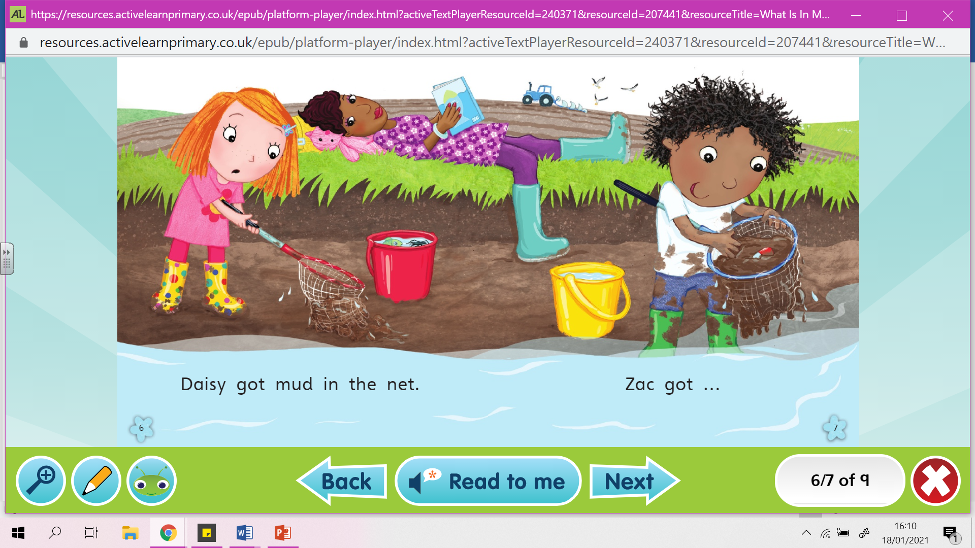

Slide 11
Questions
What are the children doing?
Where do you think the story is taking place ?
How many things can you see in the background of the story?
Would you be happy to find a rocket?
Where do you think the rocket came from?
How many times do you see Daisy’s cat bag?

Slide 12
Task
Put the pictures into the correct order

Slide 13
INFERENCING BASED ON A PICTURE
Looking at the picture on the next slide answer the questions that aren’t in the picture.

Slide 15
Questions
Where do you think this is? How do you know?
How many cats are in this class?
What time of day is it? Why do you think that?
Why is the white cat putting its paw up?
What are the other cats doing/thinking?
How is the black cat feeling? Why?
Which cat is the cleverest? Which cat is the best behaved?
Draw/describe what you think their teacher looks like.
What do you think the other classes in the school are like?
What lessons are taught in cat school?

