Slide 1
Phonics Revision Task
Friday 5th February 2021
Making CVC Words

Slide 2
Find the odd one out.
Look at the pictures, write a word to label each picture, say the word out loud and think about which picture is the odd one out!

Slide 3
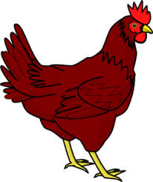
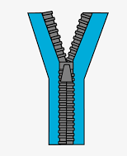
1.
hen

Slide 4
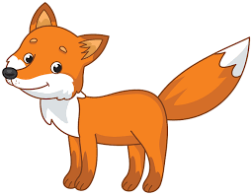
2.
Fox

Slide 5
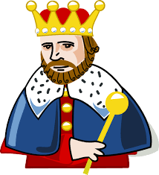
3.
 | wing

Slide 6
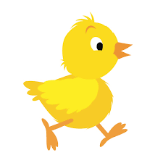
4.
chick

