Slide 1
12 Days of Christmas

Slide 2
It's beginning to look a lot like Christmas!

Slide 3
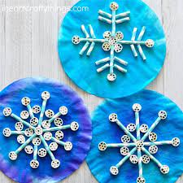
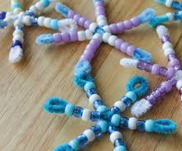
Snowflake competition
Take part in our Christmas snowflake competition.
Snowflakes are unique, just like we are!
Can you make a unique snowflake?
You could make an individual or class collaborative snowflake.
Think as creatively as possible and make your snowflakes stand out in the crowd.
Look at the following pages for some ideas.
Tweet photos of your entries and tag us @NAC_PLA
or email a picture to gw19dickensdawn@ea.n-ayrshire.sch.uk
by Friday 16th December.
The PLA Elves will deliver your prizes on the 21st of December.
Good Luck Everyone!

Slide 4
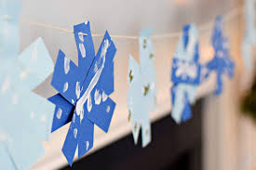
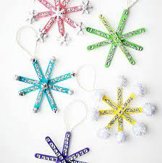
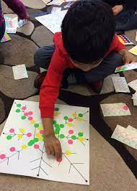
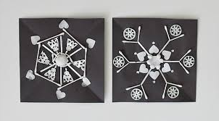
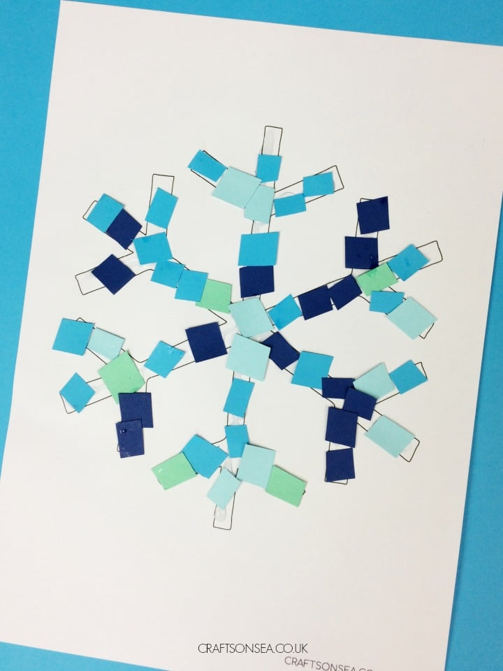
EYC- Primary 3
Design your own snowflake as individual as you!
Scale it up – A GIANT SNOWFLAKE
Use your bodies to create a snowflake
Make a symmetrical snowflake
Use outdoor chalks and materials
Loose parts snowflake
Collaborative snowflake
Stamp or printing

Slide 5
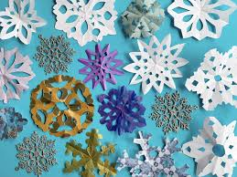
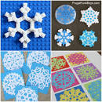
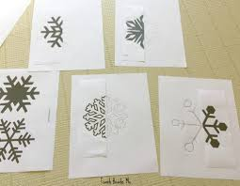
Primary 4 – Primary 7
Design a snowflake as unique as you
Use digital technology like Tinkercad to design your own snowflake
Use symmetry to design and draw a snowflake
Use loose parts or outdoor materials
Use craft materials and colours to represent yourself and your interests
Print of stamp
Cut into patterns
Use Lego or other building materials

Slide 6
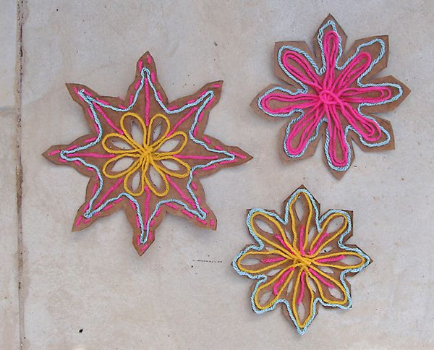
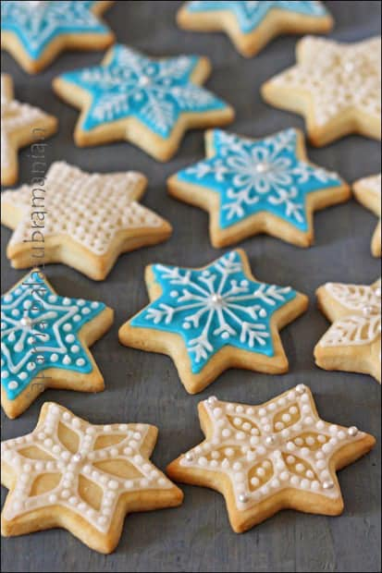
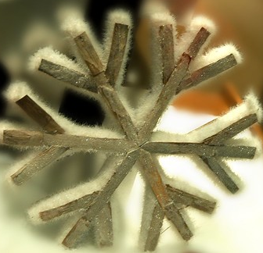

Slide 7
Contents
1. Christmas would you rather | 7. Kevin the carrots’ Christmas
2. Budgeting Buddy | 8. Busy buddy
3. Seasonal short burst writing | 9. Recipe for a happy Christmas
4. Technologies | 10. Boomwhackers and body percussion
5. Venn Christmas comes | 11. Look and Recall
6. Baking buddy | 12. Christmas sequencing
Christmas play activities
Click here
Please enter slideshow mode to click all links within PowerPoint

Slide 8
Oracy
Christmas would you rather
This activity is a great way to get learners Reasoning and Responding.
Encourage learner responses to include the correct structure and full sentences with clear reasons.
I would rather ….. because….
I would rather have Christmas dinner because I like savoury more then sweet tastes.
You can do this as a class, group or paired activity.
The next 4 slides include some options you could use.

Slide 9
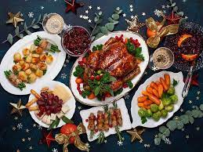
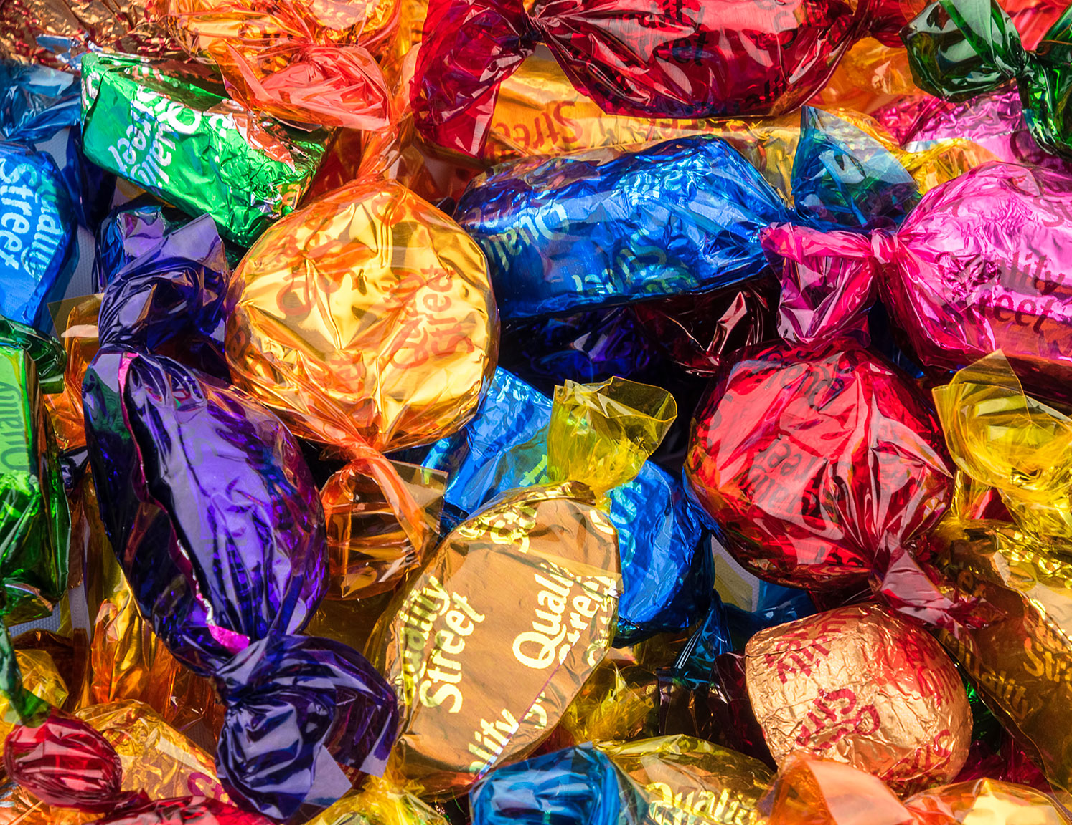
Oracy
Would you rather?
Christmas dinner or Christmas chocolates

Slide 10
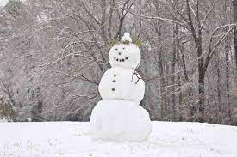
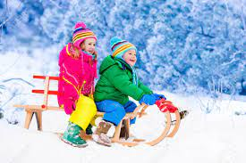
Oracy
Would you rather?
Build a snowman or Go on a sled ride

Slide 11
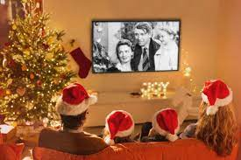
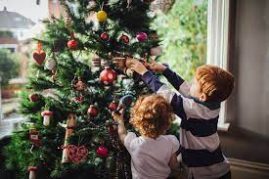
Oracy
Would you rather?
Watch a Christmas movie or Put up the decorations

Slide 12
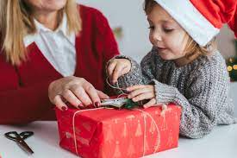
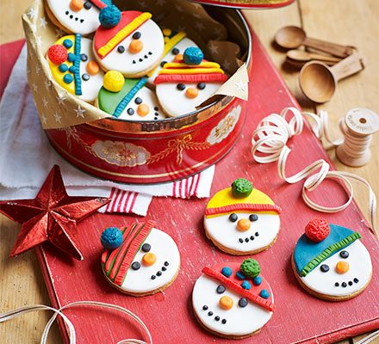
Oracy
Would you rather?
Wrap a Christmas present or Make Christmas biscuits

Slide 13
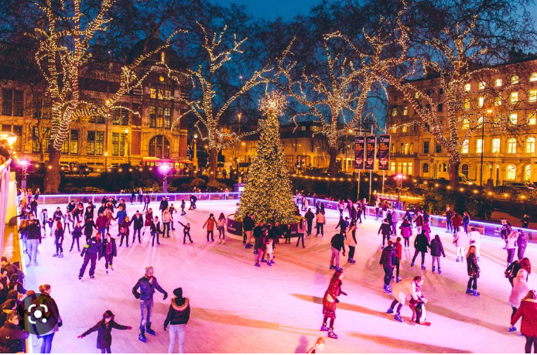
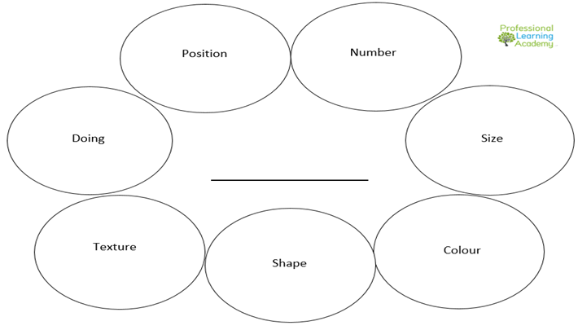
Seasonal short burst writing
As a class, gather vocabulary together which describes the scene in the image, E.g. twinkly Christmas lights, shrieks of laughter, festive fun.
You could use the bubble sheet or other notes page to gather vocabulary.
You might mention – the Christmas tree, the ice rink, the people on the ice rink. Who are the people in the scene? How do they feel?
Then, use the vocabulary to write a paragraph about the house. Can you give your writing a title?
See the following slides for other suggested images.
Click to download

Slide 14
Seasonal short burst writing
Can you up-level this paragraph? Whenever a word is highlighted, think of a way
to make it more interesting. You can use another word or phrase instead.
E.g. The Christmas tree sat on the centre of the ice rink
Better would be: The enormous Christmas tree sat magnificently on the centre of the ice rink.
The Christmas tree sat on the centre of the ice rink. Families went along the ice. All around the Christmas lights shone. Around the ice rink the city went on with buses going past and Christmas shoppers carrying their shopping bags home.

Slide 15
Seasonal short burst writing

Slide 16
Seasonal short burst writing

Slide 17
Seasonal short burst writing

Slide 18
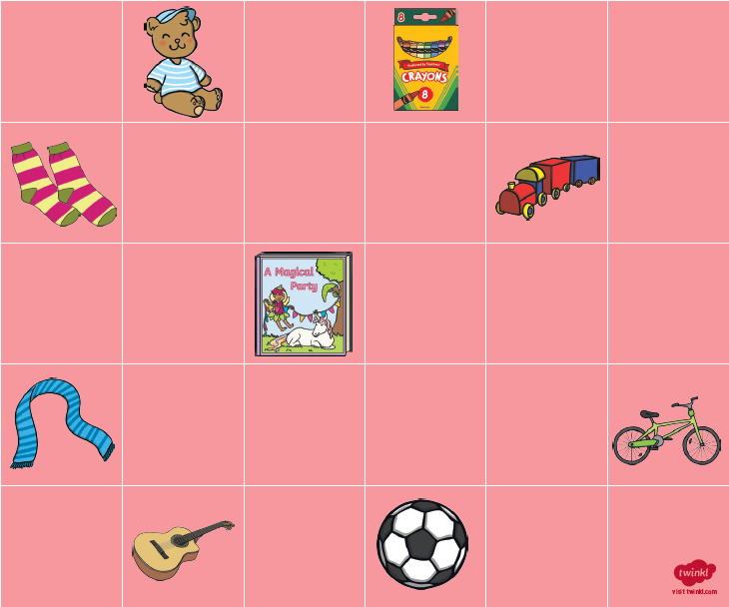
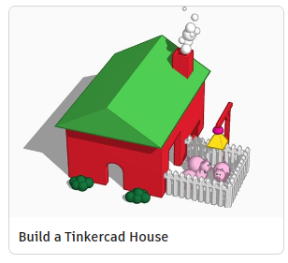
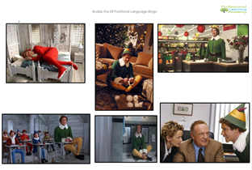
Technologies
Tinkercad Task
Build a house for Santa and his Elves
Step 1 – Build the house using construction
Step 2 – Draw a plan of your construction model
Step 3 – Translate your plan on to the Tinkercad Software - Use the following project to help you get started!
https://www.tinkercad.com/learn/overview/OG2TEUVIQFHI7DT?collectionId=OSZ5W2BL1W5N51F
Early – Positional language (BeeBot or Bingo)
Help Buddy navigate his way around the workshop to collect the presents
Use a counter and direct your partner around the board
Use a BeeBot and program it to collect the presents for Buddy

Slide 19
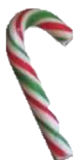
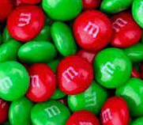
Venn Christmas Comes….
A Venn Diagram shows the relationship between
two or more items.
The point where the circles overlap shows the things they have in common. The rest of each circle show the things specific to each item.
Hard centre
Stripy
Hook shaped
Red &
Green
sweet
soft centre
round
chocolate

Slide 20
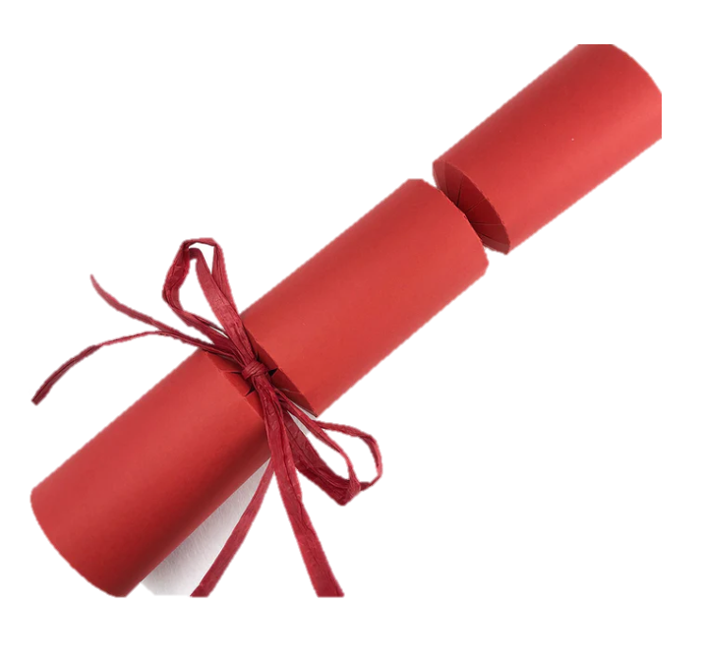
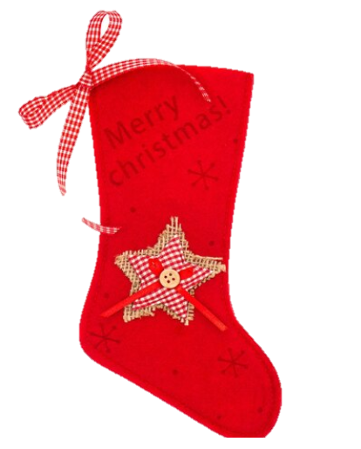
Venn Christmas Comes….
What things do these Christmas items have in common?
What things only apply to each item?

Slide 21
Venn Christmas Comes….
Can you suggest two or three items that you could compare?
Get a friend to complete your Venn Diagram.
Notes:
?

Slide 22
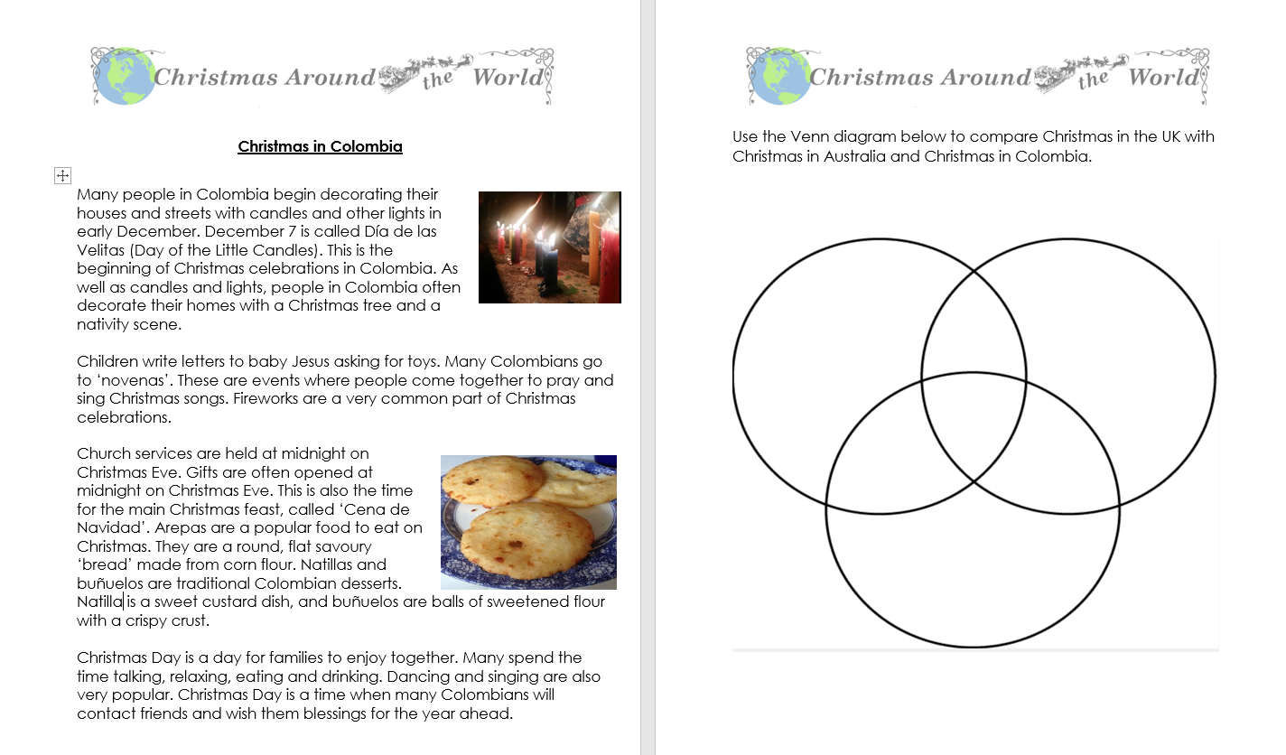
Venn Christmas Comes….
Click here for more Venn diagram related activities like the ones below from early to third level.

Slide 23
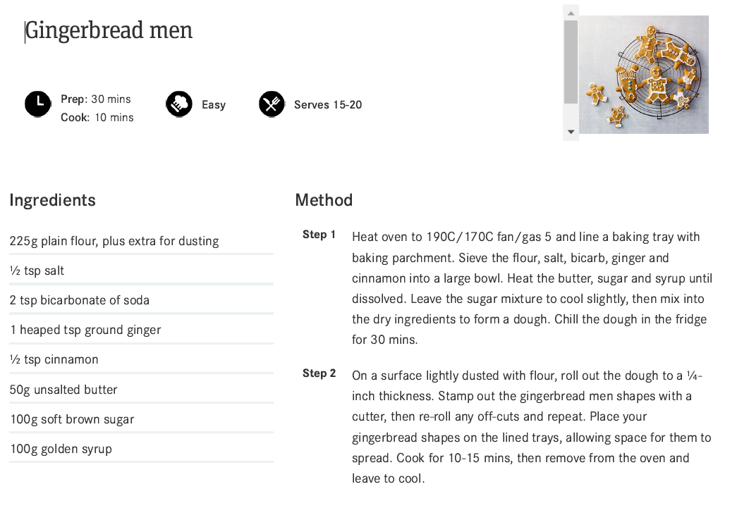
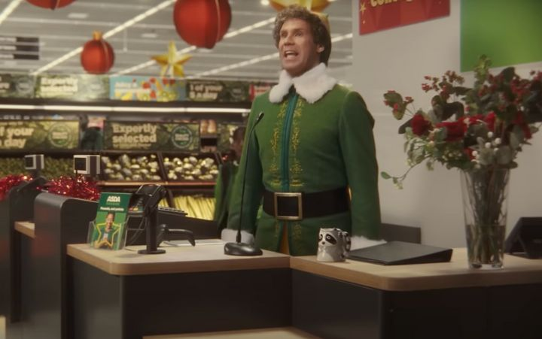
Baking Buddy
Watch the ASDA Christmas advert Buddy's Christmas
Recipe Task
Make your own Gingerbread Men!
This recipe serves 15-20 people.
What amount of ingredients would I need for a:
•Double batch?
•Triple batch?
•Quadruple batch?
•Half a batch?
Click to download

Slide 24
Kevin’s Christmas

Slide 25
Kevin’s Christmas
Predicting- Pause the video at various points, can you predict what may
happen next?
Visualising- Pause the video as Kevin goes out the window. Can learners visualise and draw what might happen next? Can they annotate their drawings and explain
what has happened?
Summarising – can you summarise what happened in the video?
Inferring- Before you watch the video, look at the image of the house at the beginning , can the learners infer what the video may be about? What time of year is it? How do you know?
Questioning- see the task boards on the following page.

Slide 26
Task Boards
Comprehension task boards for first and second level.
Click on the images to download.

Slide 28
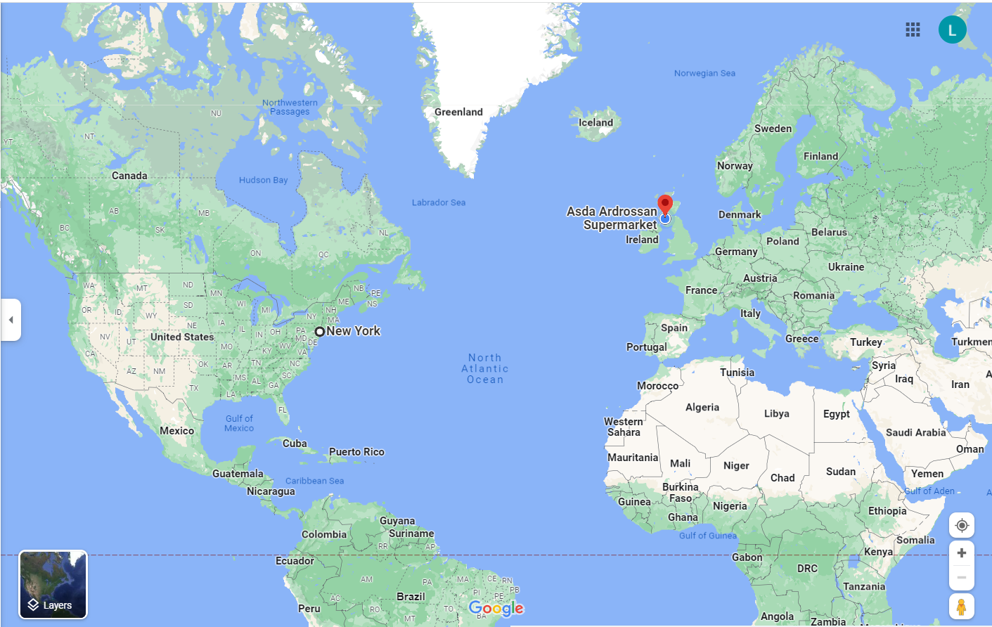
Busy Buddy
Buddy is currently in New York City visiting his family!
Today, there’s been a Christmas Decoration Disaster in Ardrossan!
Can you help Buddy make his way from New York to Ardrossan?
Use https://www.skyscanner.net/ to help you look for flights
Use https://www.travelinescotland.com/ to help you with travel when you Buddy arrives in Scotland
How quickly can Buddy make it to Asda?
How much money will it cost for Buddy to travel?
What modes of transport will Buddy have to use?
How could you make the journey cheaper?
Justify your answers

Slide 29
A Recipe for a Happy Christmas
It’s nearly Christmas! Can you write instructions for a
happy Christmas?
Use the following three slides to help structure your text.
Can you find and explore other instructional model texts before you begin?
Remember to create a word bank of Christmas vocabulary you could use?
Click here for templates and examples.

Slide 30
A Recipe for a Happy Christmas
It’s nearly Christmas! Can you write instructions for a happy Christmas?
Title
Goal
Materials
Steps

Slide 31
Title My Recipe for a Happy Christmas
Goal To create a happy, jolly Christmas
Materials
A group of important family and friends
A few lovely Christmas films
Some fun board games
A tub of delicious chocolates
A cosy log fire

Slide 32
Invite some family and friends to come to spend a day at your house.
Choose two of your favourite Christmas films.
Get out your top board game.
An hour before your guests arrive, open a big tub of Celebrations chocolates. (Try not to eat any before your guests arrive!)
Carefully turn on your fire following the instructions given.
When your guests arrive, pass round the chocolates and set up your board game to play.
Ask your guests which film they would like to watch.
Enjoy the day!
Steps

Slide 33
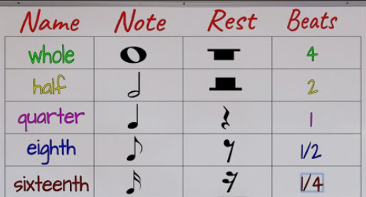
Boomwhackers
Body percussion/Boomwhackers
The best way to spread Christmas cheer, is singing loud for all to hear!
https://www.youtube.com/watch?v=ozo7S_py27k
Try out some festive body percussion – Can you work out the value of the beats on the bar?
https://www.youtube.com/watch?v=KFWlr3nzGnc
Try out some festive Boomwhackers – Can you work out the value of the beats on the bar?

Slide 34
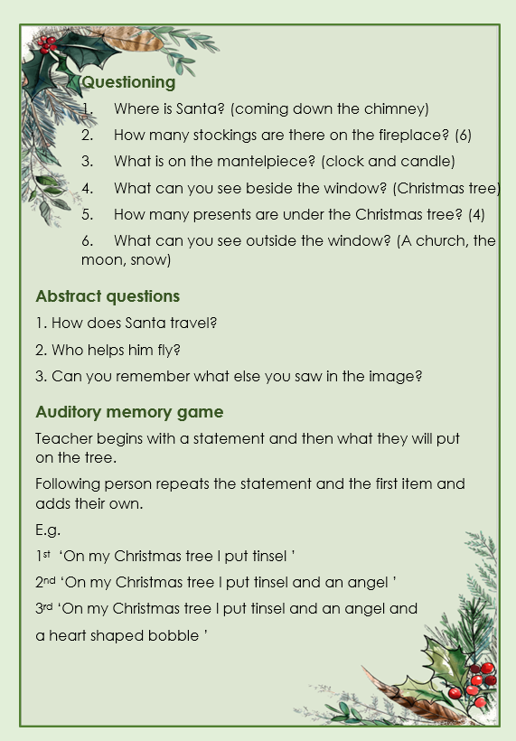
Look & Remember
Visual & Auditory memory activities
The following activities are great way to work on learners ability to store and recall information.
The next 4 slides include some images you could use.
Click here to access activities and questions linked to each of the images.
You could do these as a class or small group.

Slide 35
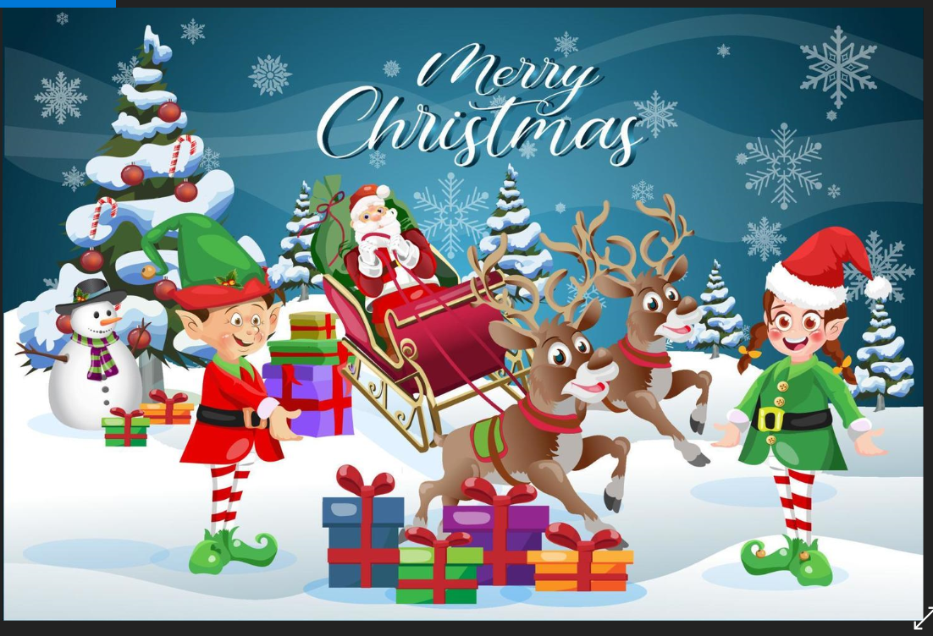
Look & Remember image 1

Slide 36
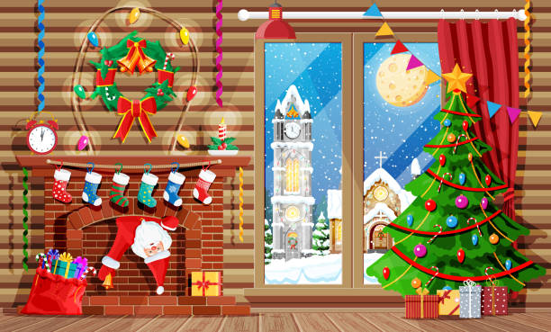
Look & Remember image 2

Slide 37
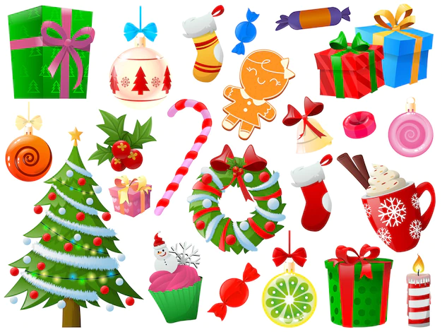
Look & Remember image 3

Slide 38
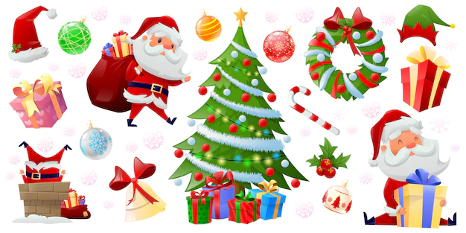
Look & Remember image 4

Slide 39
Christmas sequencing
Number sequencing – Christmas tree dot to do 1-15
Can you make the shape appear using playdough to connect the dots?
Use loose parts to decorate your tree
Can you make a pattern?
Can you make it symmetrical?
Click the image to download

Slide 41
Merry Christmas from everyone at the Professional Learning Academy

