Slide 1
Domestic Abuse and Healthy Relationships
Learning Intentions:
To develop an understanding of what is meant by the term ‘domestic abuse.’
To raise awareness of the types of behaviour associated with domestic abuse.
To understand how domestic abuse impacts the victim.
To recognise the features of a healthy relationship.

Slide 2
Learning Outcomes:
I will be able to say what domestic abuse is.
I will be able to identify the behaviours associated with domestic abuse.
I will have a deeper understanding of how it can impact a person.
I will know what I should be aware of when embarking on a relationship.

Slide 3
Discuss with a partner…
What do you think domestic abuse is?
Note your answers down and be prepared to contribute to the class discussion.

Slide 4
Copy…
Domestic abuse is a pattern of behaviours used by one partner to maintain power and control over another partner in an intimate relationship. Domestic abuse doesn’t discriminate so anyone of any
• race
• age
• gender
• sexuality
• religion
• education level or
• economic status
can be a victim or perpetrator of domestic abuse.

Slide 5
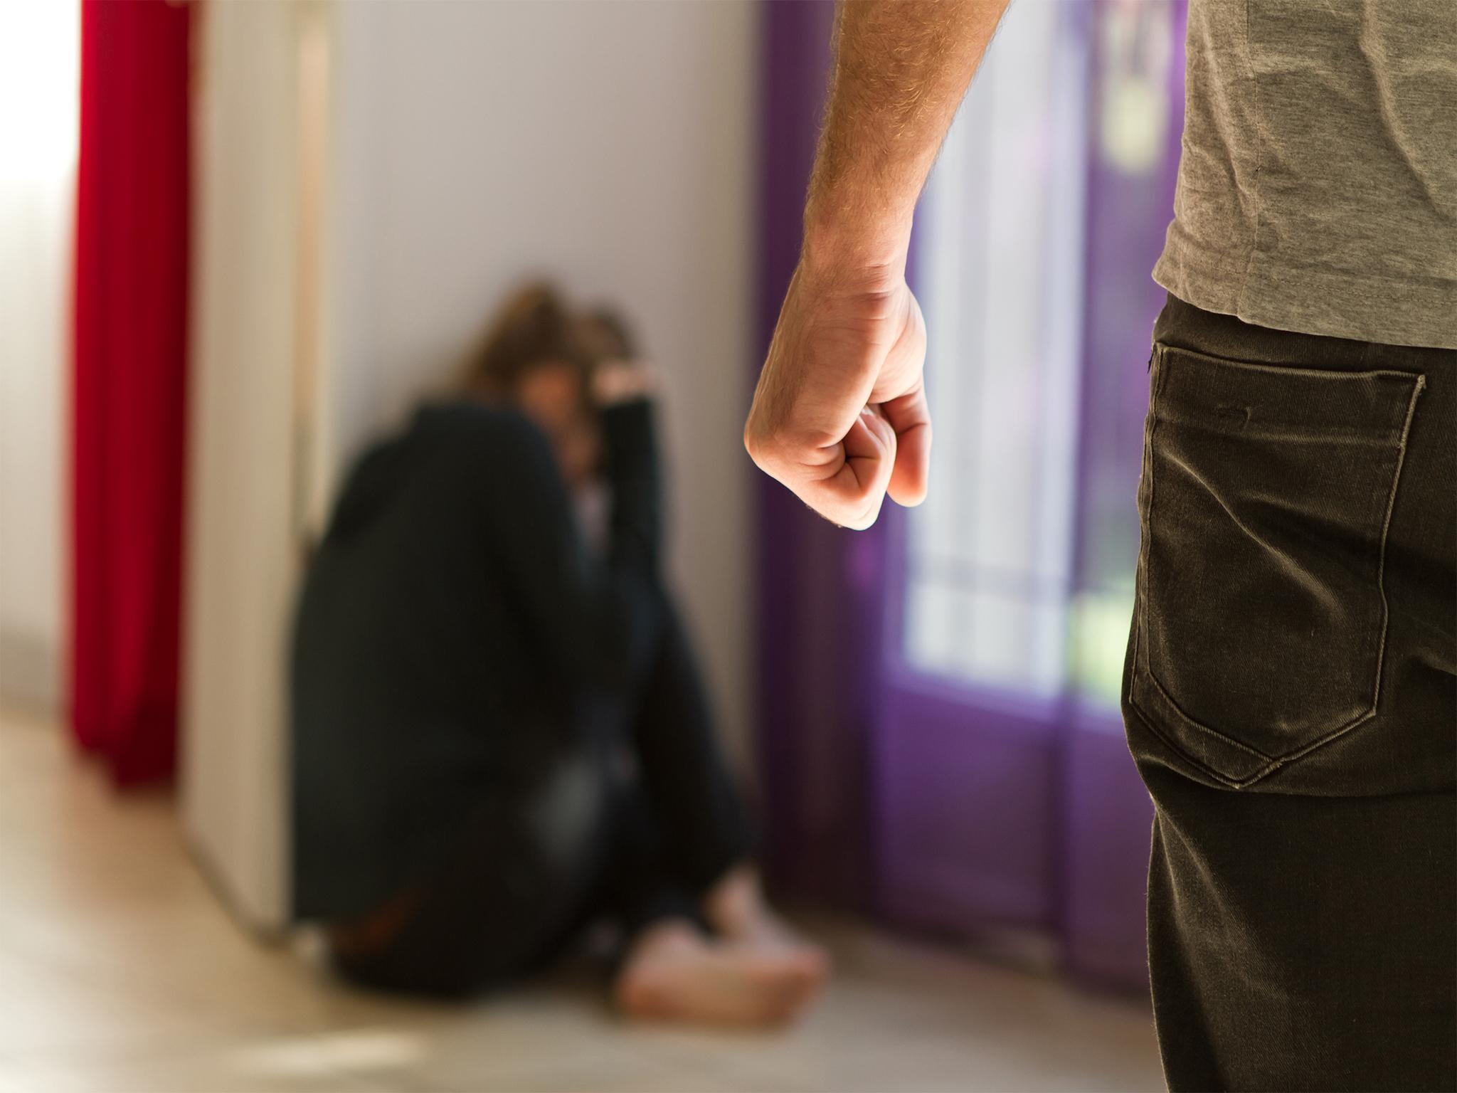
Discuss with a partner…
Discuss then list as many types of abuse as you can.
Try to give examples for each one and be ready to feedback to the class.

Slide 6
Copy…
Types of abuse include physical, sexual, emotional or mental abuse & multiple forms of abuse are usually present at the same time in abusive situations.

Slide 7
Victims of domestic abuse
Females between the ages of 16 and 24 are roughly 3 times more likely than the rest of the population to be abused by an intimate partner & only 1/3 of these women who were involved in an abusive relationship confided in someone about the abuse.
It's not just women who can be victims of domestic abuse. Male victims can also experience domestic abuse but it is just a lot more common for it to be women who are domestically abused, (the statistics are 1 in 4 females & 1 in 7 males).
Can you think of any reasons for any of the above?

Slide 8
Nobody should be or deserves to be abused in any form and by recognising the signs of abuse you can keep yourself safe.
Someone may stay with the abuser through fear of what the abuser may do if they end the relationship or they may forgive their partner because they do love them, and have been promised it won't happen again but there is a high chance it will.
People can blame themselves for the abuse as they may be told constantly that the abuse is their fault but it is not - domestic abuse is nothing to be ashamed of & there is help available.
Note down the changes you may see in someone if they are in an abusive relationship (think about physically and behaviourally).

Slide 9
Change in personality (may have been bubbly before but seem more introverted)
Lack of effort in presentation (hair, make-up, clothing etc.).
Avoids social events
No longer interested in spending time with friends (though be aware that at the early stages of a romantic relationship this can be normal)
Nervous or timid
Emotional
Sad
Agitated/ easily annoyed
Participating in increased behaviour types (drinking more alcohol etc.)
Apologetic/ feelings of guilt or shame

Slide 10
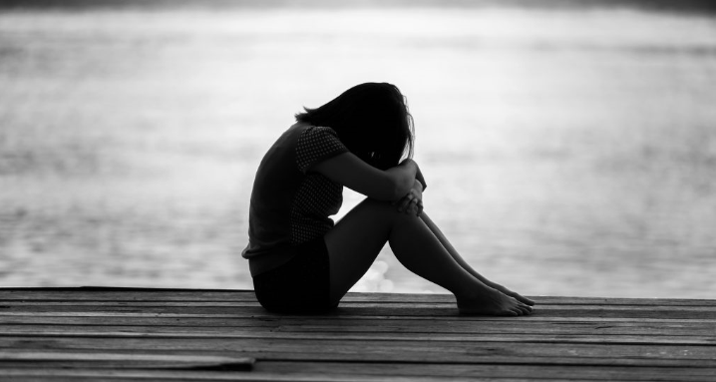
What can you do if you are worried?
Discuss the ways you could get help for yourself – or someone else – if you think you or someone you know is in an abusive relationship.
Write your answers down.

Slide 11
Talk to someone you trust (this could be a friend, an adult, a relative, a teacher…)
Ask your loved one if they are okay but be mindful of how you approach this: “I’ve noticed you have been a bit quieter lately. Is everything okay?”
“I’m here if you need me.”
Don’t be confrontational if you are checking in on a loved one as this could lead to them shutting off from you.
Encourage self-worth/ remind your loved one (or yourself) that you deserve the best and to be treated with kindness.
If you are really unsure as to how to proceed remember the first point – ask for advice.

Slide 12
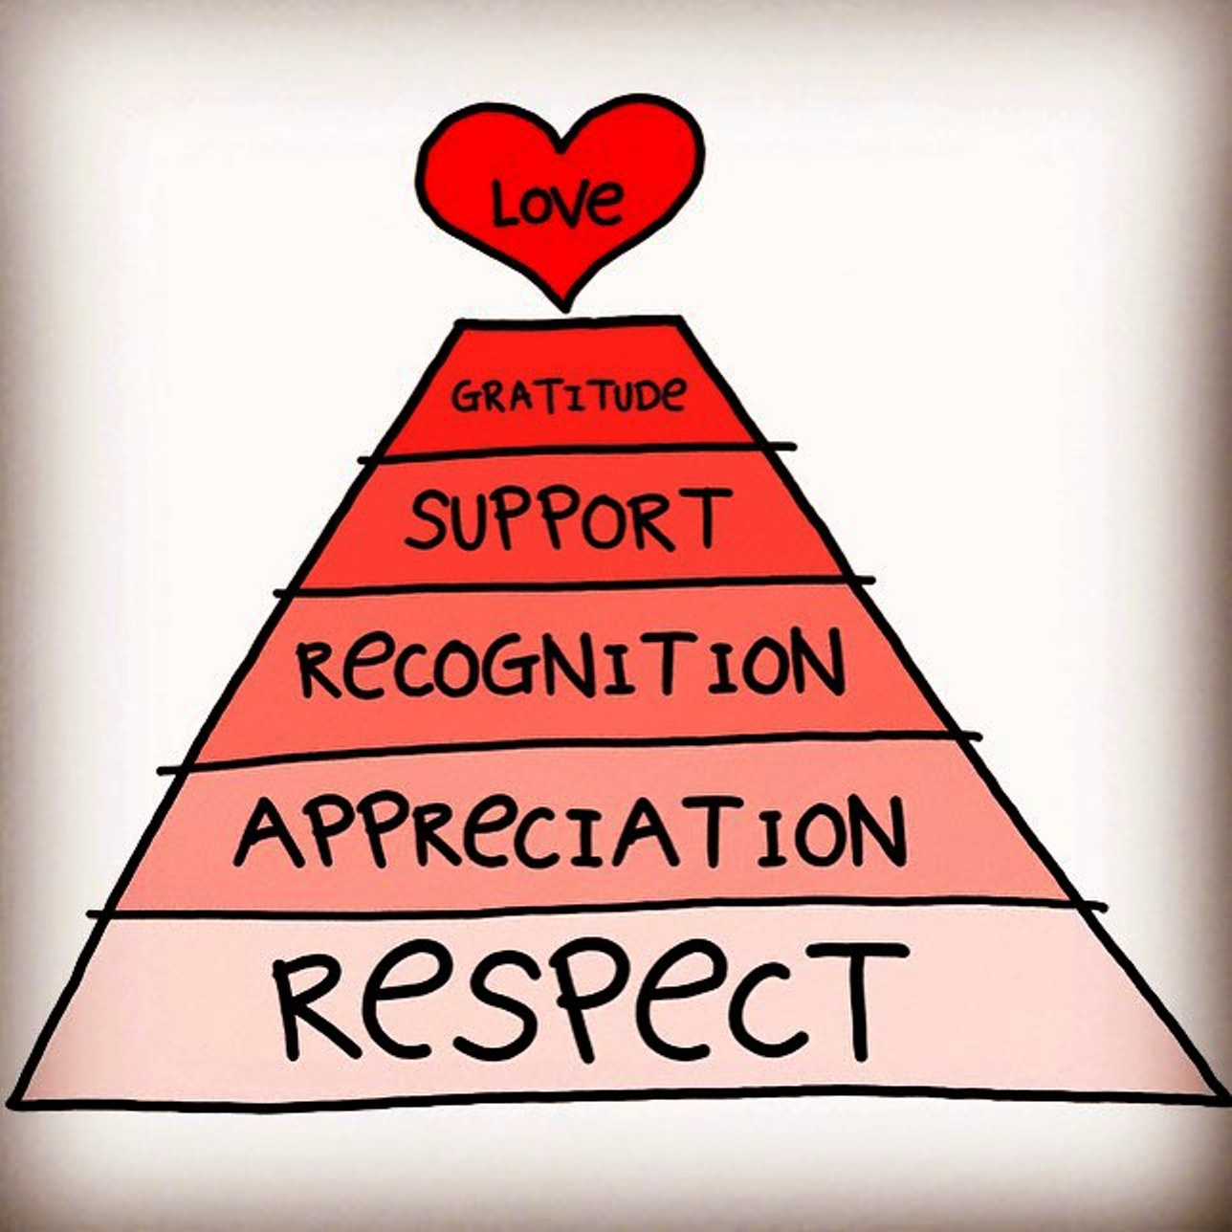
Healthy Relationships
Write down the features of a healthy
relationship.
2) What do good relationships do for us?
How do they impact our lives and how we
feel?

Slide 13
Relationships play an important part of everyday life. Everyone wants to be and deserves to be in an equal, healthy, respectful, empowering, and loving relationship.
Copy…
Equality - Making decisions together, not expecting you to do more or give more to the relationship
Respect - Listening, being non- judgmental, understanding and valuing each other’s opinions.
Trust - Respecting your right to your own opinions, friends and activities.
Support - Supporting you in your goals and ambitions, believing in you.
Safety - Respecting your personal space, non-threatening behavior, non-manipulative or intimidating behavior.

Slide 14
Honesty - Clear, open and truthful communication, being able to say if you're feeling scared or insecure.
Responsibility - Acknowledging one's own behaviors and attitudes, asking not expecting.
Freedom - Being able to live your life free from violence, intimidation or threatening behavior and make choices for yourself.
Negotiation & Compromise - Accepting that there isn't always a 'right' way to do things, accepting change, willingness to see the other side.

Slide 15
We feel and are:
More confident
Ready to take on challenges and take risks
Loved and looked after
Growing as individuals and allowed to have our independence
Not judged and accepted for who we are
Praised and given encouragement
Appreciated and valued

Slide 16
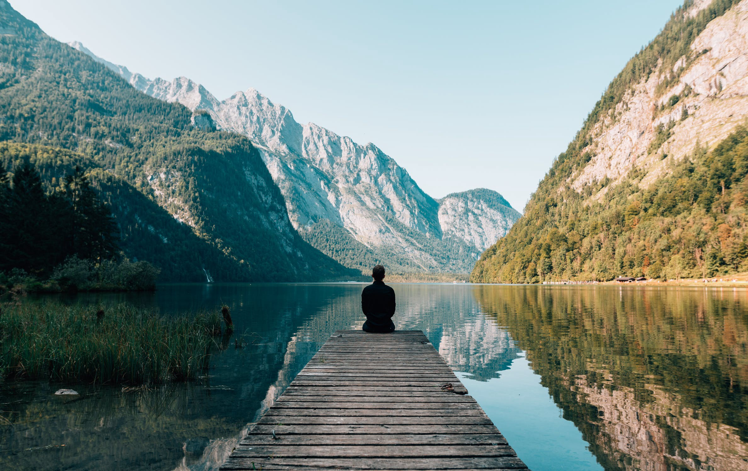
Reflective Activity
Do you feel more informed about relationships?
How has your view changed?
How confident are you in understanding domestic abuse?
Is there anything you would like to know more of?

Slide 17
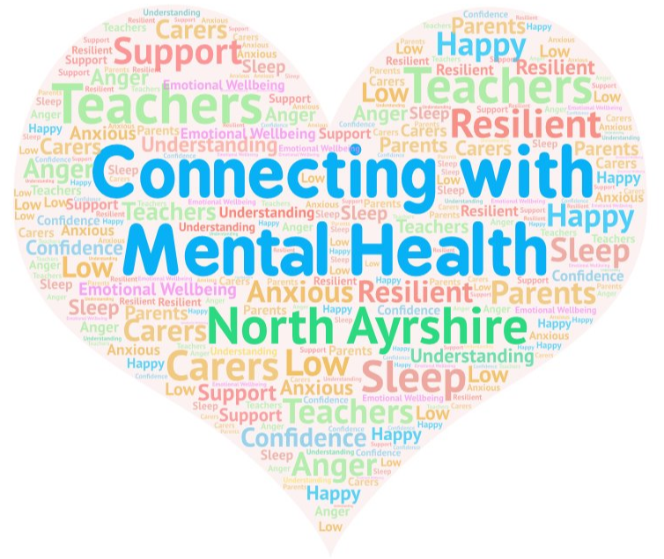
Like to know more?
Head to here on Glow….
Select secondary at the bottom and click on the Expect Respect page.
Or visit https://blogs.glowscotland.org.uk/na/northayrshirecouncilexpectrespect/

