Slide 1
TEAMS together time
12th June 2024

Slide 3
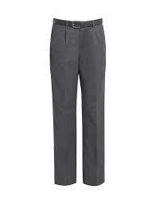
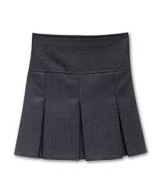
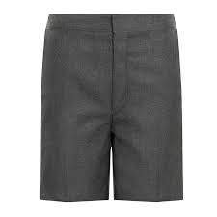
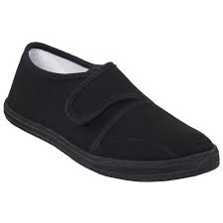
School uniform
Supplier: Logoxpress
19th June supplier will attend parent/pupil session to allow you to try items for fit
Order forms will be sent out via email and papercopy available- items delivered to your door
Tartan…
PE days: children can come to school ready for PE- these will be issued in week 1

Slide 4
Building update

Slide 12
Classes
P1- 12 children
P1- 12 children 13 girls 11 boys
P2 10 children – 6 girls 5 boys
P3 5 children – 2 girls 3 boys
P4 9 children – 4 girls 5 boys
P5 12 Children – 11 girls 1 boy
P6- 12 children- 5 boys & 6 girls

Slide 13
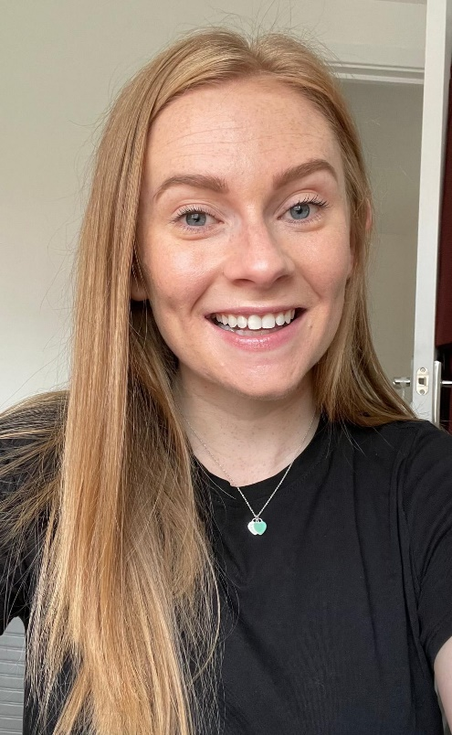
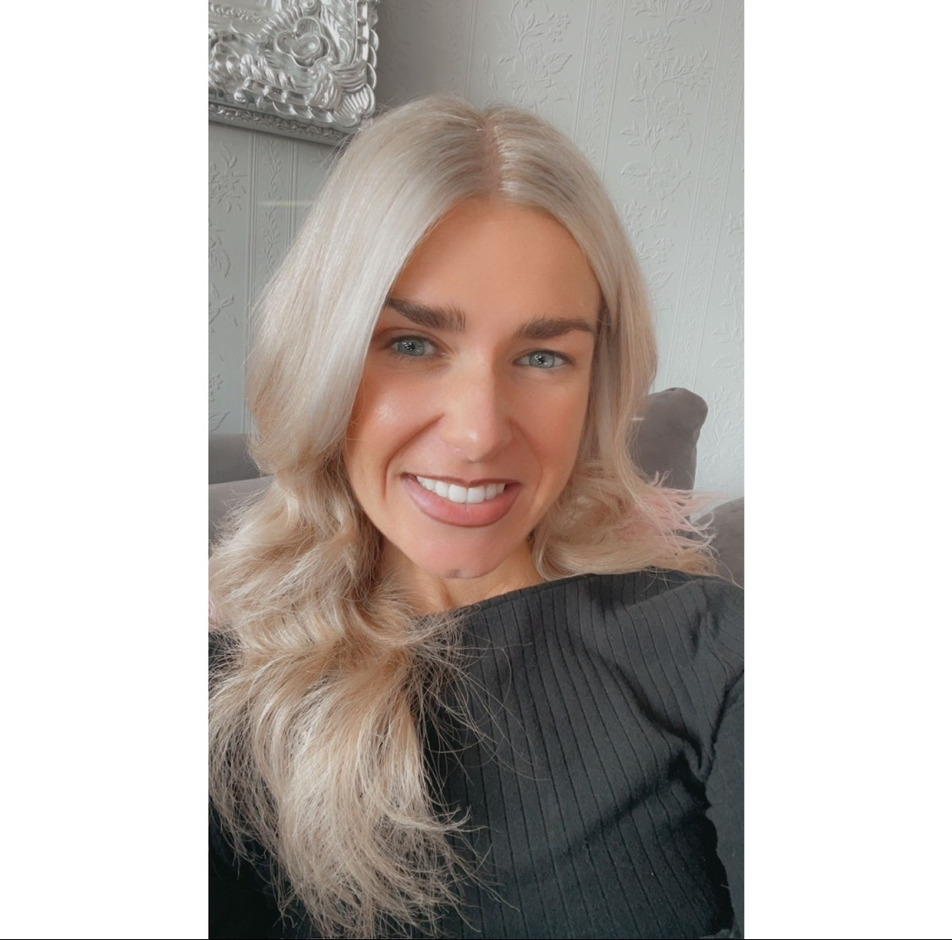
Teachers
Primary 1 hub:
Mrs Jennifer McRonald Miss Chantelle King

Slide 14
Primary 2/3
Miss Caryn Dailly

Slide 15
Primary 4/5
Mr Sijad Macfarlane-Majeed- fondly known as Mr M!

Slide 16
Primary 6
Mrs Marlene Muir

Slide 17
Buddies

Slide 18
Parent drop in session
9am-11am
2pm-4pm

