Slide 1
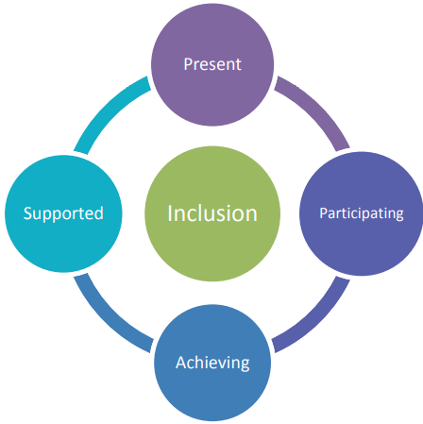
Getting it Right for Every Child at Montgomerie Park Primary School
Staged Intervention and wellbeing

Slide 2
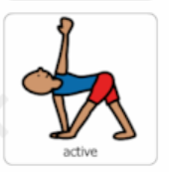
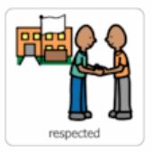
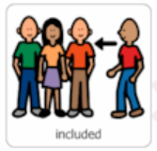
Wellbeing Indicators

Slide 3
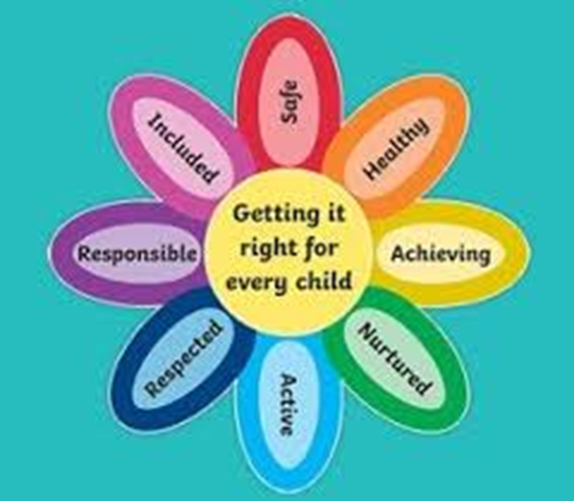

Slide 4
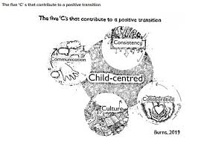
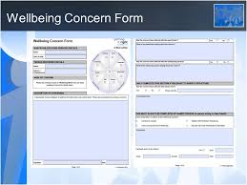
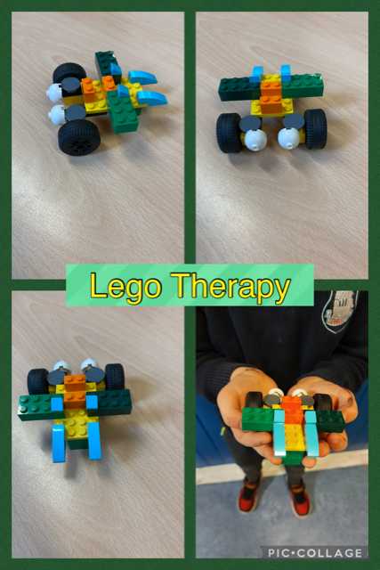
Supporting learning in and around the school…
Teachers assess children during all activities and use this information to make decisions about progress or barriers to learning

Slide 5
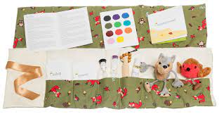
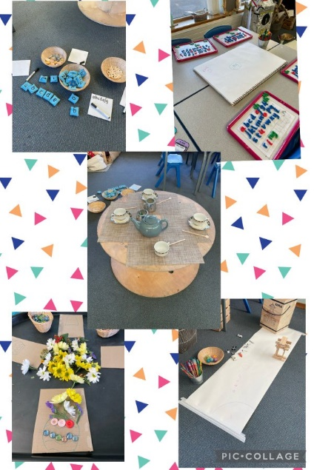
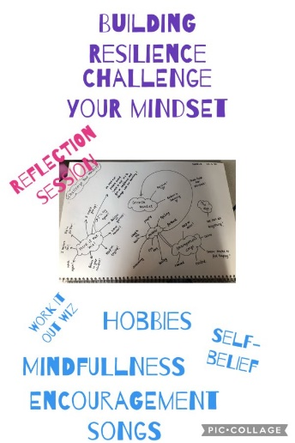
Supporting learning in the classroom…
Clear rules, routines & procedures to build positive relationships
Inclusive learning environment to cater for different needs and interests where pupils voice is listened and responded to
Wellbeing check ins and building resilience

