Slide 1


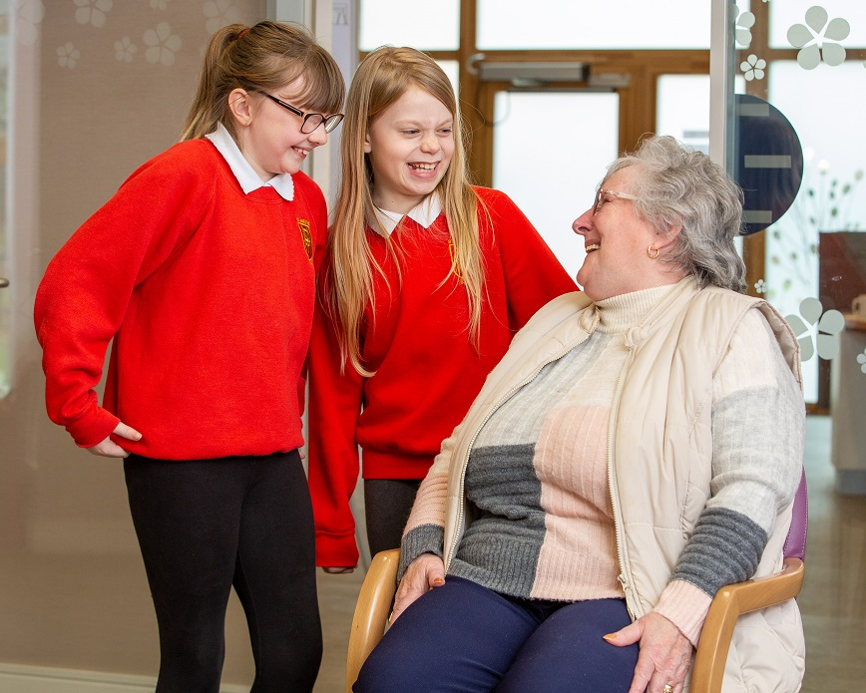

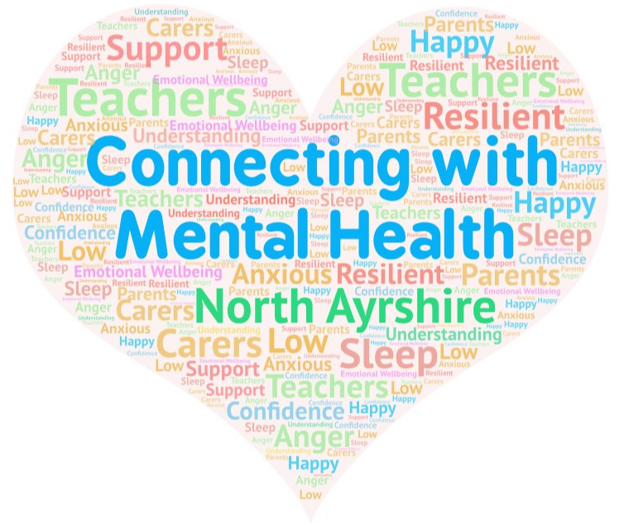



Supporting the Mental Health and Wellbeing of Children and Young People in Your Care
A Resource for Parents and Carers
Part 1

Slide 2

Welcome!
Firstly, thank you for choosing to take the time out to complete this course which has been built around Mental Health Improvement: A Practical Approach. Please work through it at your own pace and use the audio recordings that have been provided on each slide for additional support at your own leisure. We have also developed a workbook for you to use if you wish. This can be found here........
The aims of this course are to:
Remind ourselves what mental health is and how we can maintain good mental health
Understand mental health in the context of children and young people
Explore the importance of nurture
Raise our awareness of resilience and how to cultivate it
Reflect on the factors that can cause us to stress and worry
Look at practical ways we can maintain positive mental health and wellbeing
Notes:
MF - Read slide content.
Each of you will have your own unique situation and your reasons for participating in this e-learning course. Ultimately our hope is that you will feel more confident when supporting your child's mental health and reassured that you are doing the right thing to meet their needs.
We can all be guilty of doubting our actions (because let's face it; there is no manual or guide on how to parent!) and thinking we aren't being understanding or patient enough (or perhaps we worry we are being too understanding and not firm enough!); but this module has specifically been created to alleviate your concerns and show you how you can not only support your young person but look after yourself too.
In the first part of the presentation we will be exploring what mental health is; learning about the influences on mental health; looking at some key facts; understanding the importance of nurture and how it is important in building resilience before studying stress and anxiety.
Please feel free to dip in and out of this module and take it at your own pace. If you feel agitated or start to lose focus please stop and make a cuppa or come back to it the next day.
We are also very aware that in our changing times you are missing out on that face to face interaction which is why we have provided you with the opportunity to meet with the team that created this package to give you the chance to chat or explore anything you come across further. These details will be provided at the end of the presentation.

Slide 3


What is Mental Health?
“The capacity to live a full, productive life as well as the flexibility to deal with its ups and downs. In children and young people it is especially about the capacity to learn, enjoy friendships, to meet challenges, to develop talents and capabilities.” (Young Minds)
“Mental health influences how we think and feel about ourselves and others and how we interpret events. It affects our capacity to learn, to communicate and to form, sustain and end relationships. It also influences our ability to cope with change, transition and life events: having a baby, moving house, experiencing bereavement” (Friedli 2004)
North Ayrshire Council
Notes:
MF
What comes to mind when you think of Mental Health?
It can be difficult to come up with one definition. We know we all have it and like our physical health we need to look after it.
Read through the 2 definitions

Slide 4
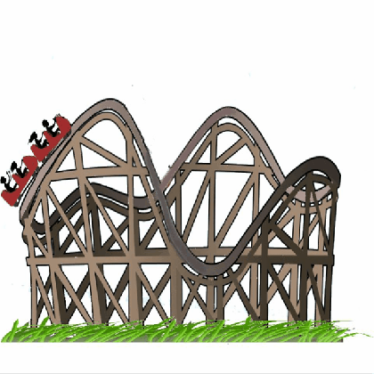
Activity – A Day in Your Life
Took the
dog a walk
Got loads done this morning and enjoyed a sunny lunchtime
Family time catching up on the day
Positive mental health
Woke up in an OK mood
Poor
mental health
Time to
sort argument
Off to bed reflecting on the day
Argument with family member
Notes:
EJ - Activity – A day in your life (10 mins)
To explore the ups and downs of everyday mental health and wellbeing;
Different things cause stress or affect mental health and wellbeing on a daily basis
It is normal for our moods to change. Our mental health and wellbeing is not static but always changing and is influenced by a wide range of factors some of which are out of our control.
Each person is affected differently by the same event. Eg. Some people worry more over financial problems than others.
Taking time out to do things you enjoy regularly helps to recharge our batteries and improve mood.
This is true regardless of whether a person has a diagnosis of a mental illness or not, we can still do things every day to keep our mental health and wellbeing positive.
People who manage a mental illness such as depression or bipolar, whether with self help, exercise, medication, counselling etc, can enjoy positive mental health despite their diagnosis.

Slide 5
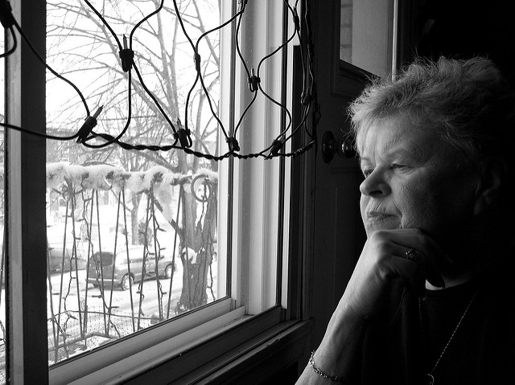

Frame of Reference
disappointments
people
influences
events
challenges
Religion/spirituality
power
environments
situations
media
education
places
local culture
role models
money
behaviours
gender
values and attitudes
achievements
Notes:
MF
When it comes to how we respond to situations it can help to consider our own frame of reference. This relates to our values and beliefs and how they have been influenced by a range of things around us. By placing ourselves in the middle (e.g. in the form of a photograph) we can spend some time thinking about the factors that have made us who we are (these form the frame around us).
A good starting point could be thinking about how our behaviour and actions were influenced by those around us when we were younger e.g. ‘respect your elders’, ‘always tell the truth’, ‘you don’t get anything for nothing.’
As we have grown and developed ourselves there will be key factors/ significant people / events that influenced our attitudes and beliefs. This can also apply strongly to mental health and wellbeing. What were your experiences of mental health in school? How did people talk about it? Did they use specific terms or words to refer to someone who had additional support needs or suffered from depression? Did you use any of these words? This exercise isn't about making you feel shame or guilt – on the contrary it is about helping us understand that the world and people around us can impact our views and how we see things and that also doesn’t make it a game of blame – we must remember that those around us have been influenced in their own way too.
Finally, think about your child and the ever growing frame they may have around them. It's a lot to take in compared to our experiences.
Ultimately, our own attitudes and those of others have a profound affect on how we deal with mental health and wellbeing issues.

Slide 6
Creating a Mentally Health Environment
Inclusion
Physical environment
Support
Feeling valued
Communication
Notes:
MF
We feel happy and content when we are part of a mentally healthy environment. The chart above could be a good place to start when considering what we should have in our environment to enable us and our children to experience the best mental health and wellbeing.
Inclusion – we feel we belong and are part of something. We are included in important decisions and our voice is heard. Can you think about a time when you felt invisible or as if you weren't being taken seriously?
Physical environment - our physical surroundings are positive and encourage us to lead healthy lifestyles. We are active and have access to necessities such as food and warmth.
Support – we know where to go when we need advice and guidance and know we won't be judged.
Feeling valued – our views matter and count for something. We know we are loved and are important.
Communication – we can manage our emotions and verbalise how we feel in a way that is calm and non-confrontational. When faced with a challenging situation we can work together to find a solution and avoid a situation escalating.

Slide 7
Benefits of a mentally healthy environment and mentally healthy people
We can reach our potential
Improved general health
Thriving communities
Reduced stigma against mental ill health
↓ risk of problems escalating
Good mental health for all
Notes:
MF
Read slide

Slide 8

Mental Fitness
North Ayrshire Council
Notes:
EJ WE talk about being physically fit and we should also consider mental fitness, being mentally well.
fitness is a positive term without connotations of illness implied by mental health or mental illness
We can understand mental fitness in a similar way to physical fitness
mental fitness is measurable and what is measurable can be changed
mental fitness can be improved, in a similar way to physical fitness

Slide 9

Key Facts
Mental health problems affect about 1 in 10 children and young people.
20% of adolescents may experience a mental health problem in any given year.
50% of mental health problems are established by age 14 and 75% by age 24.
70% of children and young people who experience a mental health problem have not had appropriate interventions at a sufficiently early age.
(Mental Health Foundation)
Parents don’t feel empowered, confident or informed in supporting their child’s mental health and wellbeing.
“Normalising difference is part of supporting kids’ mental health.”
(Connect, 2020)
North Ayrshire Council
Notes:
MF
Before we continue let's take a look at some key facts about mental health.
Read MHF facts.
According to a survey completed by parents and carers in January 2020....read slide.
Connect is a membership funded charity which brings together parents, carers, teachers and educational partners to improve results for children and young people.

Slide 10
What about Covid 19’s Influence?
We and our children and young people have been impacted severely by COVID-19, and now – with pupils having returned to school – new challenges might be emerging.
Research and studies have found that:
67% of respondents agreed that they are concerned about the long-term impact of the coronavirus on their child’s mental health.
Respondents reported a range of ways in which the crisis had impacted the children and young people in their care, including:
Increased anxiety and depression
Increased sense of loss and fear (e.g. about going out for exercise, or uncertainty about what would happen next)
Increased mood swings or children becoming more emotional
Children either becoming more attached to their parents, or becoming more introverted/isolated within the house
66% of respondents said that the coronavirus had had a negative impact on their own mental health.
(Young Minds , May 2020)
North Ayrshire Council
Notes:
MF
Read information on slide.
This Young Minds survey was carried out in May 2020 with 1,850 parents and carers participating.
Do any of these sound familiar?

Slide 11
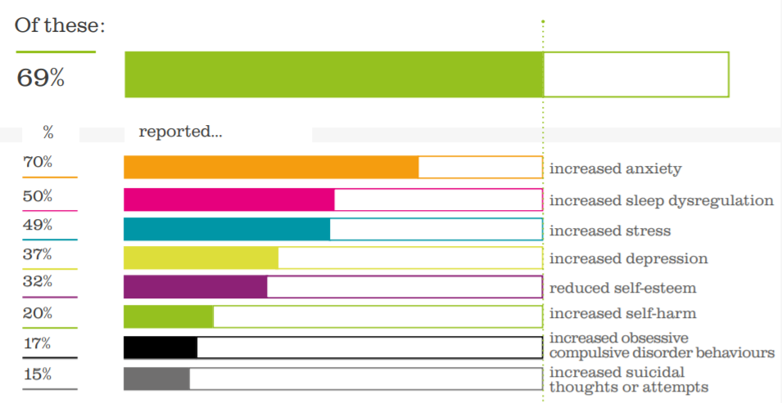
Barnardo’s Our Big Conversation poll of 4,000 children and young people aged eight to 24 years across the UK found that at least a third said they had experienced an increase of mental health and wellbeing issues including stress, loneliness and worry.
69% of our frontline practitioners are supporting someone with an increase in mental health issues due to the Covid-19 crisis.
(Barnardo’s)
Notes:
MF
Barnardo’s carried out an in-depth survey (Mental Health and Covid-19 in Our Own Words) on the impact of COVID-19 on children and young people across the UK.
Read information on slide

Slide 12
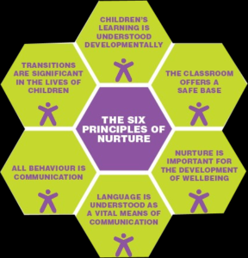
Mental Wellbeing and Nurture
We will start to think about how we can nurture wellbeing.
Notes:
We can see from all the surveys that mental wellbeing is a priority. North Ayrshire schools all use nurture principles to promote positive emotional wellbeing in our children and young people
There are Six Principles Of Nurture
1. Children's learning is understood developmentally
2. The classroom offers a safe base
3. The importance of nurture for the development of wellbeing
4. Language is a vital means of communication
5. All behaviour is communication
6. The importance of transition in children's lives

Slide 13

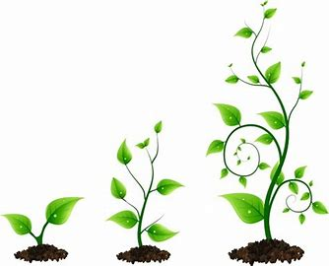
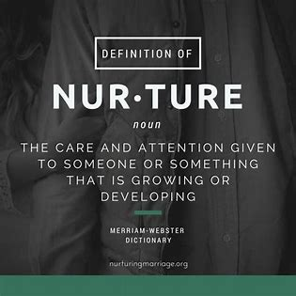
What does nurture mean?
The word nurture comes from the Latin word “nutritura” which means to nurse, nourish and to promote growth. Words that have a similar meaning to the word nurture include encourage, incubate, further and promote.
All human beings need to be nurtured and nurturing needs to begin before birth and continue throughout life.
Notes:
EJ At the heart of nurture is a focus on wellbeing and relationships that support the growth and development of children and young people…
Our schools in North Ayrshire are encouraged to use nurturing approaches in all interactions with children and young people. The nurturing approach offers a range of opportunities for children and young people to engage with nurturing experiences, giving them the social and emotional skills to do well at school and with peers, develop their resilience and their capacity to deal more confidently with the trials and tribulations of life.

Slide 14

Four ways to nurture children and young people:
There are many ways that adults nurture.
Four intentional ways that a parent or caregiver can nurture children include:
Practice empathy
Establish routines
Use positive touch
Keep children safe from harm
Safe Kids Worldwide
Notes:
Empathy requires that you observe another’s actions, recognize the related feeling that they are having and then vocalize it in a way that shows that you understand. Psychologist Alfred Adler explained it this way; Empathy is "seeing with the eyes of another, listening with the ears of another and feeling with the heart of another." This can be difficult if you have not experienced empathy yourself. Begin by observing a feeling in a child, give the feeling a name and then using the name of the feeling in a “you” message. “You must be frustrated at not being able to fit the puzzle piece in that spot.” “You probably wish that your friends would have stood up for you.” “You are angry because Joey took your toy and broke it.”
Establish routines - Children need schedules and depend on adults in their life to provide structure for them. You can nurture your child by providing regular meal, play, study and bedtime routines. By providing a schedule your child learns predictability through repetition, security through knowing what will happen next and some control over their environment. A regular routine enables children to reduce anxiety by knowing what is coming next.
Use positive touch - We all have a need for human touch. A positive touch is a hug, pat, gentle tickle or soft nudge. Regular warm and gentle touches can help children develop a healthy sense of self and can contribute to positive brain development. Positive touch can assist a child with regaining control when they are being redirected. A recent study by Michigan State University’s Kathy Stansbury showed that “positive touch caused children to comply more often, more quickly and with less fussing than negative touch or physical punishment.”
Keep children safe from harm - Children who are small need to feel safe in their own homes, childcare, in their communities and in the larger world around them. Provide limits for the children in your life by providing a safe environment. Choose child care providers carefully. Use car seats, baby gates and other approved equipment for very young children. Explore outdoor play areas for potential hazards and have rules for inside play that allow for learning while restricting unacceptable activities for toddlers and preschoolers. Talk about potential dangers without frightening children. Family friendly information is available from Safe Kids, an organization that is dedicated to providing parents and caregivers with practical resources to protect children from injuries. Safe Kids Worldwide

Slide 15
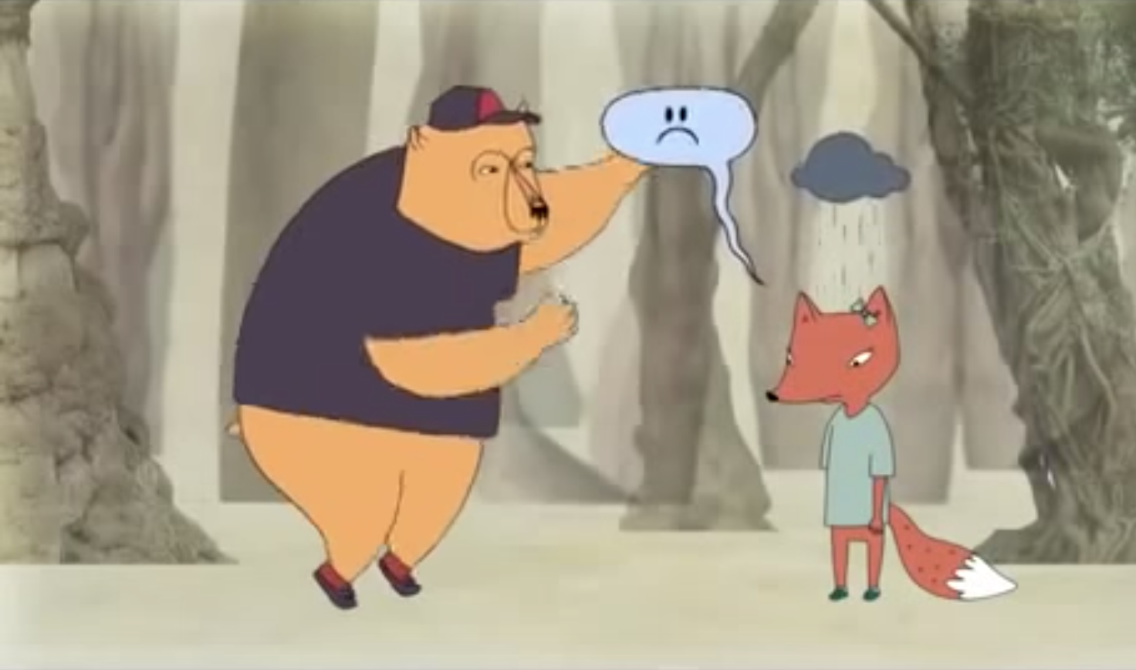
Empathy
Click the picture to see a short film about empathy
Notes:
You may wish to watch this short clip about empathy. It is narrated by Brene Brown, a writer and speaker who has spent her career studying courage, empathy and vulnerability.

Slide 16

https://www.youtube.com/watch?time_continue=2&v=isfw8JJ-eWM&feature=emb_title
The Power of Resilience – Dr Sam Goldstein
North Ayrshire Council
Notes:
EJ – Michelle will discuss resilience next. This video features Sam Goldstein a neuropsychologist who specialises in school psychology. He describes here the power of resilience. And states that a guiding principle in all of our interactions with children should be to strengthen their ability to be resilient and to meet life challenges with thoughtfulness, confidence, purpose and empathy.
Resilience fosters strength hope and optimism in our children.

Slide 17

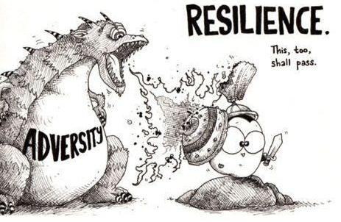
Linking Positive Relationships to Resilience
Resilience is:
Coping with adverse events
Determination to see something through to its conclusion
Skill set needed for resilience
Optimism
Self-belief
Flexibility
Social support
Emotional intelligence
Problem solver
Organised
North Ayrshire Council
Notes:
MF
One of the most crucial tools we each have is resilience. It holds the key to survival and helps us to conquer many challenges. We each have a role to play on modelling resilience and showing others that – although we may feel the tide keeps on coming – we manage every day and continue with our daily lives. We may find the day ahead an impossible thought but we push through it and come out of the other end. That is resilience and – no matter how exhausted we might be – we survived.
The key to building resilience sometimes seems the hardest step to make but when we make it we lay the foundations for inner strength.
Read slide:
Optimism – we don’t mean we make everything a positive because that is unrealistic but we practice seeing the glass as half full!
Self-belief - we believe in ourselves and focus on us, not what others think.
Flexibility - we can adapt to a situation. We bob on the surface like a cork and stay afloat no matter the current’s change in direction.
Social support - we have a support network around us.
Emotional intelligence - we can manage our emotions in positive ways to relieve stress and support others. When we do this we empower ourselves and harvest resilience.
Problem solver - we can compose ourselves when faced with unexpected challenges and seek out solutions. Think about during lockdown when you have had a wobble (or maybe 100!) and dealt with it or them!
Organised - we are organised and know what we need to do to be able to complete our day effectively.

Slide 18

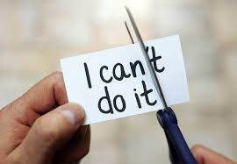
Building Resilience…
Opportunities for learning
Using self-help resources
Strong support networks
Healthy lifestyle choices
Positive affirmations
Overcoming challenges
Notes:
MF
Read slide
Positive affirmations – we change our language towards ourselves and make it positive instead. We no longer say to ourselves ‘I’ll never understand this’ but ‘this is pretty tough but I’ll give it my best shot and know that I tried. If I don’t get my head round it I’ll ask for help.’
Ultimately to overcome challenges is to build resilience!

Slide 19
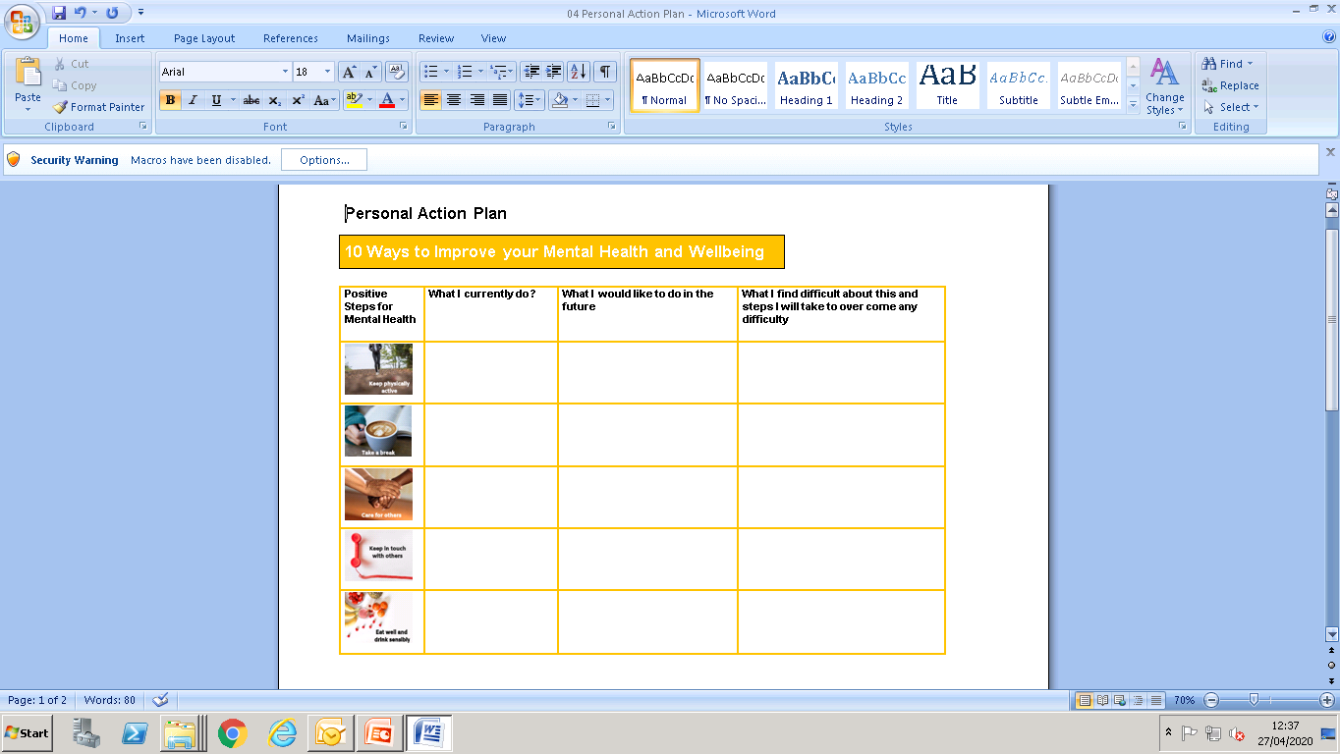
Create a Personal Wellbeing Action Plan
Identify the top two areas you think you could work on and these will help you build resilience.
Notes:
MF
This action plan is based on ways to improve mental health and wellbeing and could be used and adapted to suit your own preferred way of working. Thinking about and reflecting on each area (physical activity; taking a break; caring for others; keeping in touch and eating well) might help you to gain perspective on the things we tend to neglect and why we do this, giving you the opportunity to overcome any barriers.
Identify two areas that catch your attention and think about what you do just now; what you would like to do more of and what makes it hard for you to achieve in that area. Finally think about steps you could put in place to help you overcome any barriers you have identified. It might be something as simple as being firmer with yourself and dialling that number on your contact list!

Slide 20
Let's think about some of the key points we have covered so far:
Individuals each have their own values and beliefs that shape their attitudes towards mental health and wellbeing and we should consider individual’s values and beliefs when promoting mental health and wellbeing
Attitudes towards mental health and wellbeing can change over time depending on the environment, people and experiences we have in life
When we invest in mental health improvement, we see many benefits both to individuals and communities
Notes:
MF
Read slide

Slide 21
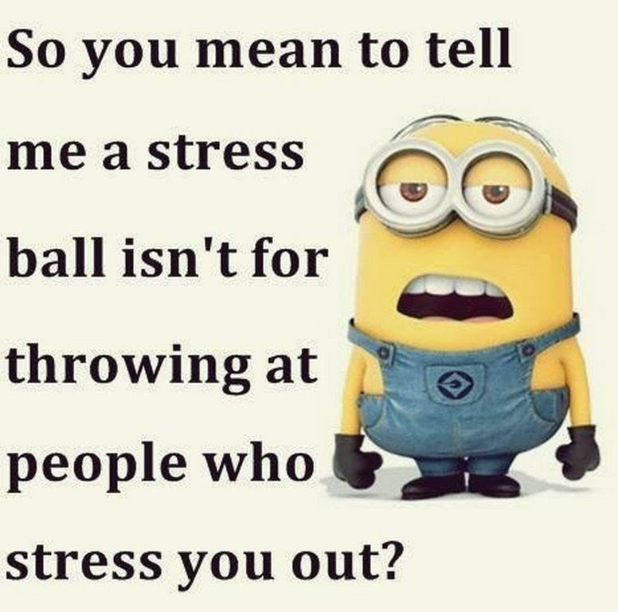
Stress
Notes:
EJ We have discussed mental wellbeing and what we can do to build resilience in our children and young people. We are going to move on now to look at stress and the impact it has on our children and young people. And of course ourselves We will discuss how to spot the signs and crucially what we can do about it.

Slide 22
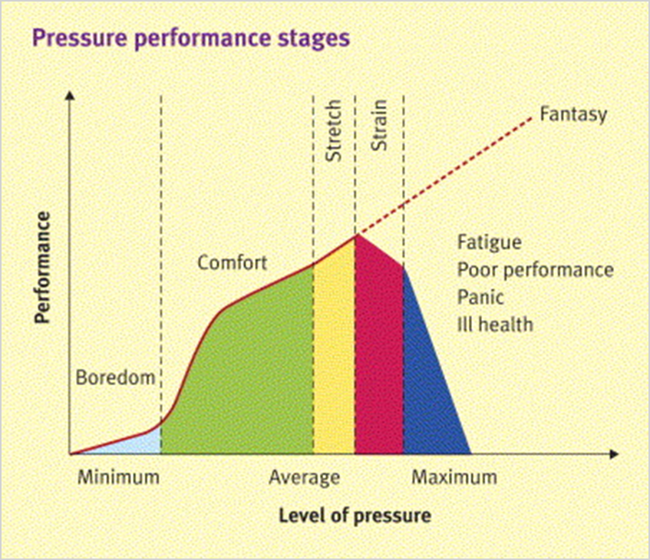

Activity - Stress Awareness
Notes:
EJWhat is stress? Stress is something everyone feels at times, and there are all kinds of stressful situations that can be a part of daily life. Low-level stress can even be helpful or motivational.
There are plenty of things you can do to help cope with stressful events, and simple steps you can take to deal with feelings of stress or burnout.
Stress is the body's reaction to feeling threatened or under pressure. It's very common, can be motivating to help us achieve things in our daily life, and can help us meet the demands of home, work and family life.
But too much stress can affect our mood, our body and our relationships – especially when it feels out of our control. It can make us feel anxious and irritable, and affect our self-esteem.
Experiencing a lot of stress over a long period of time can also lead to a feeling of physical, mental and emotional exhaustion, often called burnout.
EJ - Activity 4 - Human Function Curve
The general theory is that as pressure increases so does performance, up to a point where the pressure becomes too great and performance then drops off.
Stress kicks in when the pressure is so great that there are health effects and the person becomes unwell. (Dark blue)
It is important to talk about how we feel regularly so that we can be realistic about what we take on.
Think about where on the curve you are positioned. It’s important to recognise you can move along the curve over time. If you can talk to another course participant about your position
We will look later at ways to manage stress and stressors.

Slide 23
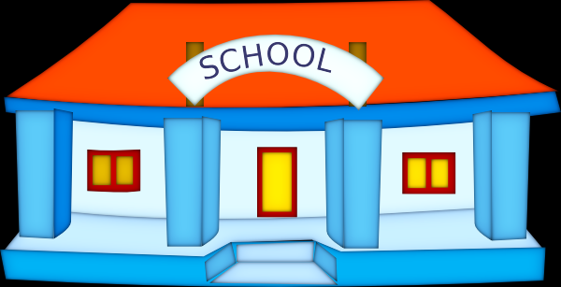
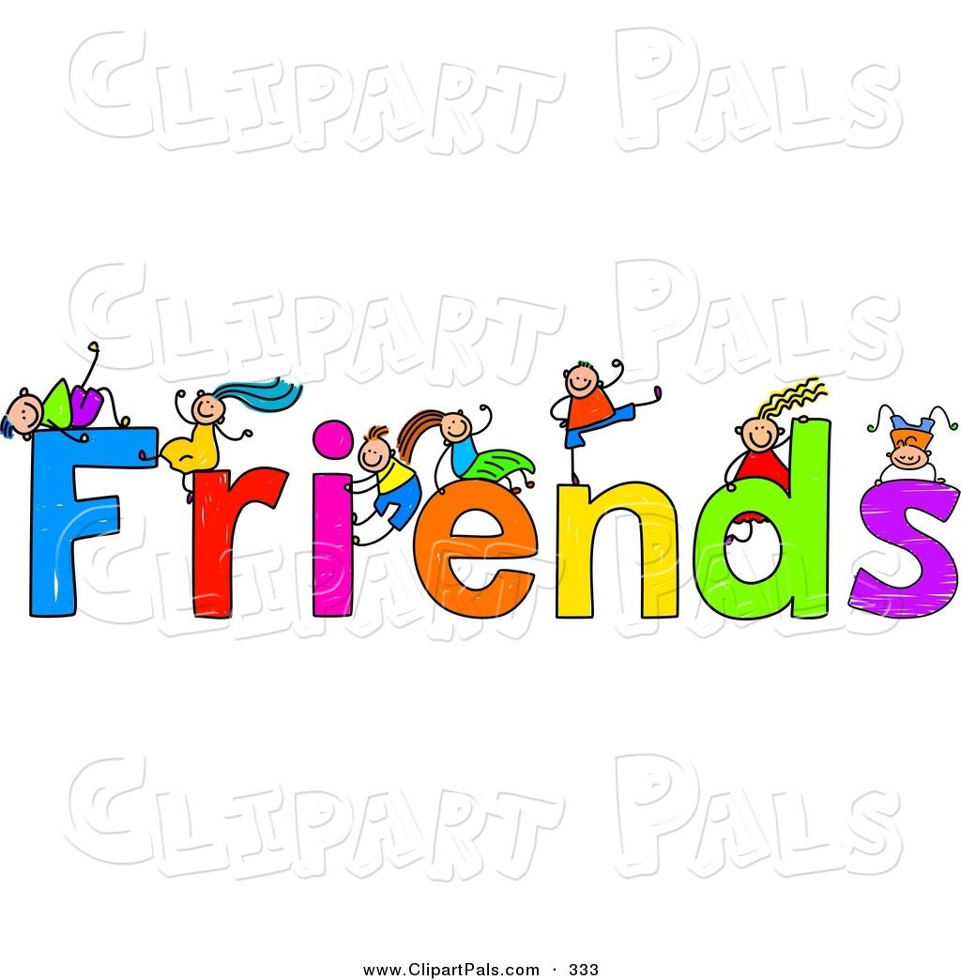
Everyday Stressors…
Everyday Stressors are typical situations and challenges that most children and young people face as they develop. They include changes in routine, social disappointments, changing school or when moving into a new school session. Whether these everyday events are stressful or not will depend in part on the child’s coping skills
Notes:
EJ Everyday Stressors are typical situations and challenges that most children and young people face as they develop. They include changes in routine, friendship issues, changing school or when moving into a new session. Whether these everyday events are stressful or not will depend in part on the child’s coping skills and their home and school environment.
Major stressors on the other hand are significant events like family trauma, bereavement, divorce, parental job loss and it amy be that children and young people will require support to manage these.
Everyday Stressors are to be expected and children ad young people should be able find personal solutions.

Slide 24
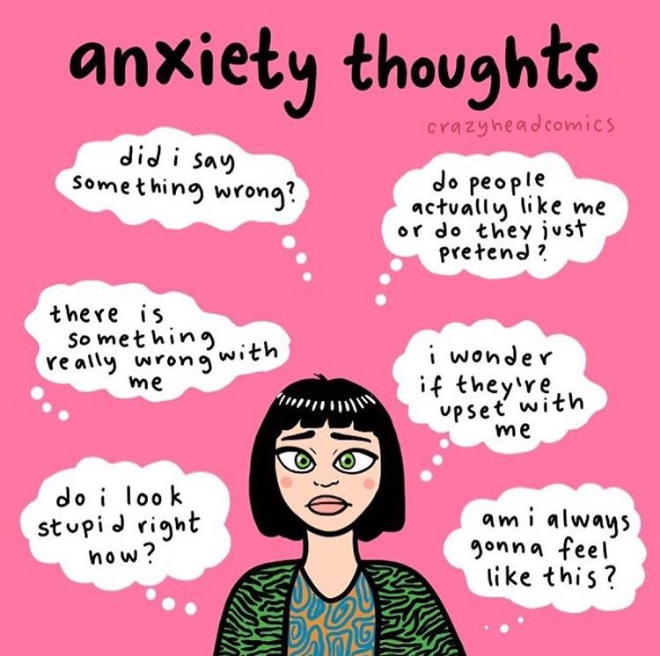
Anxiety
It’s a normal part of growing up
to feel worried sometimes.
However when it goes on for a long
time and interferes with daily life
then it may be time for additional
support.
There's lots we can do to control
our worries.
Notes:
EJ What is anxiety?
Anxiety is a feeling of worry or fear that is experienced as a combination of physical sensations, thoughts and feelings.
All children and young people feel worried sometimes, and this is a normal part of growing up. At certain points, such as on their first day of school or before an exam, young people may become more worried, but will soon be able to calm down and feel better.
Anxiety can become a problem when a young person feels stuck in it, or when it feels like an overwhelming, distressing or unmanageable experience. If this kind of worrying goes on for a long time, it can leave a young person feeling exhausted and isolated, and limit the things they feel able to do.
YoungMinds a respected charity to support positive MHWB in young people have a number of resources and videos available that can help you recognise and support anxiety. In the second part of this presentation Michelle will provide you with ideas and strategies you can use to support your child or young person.

Slide 25

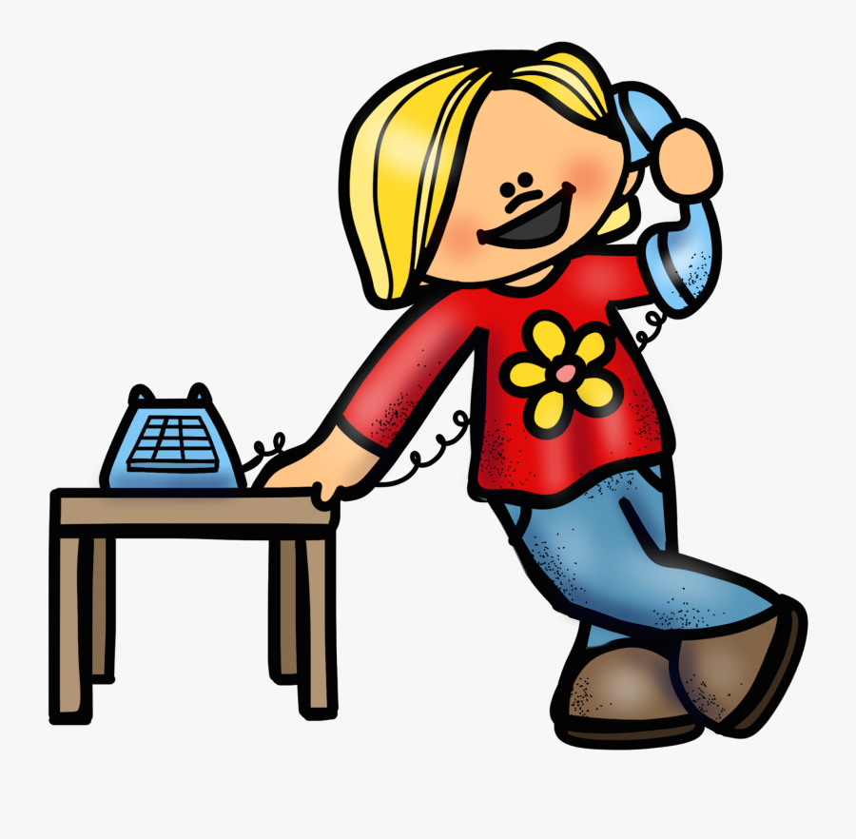
Video…
https://youtu.be/IkncJ0YzlZA
Young Minds have a dedicated parent helpline and host regular webchats. In this episode there is focus on some scenarios a parent or carer may experience with their child and advice on what to do.
Notes:
EJ
Young Minds, also have regular parents' sessions they call the parents' lounge. In this episode which is 19 minutes long the expert answers questions on managing anxiety. Questions like what to look out for, they discuss reasons for school avoidance and ways to help. There are lots of supportive tips.
It discusses ways to help you get over the stigma associated with childhood and anxiety and provides ways to help you talk to school staff. Please click on the speech bubble to follow the link.

Slide 26

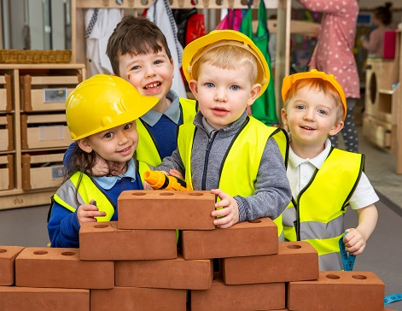
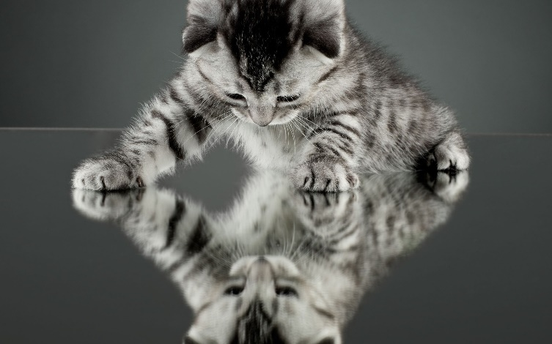
Reflective Activity
ext
Over the course of the next few days/week observe:
How you and your family’s days are going.
Notice – if you can – anything that happens
that knocks you off your stride a little or
things that make you feel good.
Notes:
EJHave a think about the reflective activity before moving on to the next stage of the presentation. You may wish to give yourself a few days to think about the material so far before moving on.

