Slide 1
















Welcome to Mayfield primary school
Primary 1 Induction
Friday 6th June 2025

Slide 2


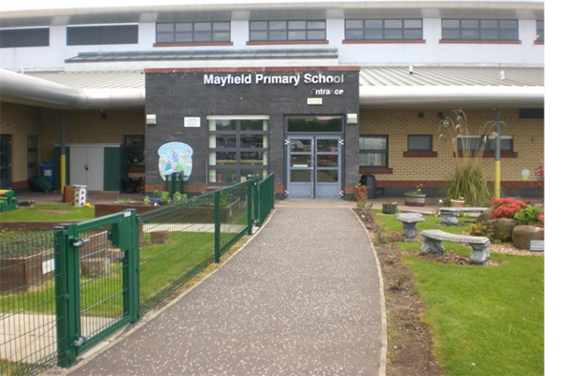

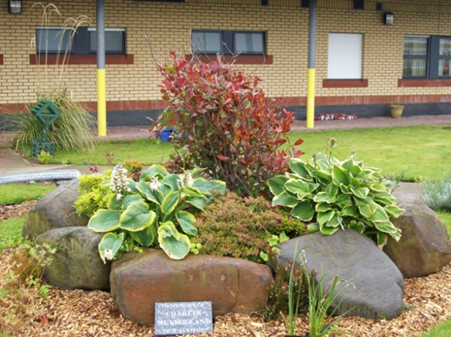



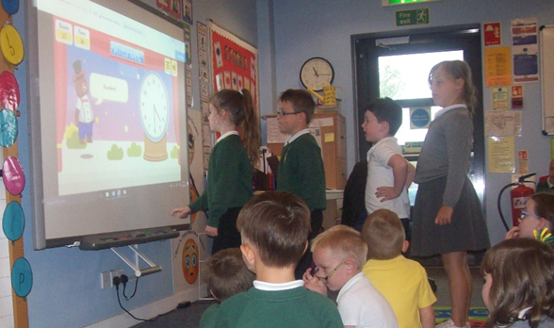
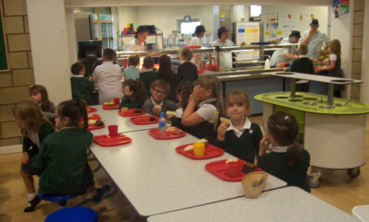

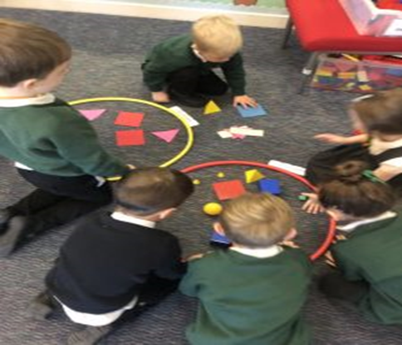

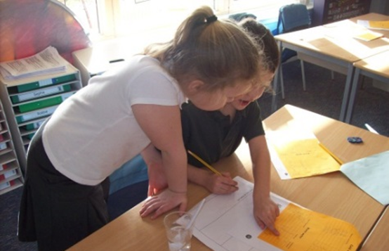
Our projected roll next session will be 198 pupils
+ 24 children
in the Early Years Class

Slide 3






Staffing
Head Teacher – Mr Faulds
Depute Head Teacher – Mrs Hall
Class teachers – 8 classes
Additional teacher to support P1 cohort
Targeted support teachers
School counsellor – Julie Cassidy
Early Years Practitioners
Pupil Support Assistants
Clerical Staff – Mrs Hyslop and *vacancy
Janitor – Mr McMillan
Kitchen staff
Cleaning staff

Slide 4
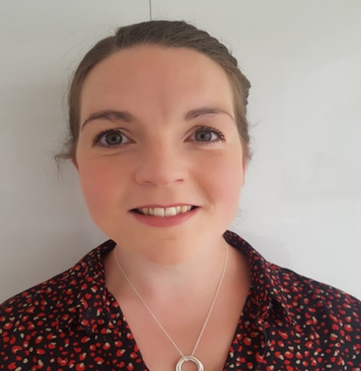
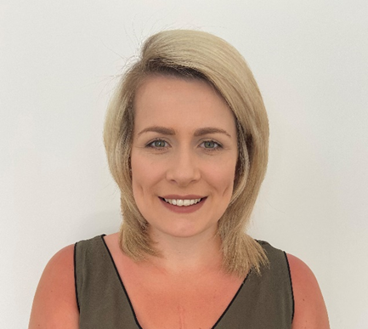
Mrs Muir
Primary 1 Teachers
Mrs Muir works...
Monday – Wednesday
Mrs Anderson works... Wednesday – Friday
Mrs Anderson

Slide 5






The School Day...
Full time from Day 1
Wednesday 20th August
9:05am on first day ONLY
2:45pm pick up for 20th, 21st and 22nd August.
Normal school times 9.00am – 3pm
Informal entry from 8:50am
Break 10.45am – 11am
Lunch 12.30pm - 1.15pm
Finish 3pm

Slide 6



Bringing / Collecting your child
Children can be escorted into the playground through the gates from 8:50am and will enter the school through the cloakroom.
Pupil Support Assistants will be in the playground, cloakroom and class areas to supervise from 8:50am.
At the end of the day, your child’s teacher will bring them into the playground and wait with them until they see the adult who is there to collect them.
9-3pm (8:50am soft start)

Slide 7




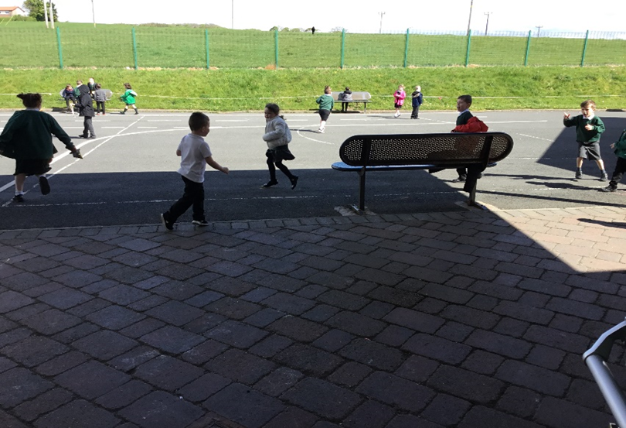
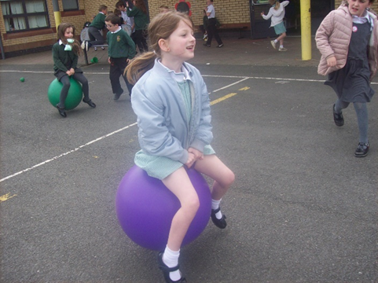


Playground
Your child will eat their snack at Playtime and play in the playground

Slide 8




What your child will need…
FYI:
ALL children will be gifted a Mayfield PS bookbag!
From Day 1...
Water bottle filled with water
Packed lunch, if not having school lunch
Eventually...
Snack for playtime – separate from packed lunch
Gym shoes and shorts (to be kept in school)

Slide 9
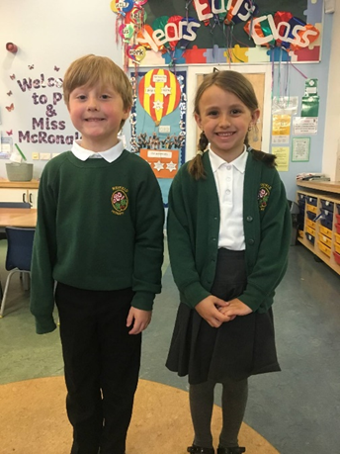
Uniform
Green sweatshirt or cardigan with school badge
White/yellow polo shirt or shirt with school tie
Grey/black skirt or trousers
Black shoes
Shorts and gym shoes (to stay at school)
Discourage jewellery – not allowed at PE
No football tops or colours
LABEL EVERYTHING!!!

Slide 10
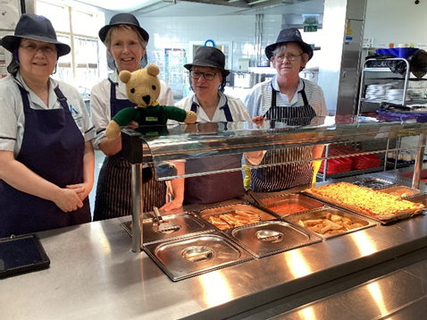
School Lunches...
Hot or Sandwich options – free for all
pupils P1 - P5
Menus available online to help with lunch ordering system
SLT and Pupil Support Assistants on hand to help
All Primary 1 pupils will go into hall 5 minutes earlier than the other children with their buddies
Packed lunches eat in the same hall and at the same time as school lunches

Slide 11


First Day Survival!
Children and Parents should enter the playground between 8:55am and 9:05am
“Welcome New P 1” board will be in playground for parents / Carers to take photographs.
Primary 1 teachers and buddies will collect children from playground at 9:05am and escort them into class.

Slide 12


End of the school day...
Week 1 only = 2:45pm
At 2:45pm, the P1 teacher will bring your child into the playground and wait with them until they see the adult who is there to collect them.
Please stand in a space to allow your child to spot you waving.

Slide 13

Dates for your diary...
Children return... Wednesday 20th August
Meet The Teacher Event...
Friday 22nd August

Slide 14

Mayfield Breakfast Club
Available Monday - Friday
8-8:30am
School Dining Hall
Grab ‘n’ Go Bagels from 8:45am at school gate.
Parents / Carers are required to complete a registration / allergies form on first visit.
No need to book in, just turn up!

Slide 15

Mayfield Out of School Club
Hosted in Mayfield PS but privately owned -cost involved!
Accommodated in dining hall run by Margaret and Nicole.
Children walk from their class, through school to access at the end of the school day.
For more information, call:-
07766 133 816

Slide 16





Absence
Lateness
Inform school before 9.15am on the first day of absence
Pupils should enter by the main office door if running late to allow staff to sign them in.
Communication
Inform school by letter/email. This will be unauthorised.
Being on time is important!
* Inform school
* Collect child
* Sign child out

Slide 17



Communication
Health & Safety
Illness
Accident
Medication

Slide 18

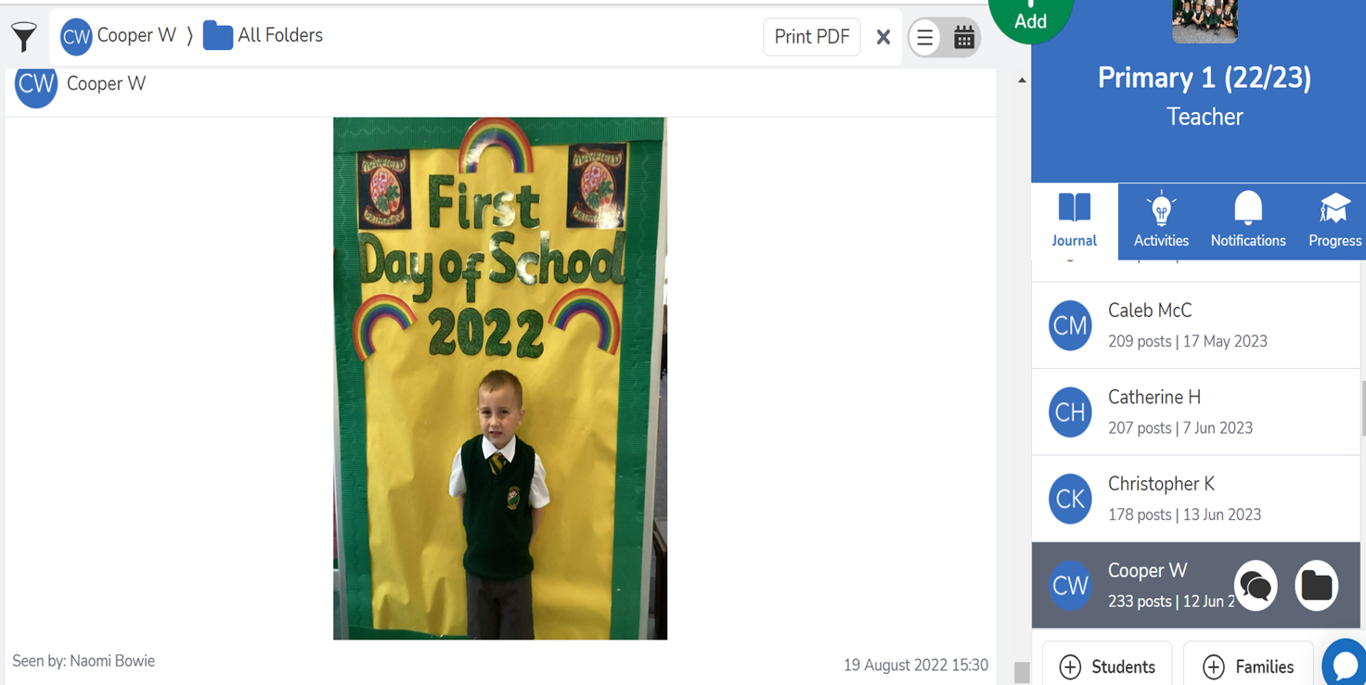
Communication
Seesaw

Slide 19
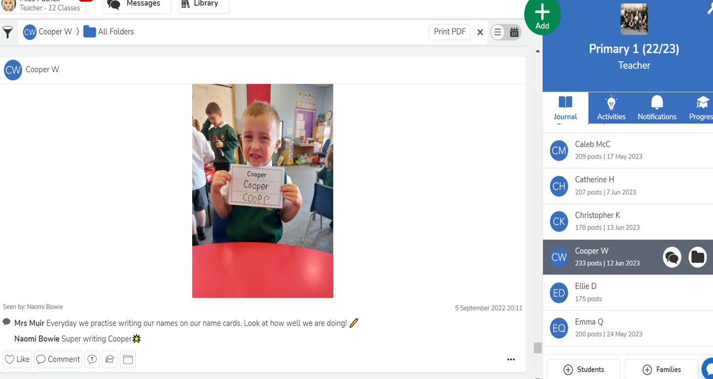
Communication
Seesaw
Invite will be sent home in August to let you sign up.

Slide 20
Working Together
It’s good to talk!! We are available to chat informally and answer any questions at the beginning and end of the day.
If you have a concern about your child or their education, please make an appointment at the school office to speak to the class teacher or a member of the leadership team.
IMPORTANT
For Health and Safety reasons, you must enter through the main door at the front of the school.
Parents should not enter the school building by the playground doors.

Slide 21
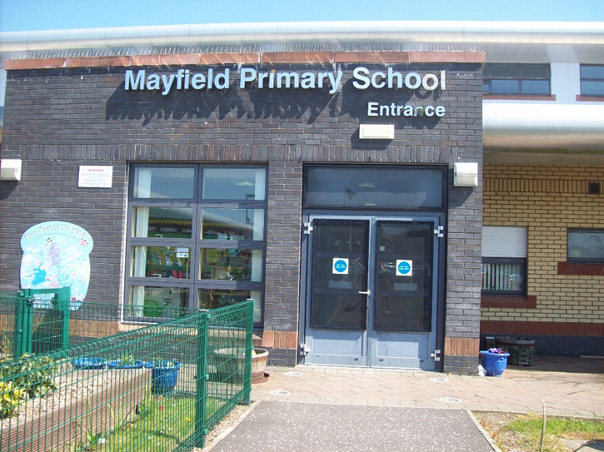
Thank you for attending today and for choosing to send your child to Mayfield Primary School

