Slide 1
How To Stay Safe On The Internet
The Digital Leaders

Slide 2
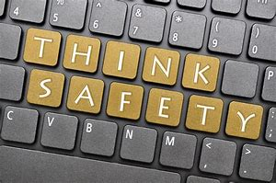
S-SAFE
Keep your personal information safe. When chatting or posting online don’t give away things like your full name, password or home address. Remember personal information can be seen in images and videos you share too. Keep them safe to keep yourself safe.

Slide 3
M-Meet
Meeting with people who you don't know is dangerous.
If anyone you don't know ever asks to meet up with you tell a trusted adult.

Slide 4
A- Accepting
Think carefully before you click on or open something online like links, adverts, friend requests or photos as you never know where they may lead to or they may contain viruses. Do not accept something if you are unsure of who the person is or what they’ve sent you.

Slide 5
R-Reliable
Someone online might lie about who they are. You cannot trust everything you see online as some things can be out of date, inaccurate or not entirely true.
To find reliable information compare at least three different websites, check in books and talk to someone about what you have found.

Slide 6
T-Tell
Tell a trusted adult if something or someone ever makes you feel upset, worried or confused. This could be if you or someone you know is being bullied online. There are lots of people who will be able to help you like a teacher, parent or carer.

