Slide 1
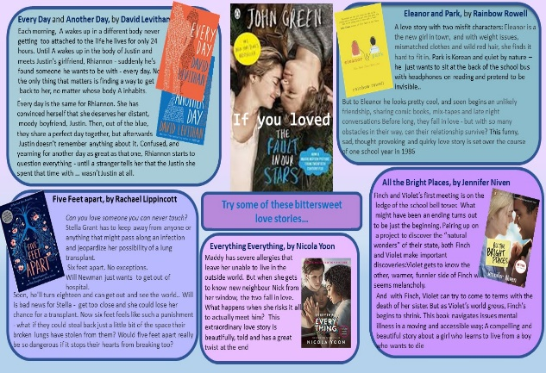
Maddy has severe allergies which mean that she is unable to live in the outside world. She has to live her life being very careful about everything she does. This is a full-time job for her mother too, and for the nurse who is employed to look after Maddy. But ill as she is, Maddy’s just like any other girl, and when she gets to know new neighbour Nick, first from her window, and then online, the two fall in love. Suddenly, Maddy is willing to take risks and perhaps put her life in danger to be with the boy she loves… A beautifully told love story, with a great twist at the end.
Everything, Everything, by Nicola Yoon
What kind of story is this?
A story about romantic relationships; also looks at the impact of serious disease and living an isolated life (particularly relevant for the times we’re living in). The story also looks at themes of domestic abuse and parental control.
Genre/type of book:
real life issues/ relationships
Who would enjoy this story?
Fans of Five feet apart will definitely want to compare the two stories
Additional notes:
a movie of the book was released in 2017
For more books like this:
check the What to Read next page of the Library
website: https://tinyurl.com/1c7c4jub and
the Real Life and Relationships section in the
Campus Library

