Slide 1
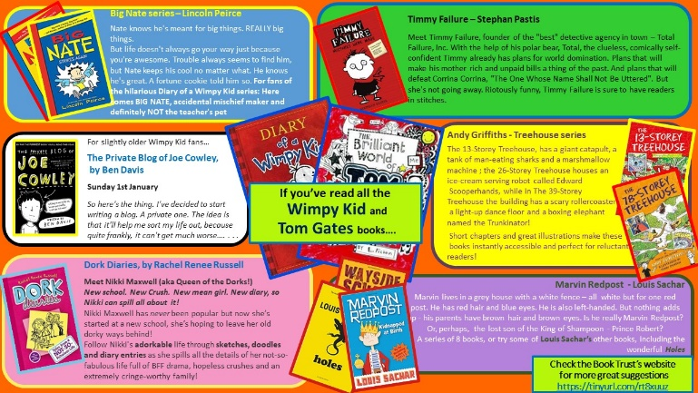
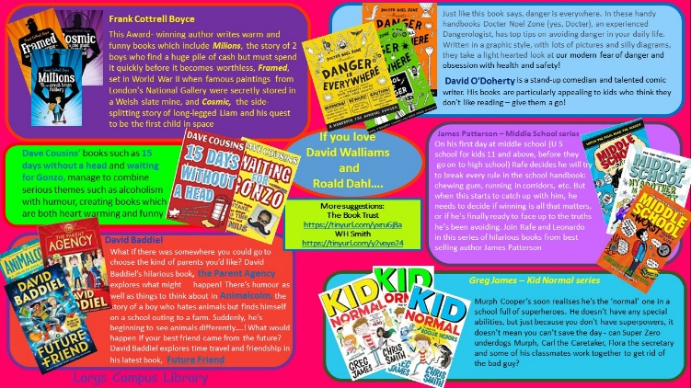
The 13-Storey Treehouse by Andy Griffiths and Terry Denton
Recommended by Ms Gilmour, Largs Academy
Genre/type of book: funny
Who would enjoy this story?
Aimed at primary aged pupils
Additional notes:
If you enjoy this book, check out the others in the series!
For more books like this:
check the What to Read next page on
the Your Next Great Read website:
https://tinyurl.com/1c7c4jub
and the Funny Stories section in the
Campus Library

