Slide 1
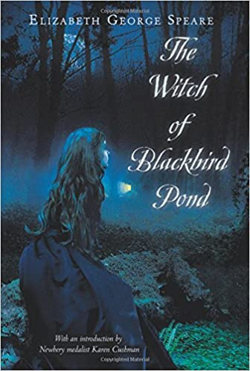
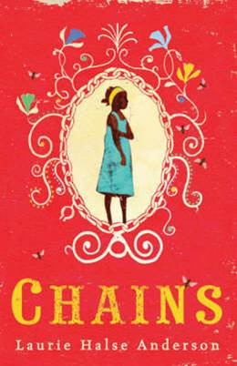
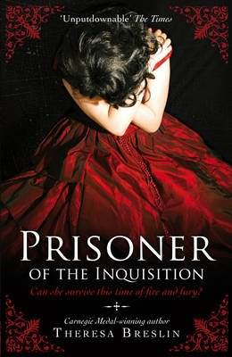
The Witch of Blackbird Pond by Elizabeth George Speare
It's old, but I loved it. Set in America in the late 1600s, and there are not actually any witches in it. The main character's a 15 year old girl but there's a lot of action and I think it would appeal to boys too.
Recommended by Ms Gilmour, Largs Academy
Genre/type of book: historical fiction
Who would enjoy this story?
Aimed at upper primary/ secondary pupils
Additional notes:
If you enjoy this book, and stories set in the past, there are loads of other wonderful titles to discover – here are just a few examples:
For more books like this:
check the Historical Stories section in the Campus Library

