Slide 1
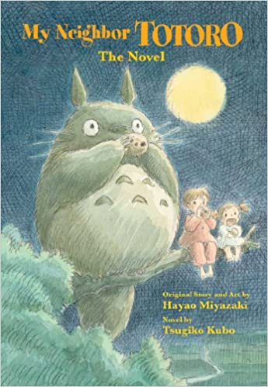
My Neighbour Totoro: original story and art by Hayao Miyazaki, novel by Tsugiko Kubo, translated by Jim Hubbert
Based on the film, which is amazing and everyone should watch it
Recommended by Ms Gilmour, Largs Academy
Genre/type of book: fantasy
Who would enjoy this story?
Aimed at upper primary/ S1/2 pupils
Additional notes:
Publisher’s information
“Eleven-year-old Satsuki and her sassy little sister Mei have moved to the country to be closer to their ailing mother. The girls explore their sprawling old house and the forest and fields that surround it. Soon, Satsuki and Mei discover Totoro, a magical forest spirit who takes them on fantastic adventures through the trees and the clouds - and teaches them a lesson about trusting one another”
Official trailer for the film
https://www.youtube.com/watch?v=upsjMqlDa-A&safe=active

