Slide 1
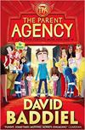
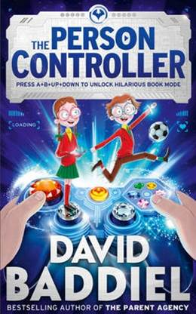
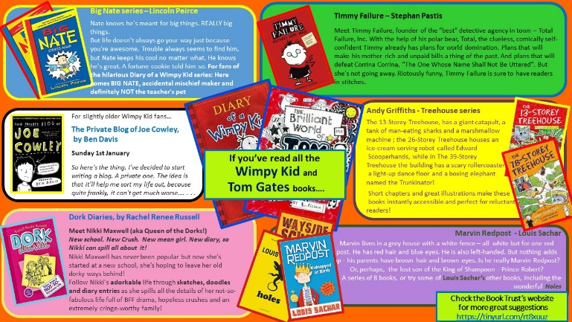
The Parent Agency and The Person Controller by David Baddiel.
Recommended by Ms Gilmour, Largs Academy
Genre/type of book: funny
Who would enjoy this story?
Aimed at upper primary/lower secondary pupils
Additional notes:
If you enjoy this book, check out the others in the series!
For more books like this:
check the What to Read next page of the Library
website: https://tinyurl.com/1c7c4jub and
the Funny Stories section in the
Campus Library

