Slide 1

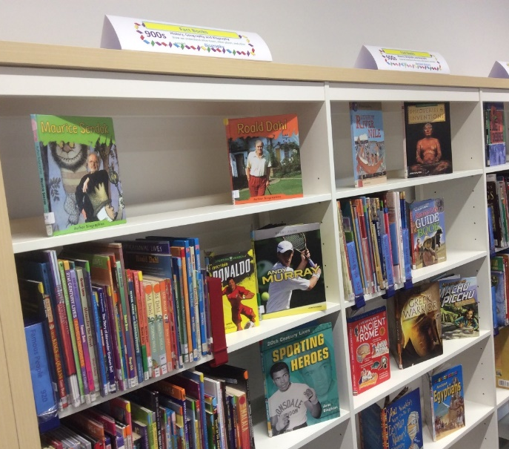
Non Fiction books
How do I find books on a topic that interests me?
Non Fiction books are not arranged in alphabetical order, but by the subject they cover.
This makes more sense, because it means that all the books on one topic are kept together on the shelves.
For example, you would find all the books about Sport in the same section.
To organise Non Fiction books, we use a system call the Dewey Decimal System. To sum up how this system works:
All the Non Fiction books are divided up into 10 main sections
Each section has a different type of books
The sections have numbers : 200s, 500s, and so on
There are signs on the shelves showing which show the kind of books you will find there
Each topic has its own code number – these have at least 3 digits– sometimes they’re longer and might have a decimal point
All the books have labels on the spine showing the code number
You’ll find some examples of code numbers below
745.1
Drawing
590
Animals
940.5
World War Two
391
Fashion
917.2
Mexico

Slide 2
Non Fiction books
The 10 main sections of the Dewey Decimal System
Here is some more information about the kind of books you’ll find in each of the 10 main sections of the Dewey Decimal system
Number | Name | Summing up this section | Examples of topics you’ll find here
000s | General Information | what we know | information on lots of different topics gathered in one book, or set of books (encyclopaedias are a good example); computers
100s | Philosophy and Psychology | what and how we think | the paranormal; do we believe in ghosts? optical illusions
200s | Religion | what we believe | religions of the world; Bible stories; Greek myths
300s | Social Sciences | how we live with others in our society | Education; law; politics; transport; folklore’ fairy tales.
400s | Language | how we communicate with each other | sign languages; dictionaries; books about foreign languages; grammar books
500s | Science | what we know about our world and the universe | science experiments; mathematics; astronomy; chemistry; physics; climate and weather; natural disasters; biology; animals
600s | Technology (Applied Science) | how we use science to make things | anatomy; medicine; cookery; looking after pets
700s | Arts, Music and Sport | how we enjoy our leisure time | art and artists; drawing; crafts; music; sports
800s | Literature | how we express ourselves in writing | poetry; plays; classic literature; authors
900s – | History, Geography, Biography | how we understand other times, other places and other people | atlases; explorers; countries; history; biographies
For a more detailed breakdown of each of the sections, see the information on the next page,

Slide 3
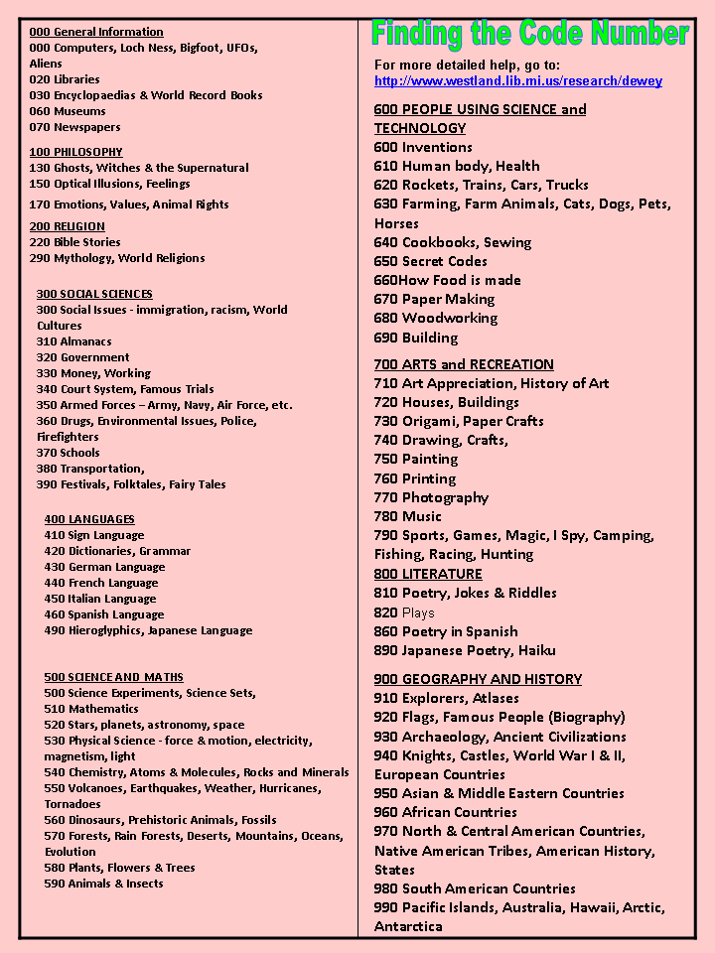
Non Fiction books
The 10 main sections of the Dewey Decimal System
Here is some more information about the kind of books you’ll find in each of the 10 main sections of the Dewey Decimal system

