Slide 1
P7 to S1 Transition Guide
Achievement | Ambition | Respect | Responsibility | Community

Slide 2
Our Vision
Largs Academy provides all young people with the opportunity to work and learn within a respectful and nurturing environment, where achievement is celebrated in class, in school, and within the wider community
We endeavour to change lives and transform the school through inspiring, supporting and challenging young people to take responsibility for their learning, to recognise opportunities and fulfil their ambitions

Slide 3
Our Values
Respect, achievement, community and ambition are the core values we aspire to live by, and aim to demonstrate, in all aspects of school life, on a daily basis

Slide 4
Pastoral Support
Pastoral Support Teachers follow the progress of each pupil, in their house group, from S2 until he or she leaves school. S1 are provided a dedicated Team to ensure specific transitional support in their first year.
They are concerned with each student's personal, curricular and vocational welfare
To speak with your child's Pastoral Support Teacher telephone 01475 687687 and make an appointment

Slide 5
Pupil Support
The Faculty of Pupil Support provides an array of supports for pupils.
We gather and share primary school transition information with subject teachers to help with learning and teaching. Furthermore, we give guidance and support to subject teachers. In addition, we deliver support in class, in small groups or as a whole class.
Should you have any concerns regarding your child’s progress in their learning telephone 01475 687687 and ask to speak to the head of The Faculty of Pupil Support

Slide 6
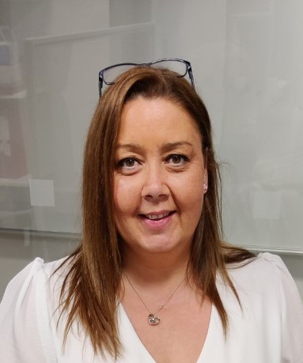
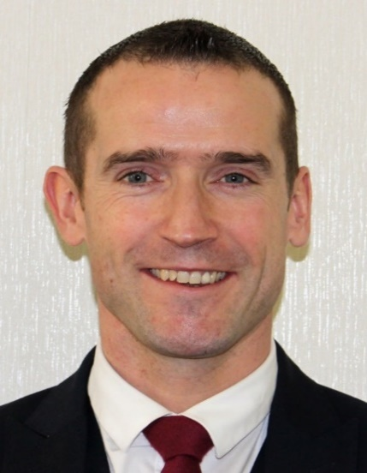
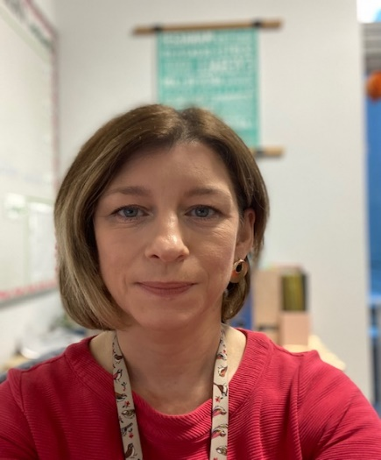
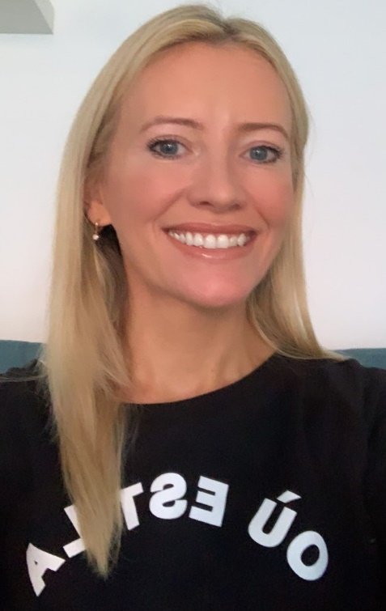
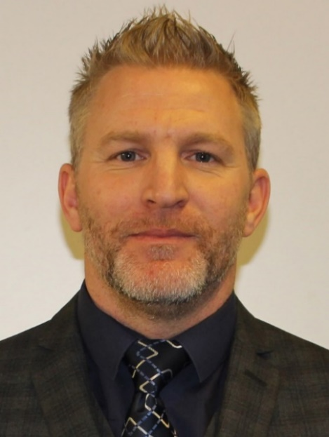
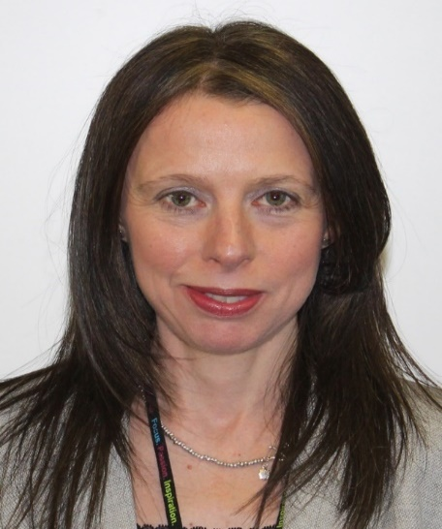
Senior Leadership Team
Mr Doherty
Head Teacher
Mrs McTaggart
Faculty Head Pupil Support
Year Head S1
Mr Wilson
Depute Head Teacher
Year Head S2
Mrs Gilmour
Faculty Head English & Drama
Year Head S3
Miss Gall
Faculty Head Modern Languages & RME
Year Head S4
Mr Frew
Depute Head Teacher
Year Head S5
Mrs McClelland
Depute Head Teacher
Year Head S6

Slide 7
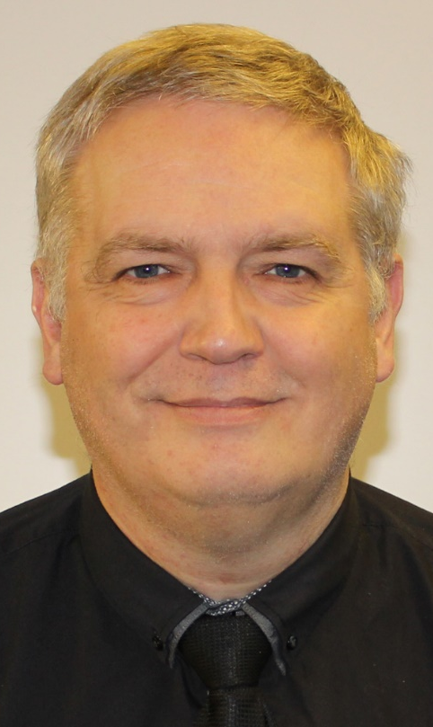
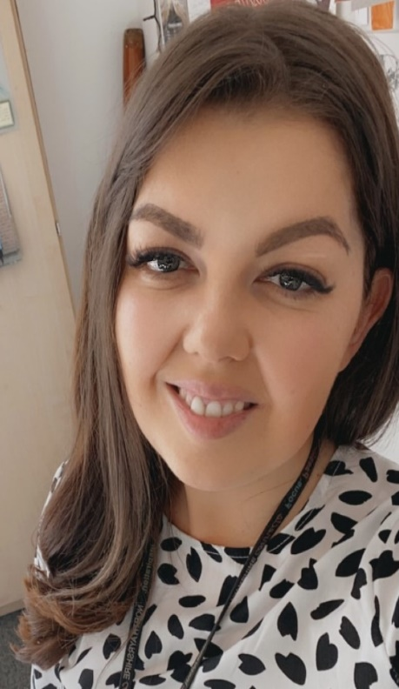
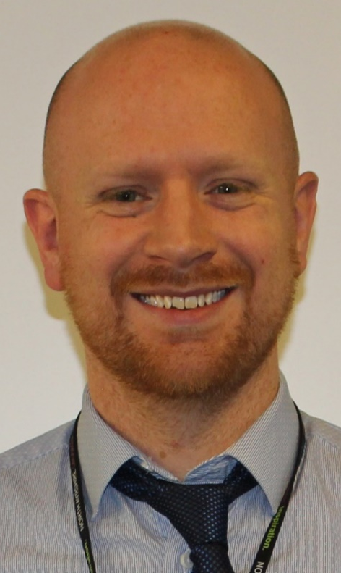
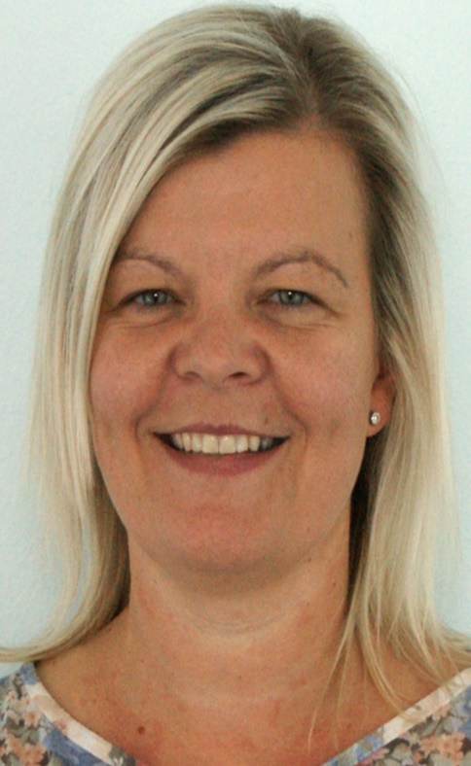
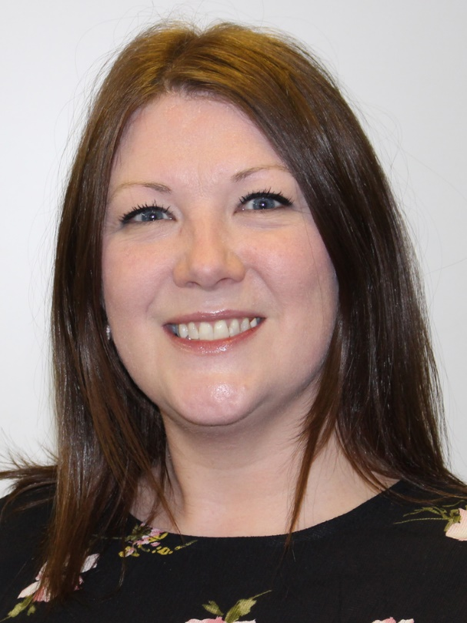
Pastoral Support
Mr Gibson
First Year
Miss Griffiths
Second Year
Mr Sinclair
Third Year
Mr McCoy
Fourth Year
Miss McIlroy
Fifth Year
Miss Furey
Sixth Year

Slide 8
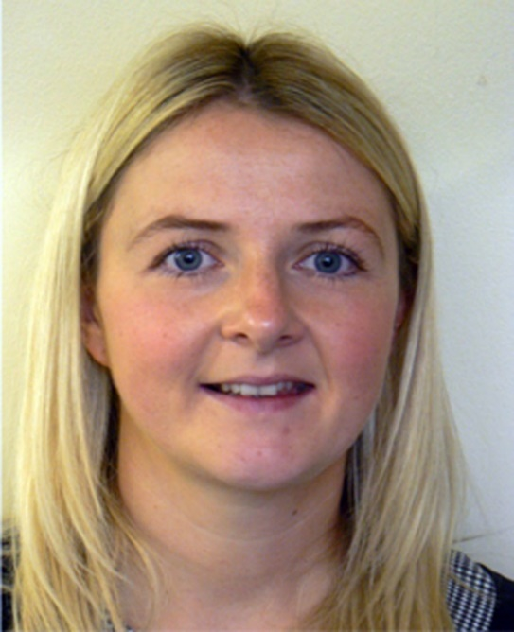
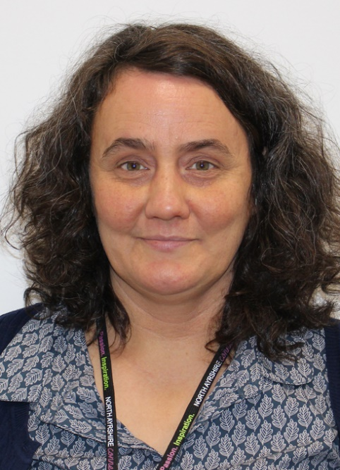
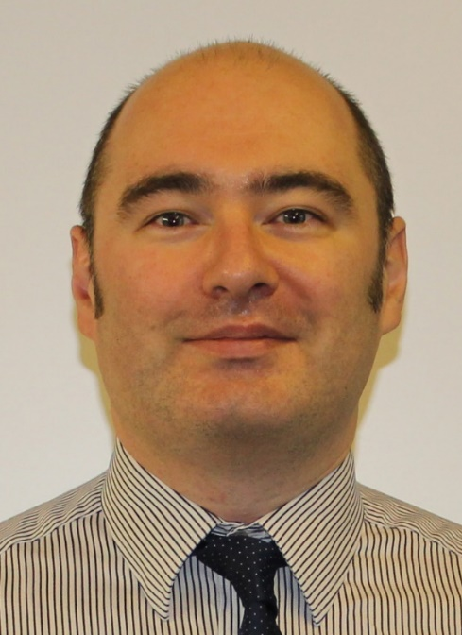
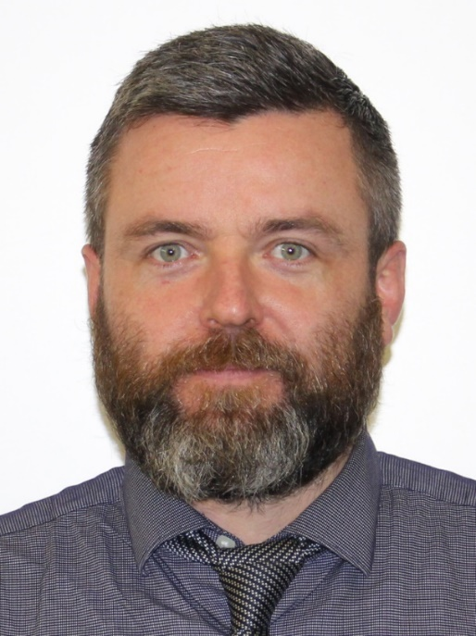
Pupil Support Teachers
Mrs McTaggart
Faculty Leader
Mrs Blair
S1 (M, T, F)
Mrs Guthrie
S1/Nurture (W, Th)
Mr Elliot
S2 & S3
Mr McLean
S4, S5 & S6

Slide 9
Timetable
32 period week
Mondays and Tuesdays 9:00am - 3:55pm
Wednesdays, Thursdays and Fridays 9:00am - 3:05pm
50 minute periods
Morning registration every morning 9:00am – 9:10am

Slide 10
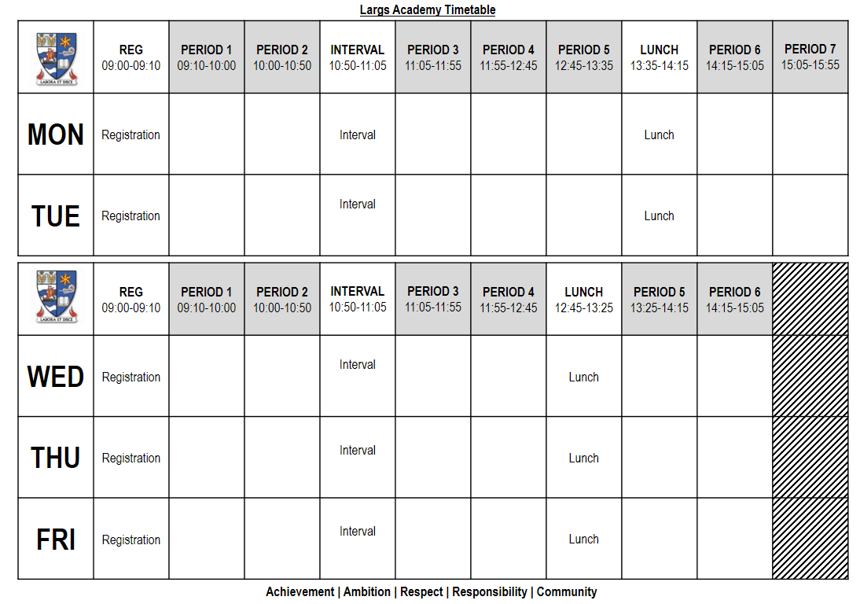

Slide 11
Lunchtime
Pupils use their Young Scot Card to pay for their school meals. The card will be issued to pupils before the start of S1.
Parent Pay allows parents and carers to:
pay for school meals online
see what meals your child has been buying
check your child’s balance
top up at your convenience
Click on the following web link: www.parentpay.com
If online payment is not a suitable option, North Ayrshire Council can issue a PayPoint card - to request a PayPoint card, phone 01294 324759.
Pupils can use machines, located around the school, and their Personal Identification Number (PIN) to 'top up' with cash and view their balance. This PIN can be obtained from your child’s guidance teacher or a member of the catering staff.

Slide 12
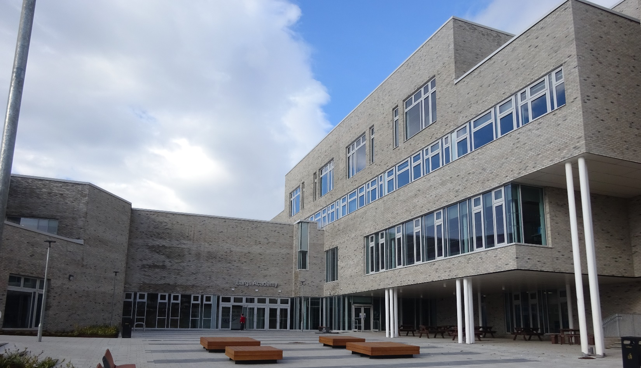
Get to know Largs Academy

Slide 13
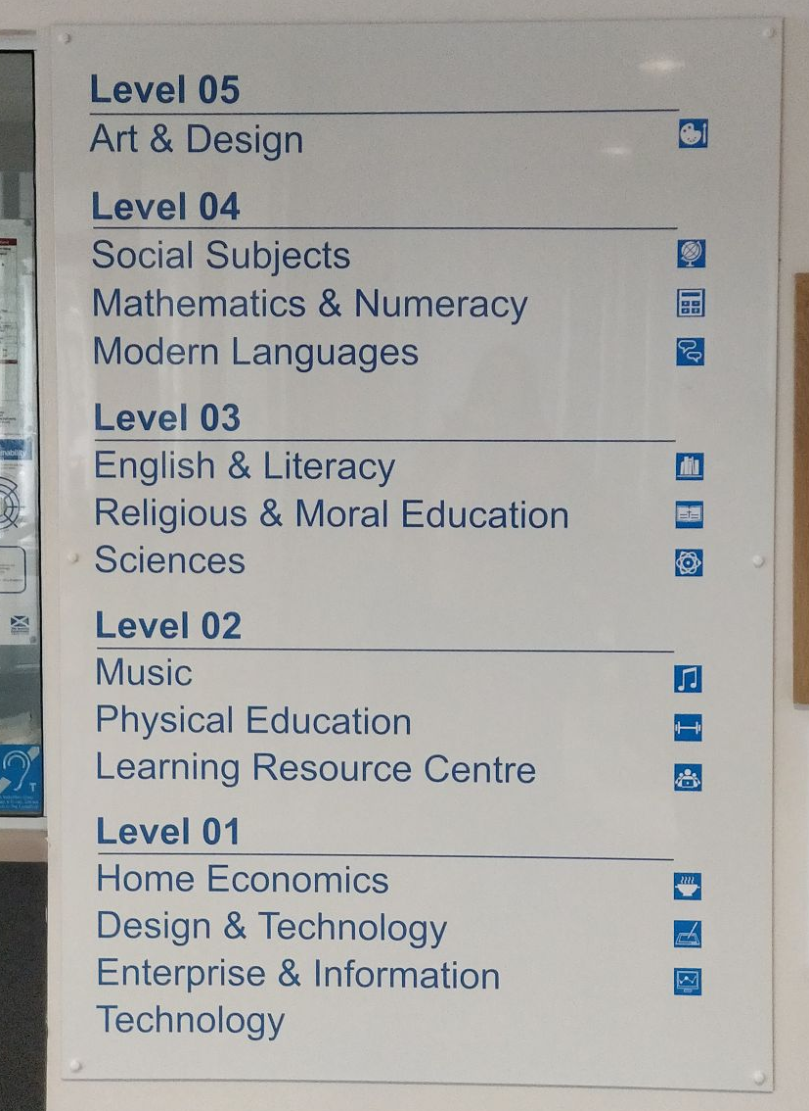
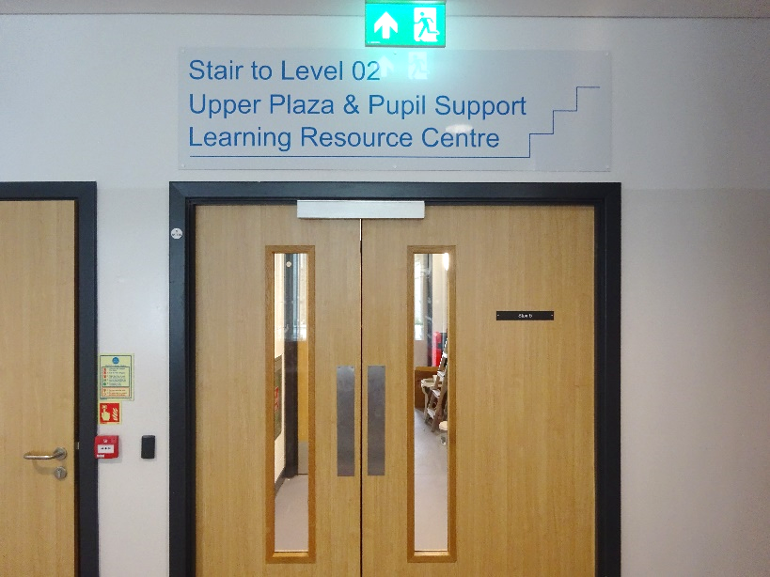
Pupils are advised to look out for signs to help them navigate around the school

Slide 14
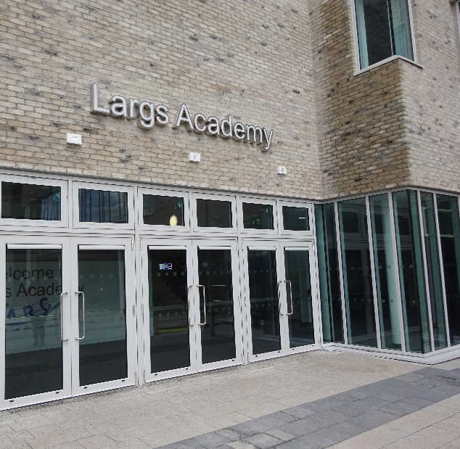
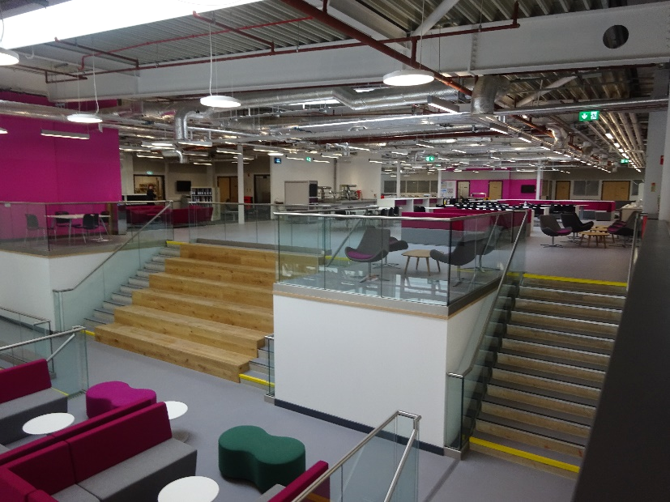
Pupils will enter via the Main Entrance

Slide 15
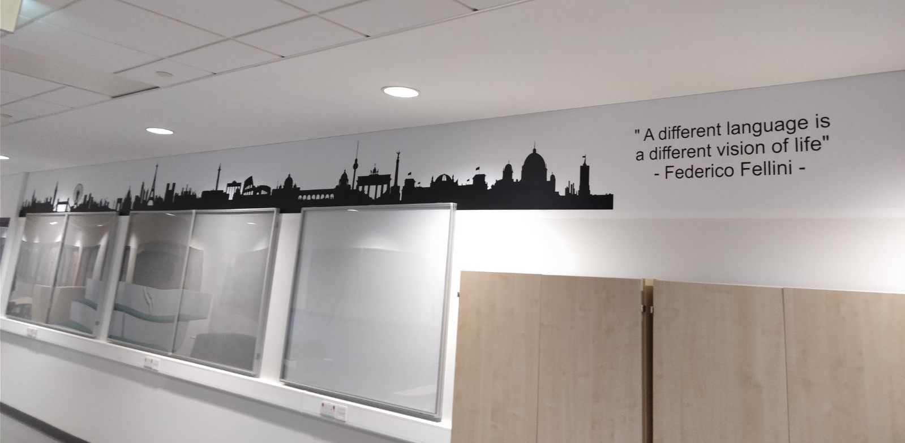
Images and quotes on walls can help pupils recognise what department they are in

Slide 16
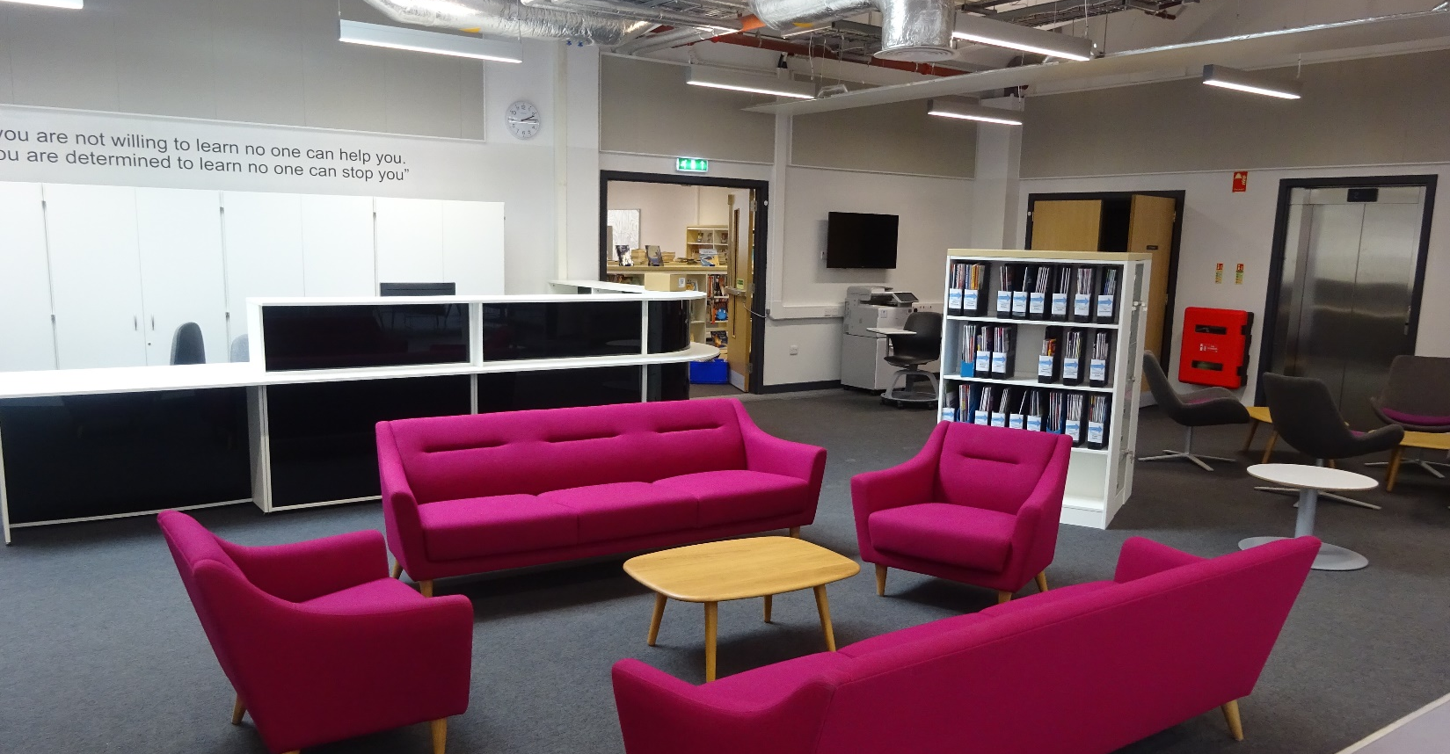
Pupils have the opportunity to use the school library

Slide 17
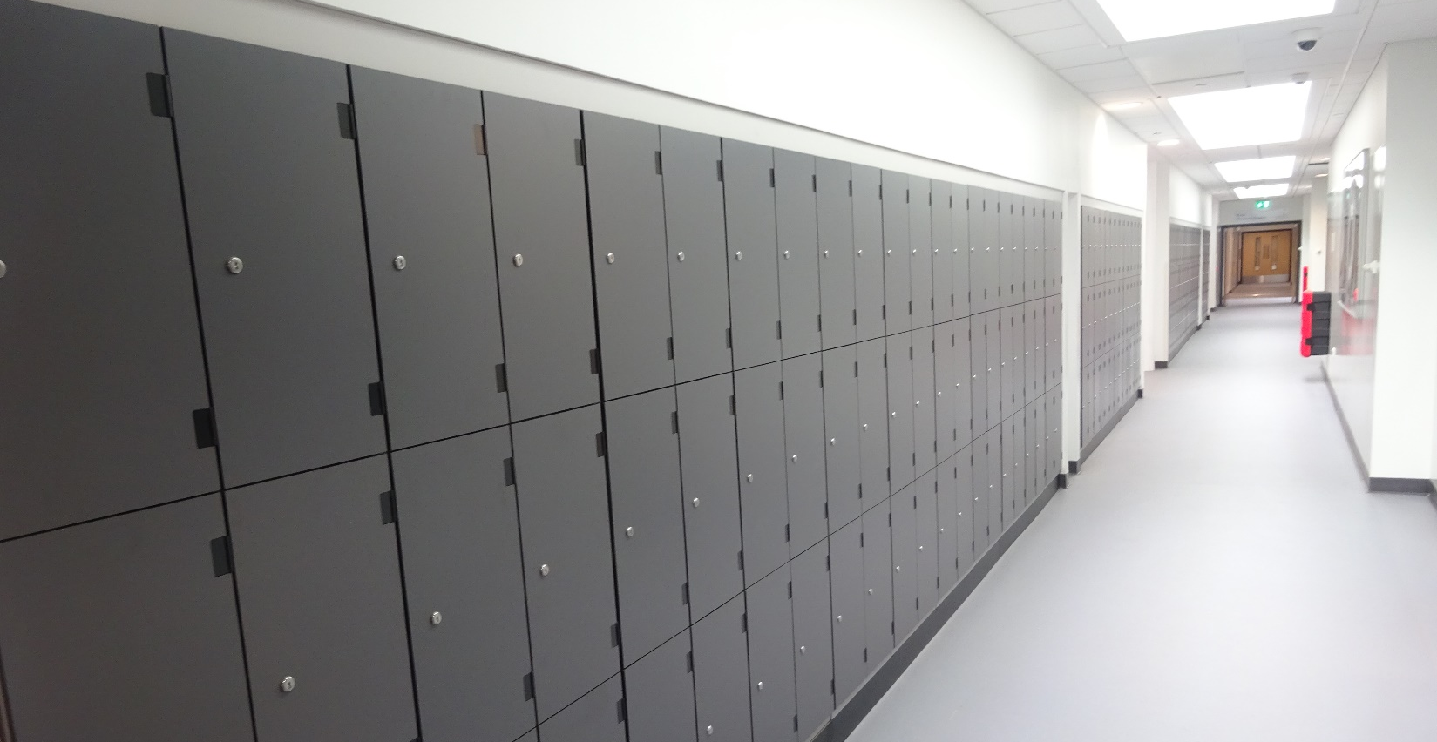
Pupils can rent a locker to store belongings

Slide 18
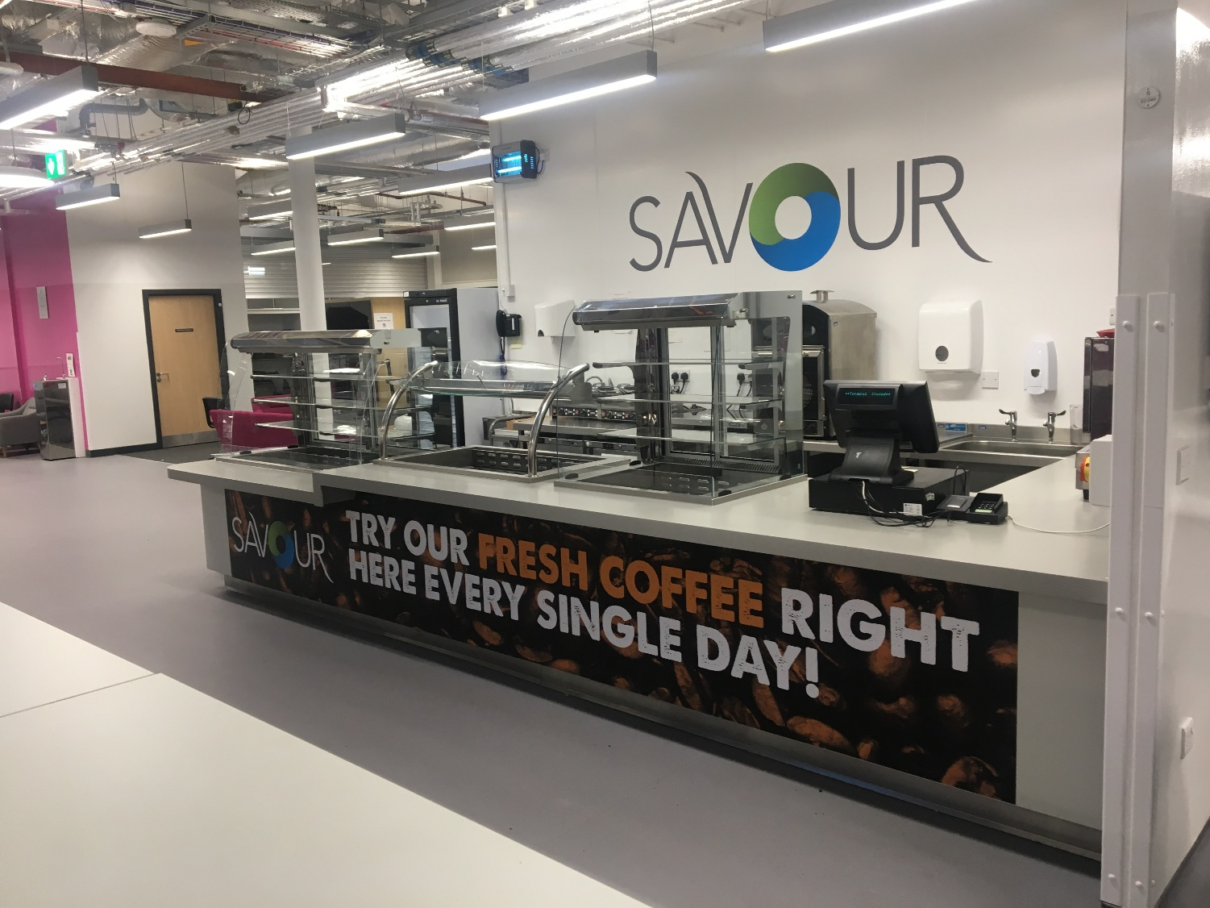
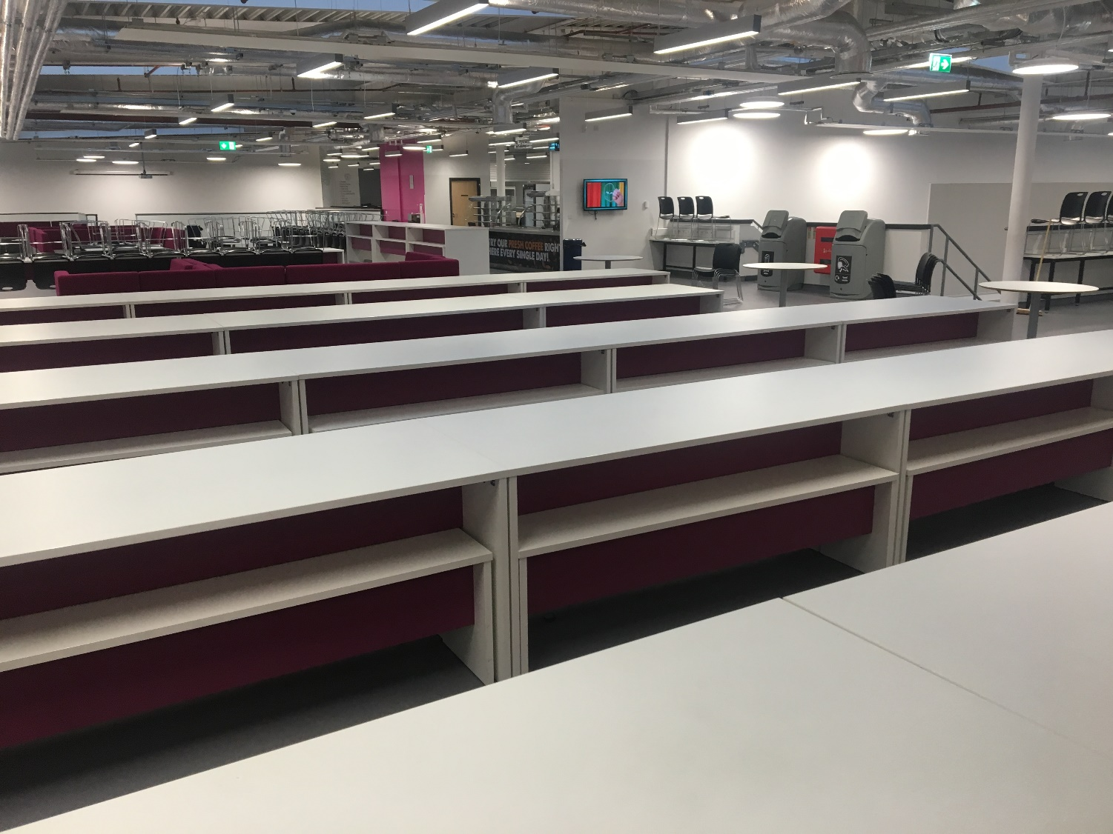
Upper Plaza – Food Serving & Seating Area

Slide 19
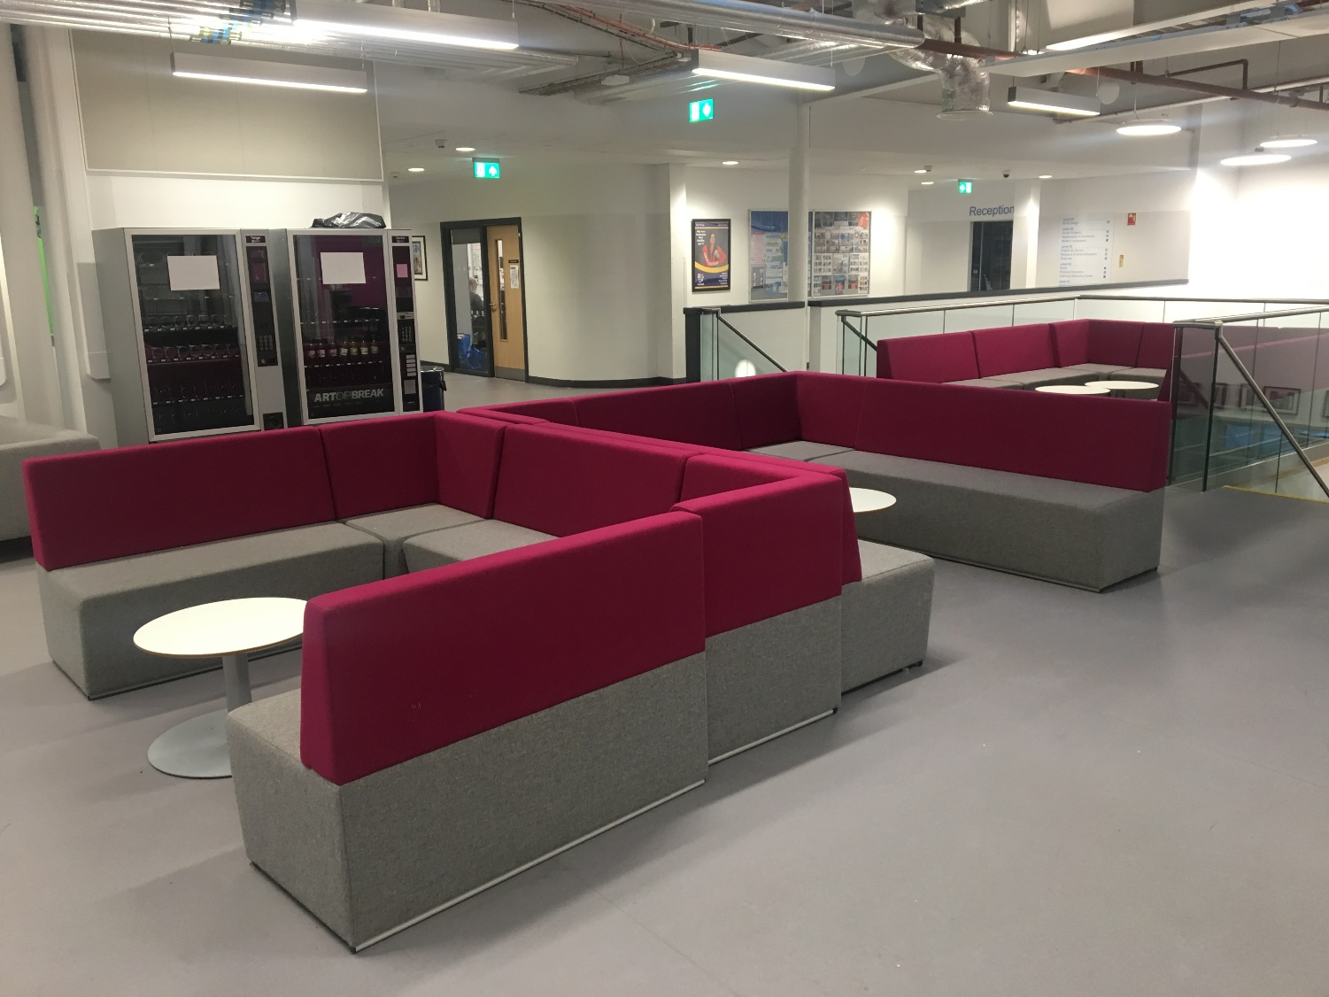
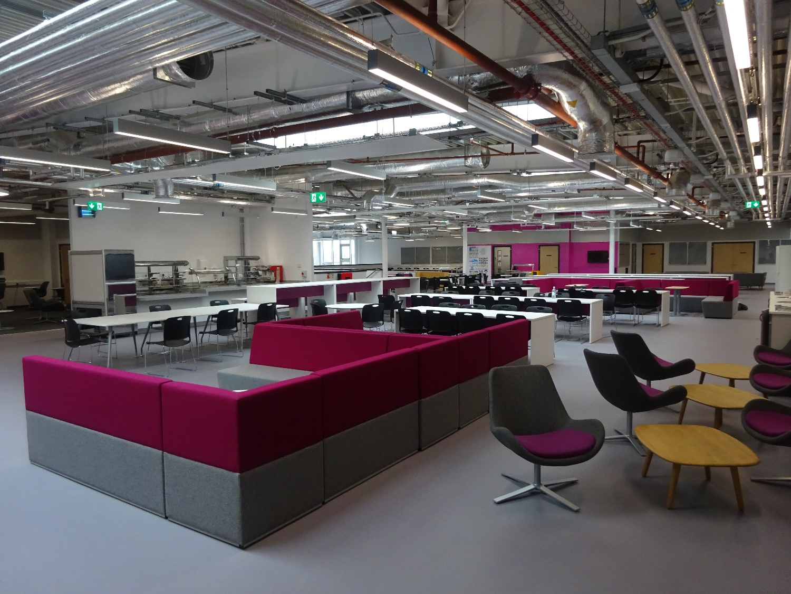
Upper Plaza – Pupil Social Areas

Slide 20
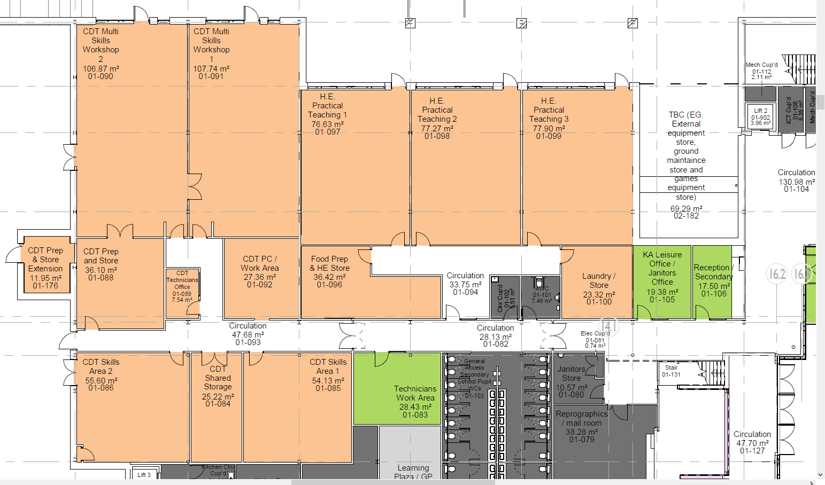
Level 1 - North Block - Home Economics (HE) &
Design and Tech (DT)
The hills
1N.DT
1N.DT
1N.HE3
Mrs
McGowan
1N.HE2
Mrs MacPherson
1N.HE1
CDT Prep
& Store
CDT Prep & Store
CDT PC / Work Area
Food
Prep
& HE Store
Laundry
Store
Jan.
Office
Jan.
Store
Technicians Work Area
CDT
Shared
Storage
1N.DT
1N.DT
Pupil
WCs
Reprographics / Mail Room
N
The sea

Slide 21
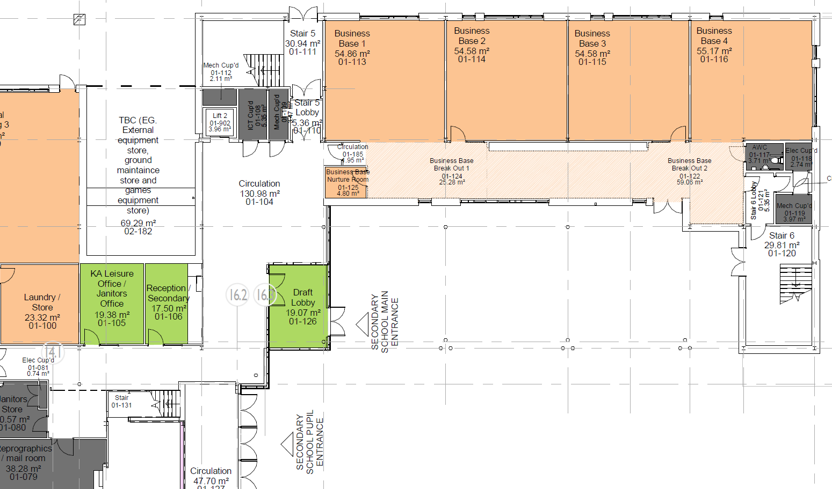
Level 1 - South Block - Business and Computing (IT)
The hills
South
UP Stair 5
1S.IT1
Miss
MacLean
1S.IT2
Mrs
Moran
1S.IT3
Miss
Newell
1S.IT4
Mrs
Denim
Laundry
Store
Jan.
Office
South
DOWN Stair 6
N
The sea

Slide 22
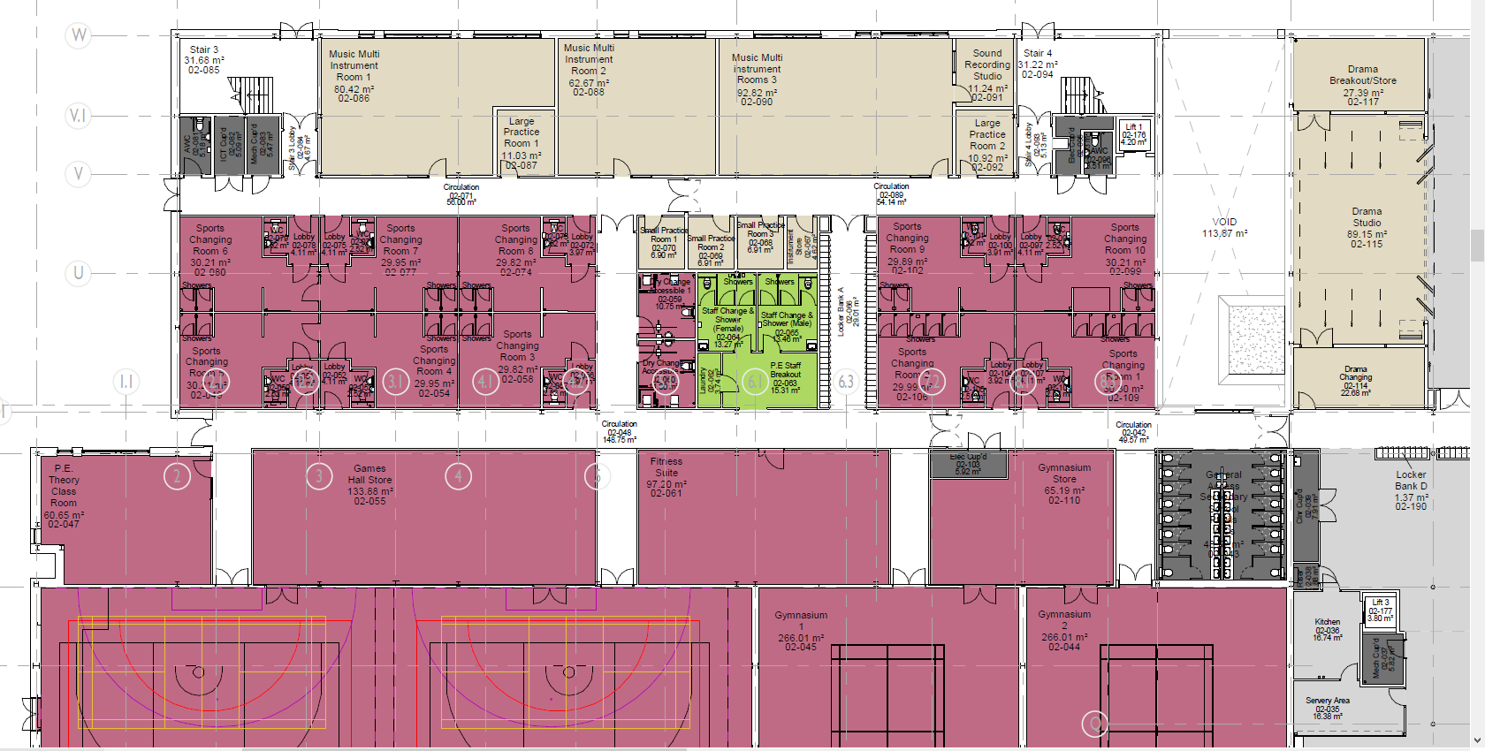
Level 2 - North Block – Music (Mu) & Physical Education (PE)
The hills
2N.Mu1
Miss McCarron/Miss McGregor
2N.Mu3
Mr Smith (FL)
Drama
Breakout
2N.Mu2
North
UP Stair 4
North
DOWN Stair 3
Drama
Studio
Sports Changing
Sports Changing
Drama
Changing
P.E. Theory
Class Room
Games Hall Store
Fitness Suite
Gymnasium Store
PupilWCs
Games Hall
Gymnasium 1
Gymnasium 2
N
The sea

Slide 23
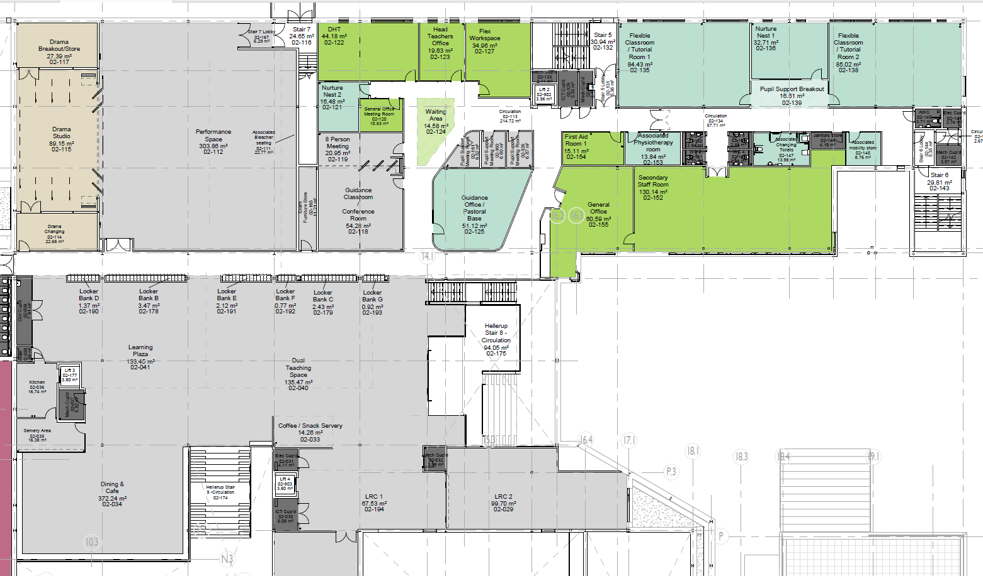
Level 2 - South Block - Drama, Pupil Support, Pastoral Support,
Head Teachers, Learning Resource Centre & General Office
The hills
South
UP Stair 5
Drama
Breakout
DHT
HT
Pupil Support 1
Pupil Support 2
Pupil Support 3
Drama
Studio
Performance Space
Guidance Classroom
Pastoral Base
General
Office
Secondary Staff Room
Drama
Changing
South
DOWN Stair 6
Dining & Cafe
Learning Resource Centre 1
Learning Resource Centre 2
N
The sea

Slide 24
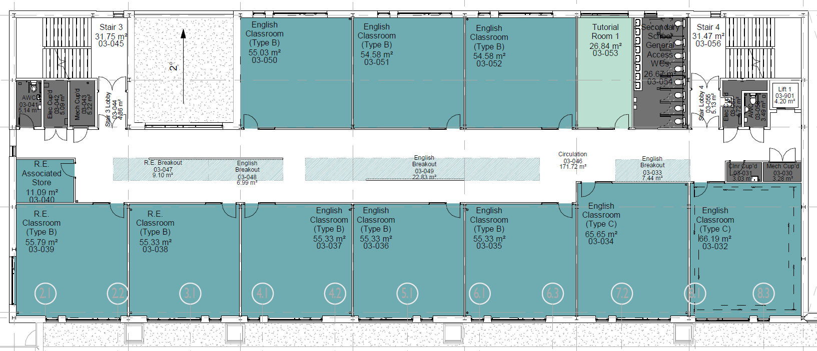
Level 3 - North Block – English (E)
The hills
North
DOWN Stair 3
North
UP Stair 4
3N.E1
Miss McKelvie
3N.E2
Mr McDaid
3N.E3
Mrs Newton
Tutorial
Room
1
Pupil WCs
RE
Store
RE Classroom
RE Classroom
3N.E8
Mr Halliday
3N.E7
Mrs Griffiths
3N.E6
Ms Cook
3N.E5
Mrs Gilmour (FL)
3N.E4
Mrs Clark
N
The sea

Slide 25
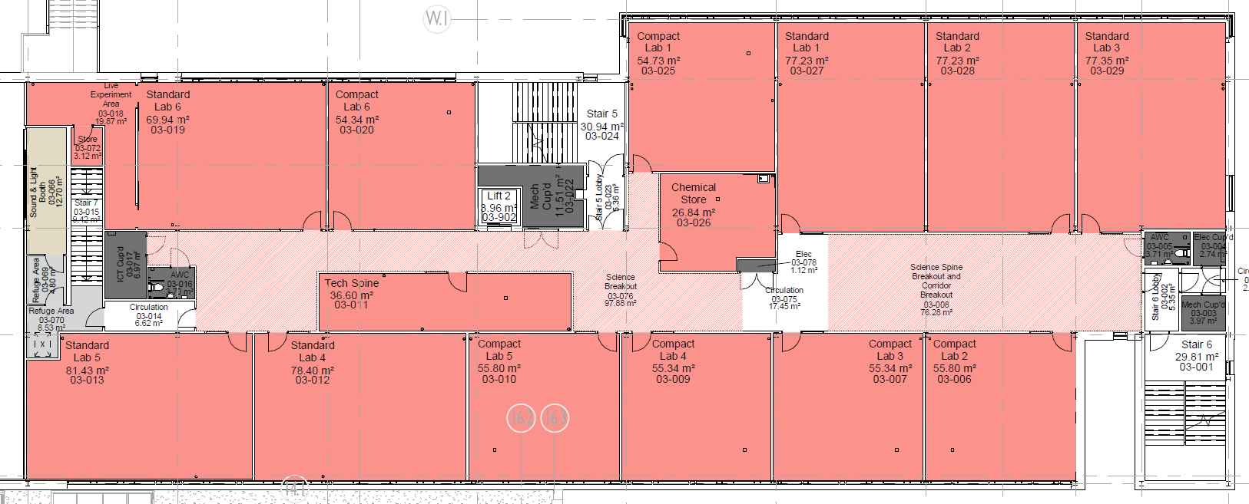
Level 3 - South Block – Science (Sc)
The hills
South
UP Stair 5
3S.Sc3
Mrs Scott (FL)
3S.Sc4
Mrs Mazzoni/ Mr Roser
3S.Sc5
Mrs Duff
3S.Sc6
Mr Leishman
3S.Sc1
Mrs Campbell
3S.Sc2
Mr Usher
Chemical
Store
Tech Spine
3S.Sc12
Mr Trainer
3S.Sc11
Mr Higgins
3S.Sc10
Mrs Cozens
3S.Sc9
Dr Mitchell
3S.Sc8
Miss Furey
3S.Sc7
Dr Caldwell
South
DOWN Stair 6
N
The sea

Slide 26
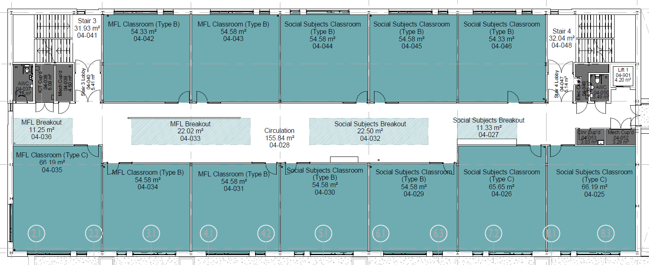
Level 4 - North Block - Social Subjects (SS), Modern Languages (ML) &
Religious and Moral Education (RME)
The hills
North
DOWN Stair 3
North
UP Stair 4
4N.ML4
Miss Kerr
4N.ML5
Mrs Paterson
4N.SS1
Mrs Scott (FL)
4N.SS2
Miss Griffiths
4N.SS3
Mr Atkinson
4N.ML3
Miss Gall (FL)
4N.ML2
Mr McFadyen
4N.ML1
Mrs Tait
4N.SS7
Mr Martin
4N.SS6
Miss Stewart
4N.SS5
Mrs Booth
4N.SS4
Mr Lindsay
N
The sea

Slide 27
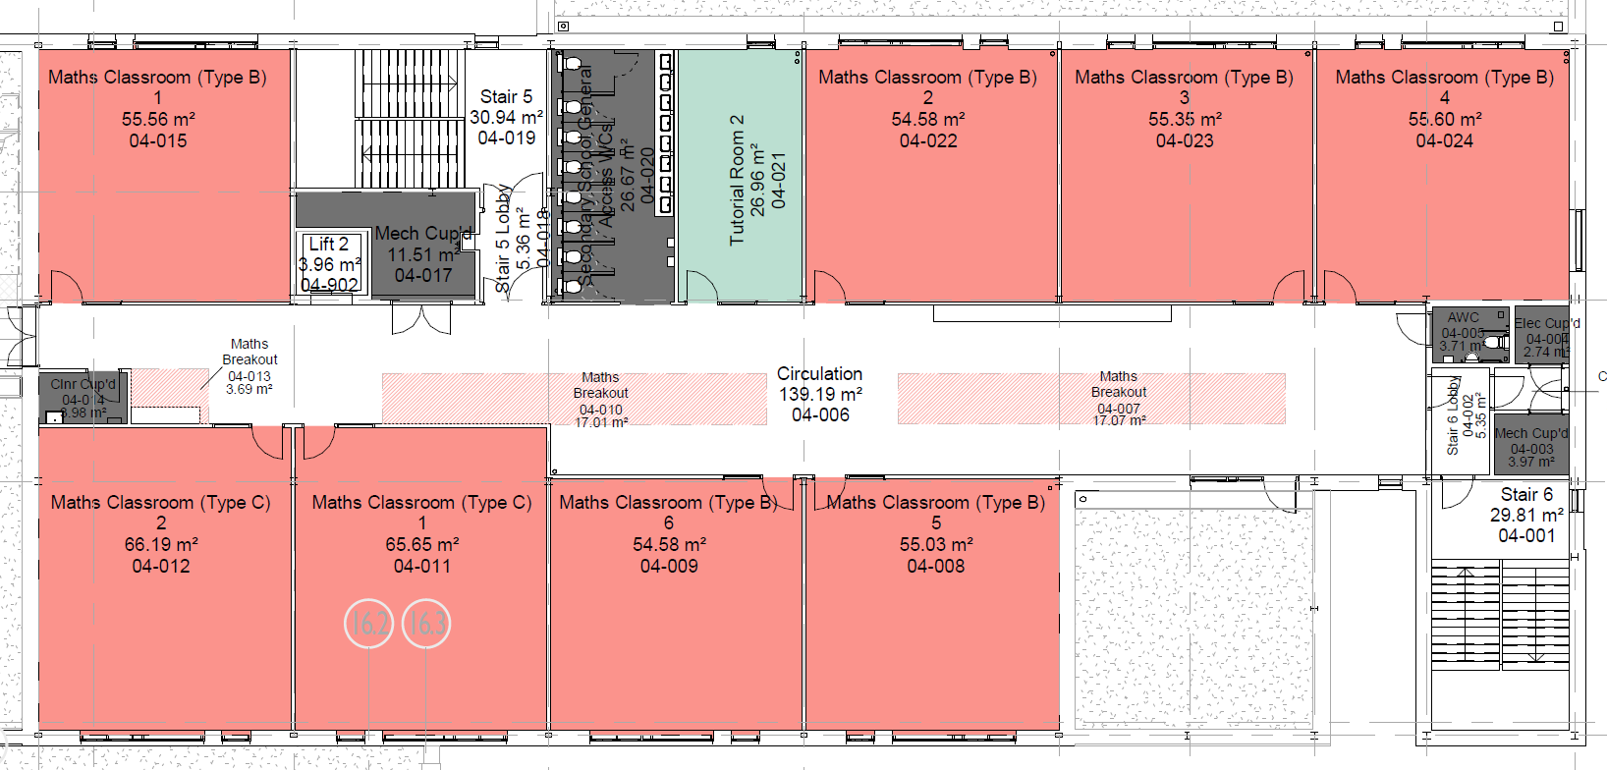
Level 4 - South Block – Maths (M)
The hills
South
UP Stair 5
PupilWCs
Tutorial
Room
2
4S.M2
Mrs Galbraith
4S.M3
Mrs Lunday
4S.M4
Mrs O’Connor
4S.M1
4S.M8
Mr McLean
4S.M7
Mr Stevenson
4S.M6
Mr Blair
(FL)
4S.M5
Mr Alexander
South
DOWN Stair 6
N
The sea

Slide 28
The hills
Level 5 - North Block Art & Design (A)
North
DOWN Stair 3
North
UP Stair 4
Art Break Out Space
5N.A1
Miss Shaw
5N.A2
Mrs Simpson
Art Sixth
Year Area
5N.A3
Miss Jarvis
5N.A4
Mrs Watson
Art Kiln
Room
N
The sea

Slide 29
Achievement | Ambition | Respect | Responsibility | Community
Follow Us
T: 01475.687.687 | W: http://www.largs.n-ayrshire.sch.uk/ |A: Largs Academy, Largs Campus, Alexander Avenue, Largs, KA30 9DR

