Slide 1
Pastoral Support

Slide 2
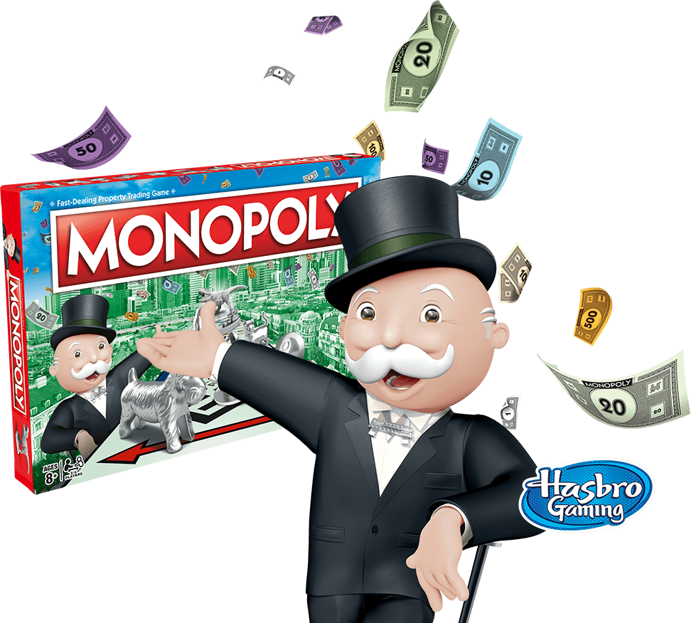
ROUND 1.
(6 marks)
1. Which colour is Oxford Street in the board game Monopoly?
Pastoral Support
(1)
GENERAL
KNOWLEDGE

Slide 3
ROUND 1.
2. Can you name the logos below in regards to who they belong to?
(4)
Pastoral Support
GENERAL
KNOWLEDGE

Slide 4
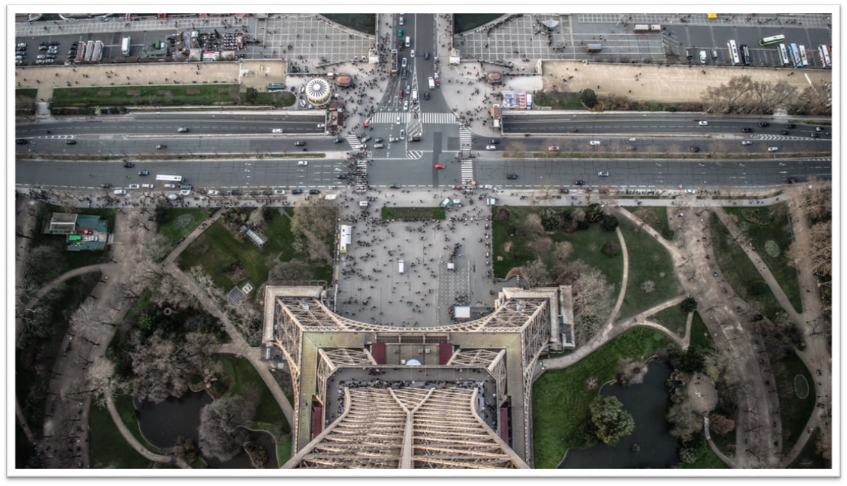
ROUND 1.
3. This is an aerial view from which famous landmark?
(1)
Pastoral Support
GENERAL
KNOWLEDGE

Slide 5
ROUND 2.
(10 marks)
TV &
MOVIES

Slide 6
ROUND 2.
1) Can you tell me the 3 characters from their silhouettes?
3

Slide 7
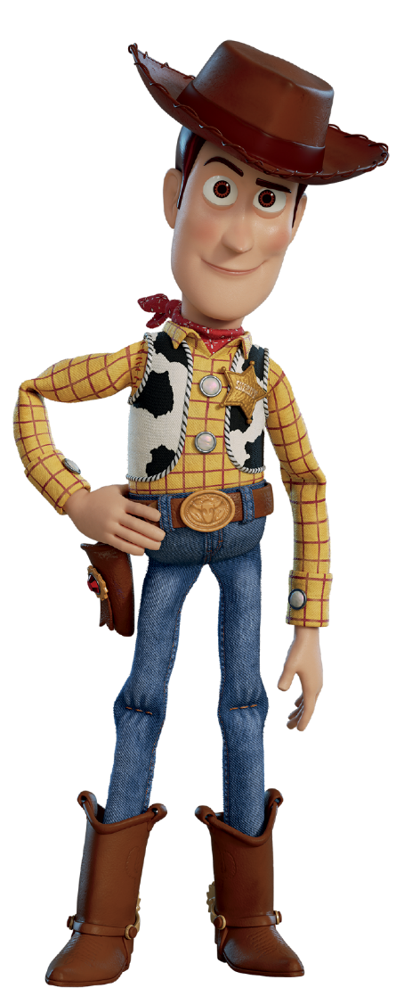
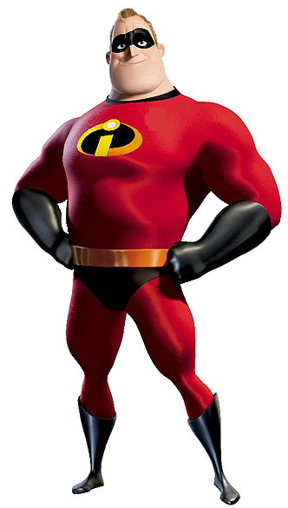
ROUND 2.
x
+
2) Sum: Number of (Toy Story Movies x The Incredibles Movies) + Harry Potter Books= ?
1

Slide 8
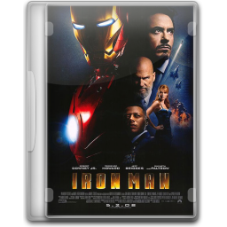
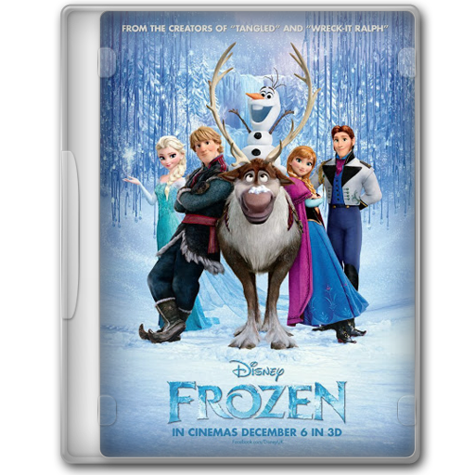
ROUND 2.
3) Which 3 films are the guidance team starring in above?
3

Slide 9
ROUND 2.
4) Which 3 actors make up the face shown?
3

Slide 10
ROUND 3.
(3 marks)
GEOGRAPHY

Slide 11
ROUND 3.
1) Which 2 countries flags have been combined here to create 1 flag?
2

Slide 12
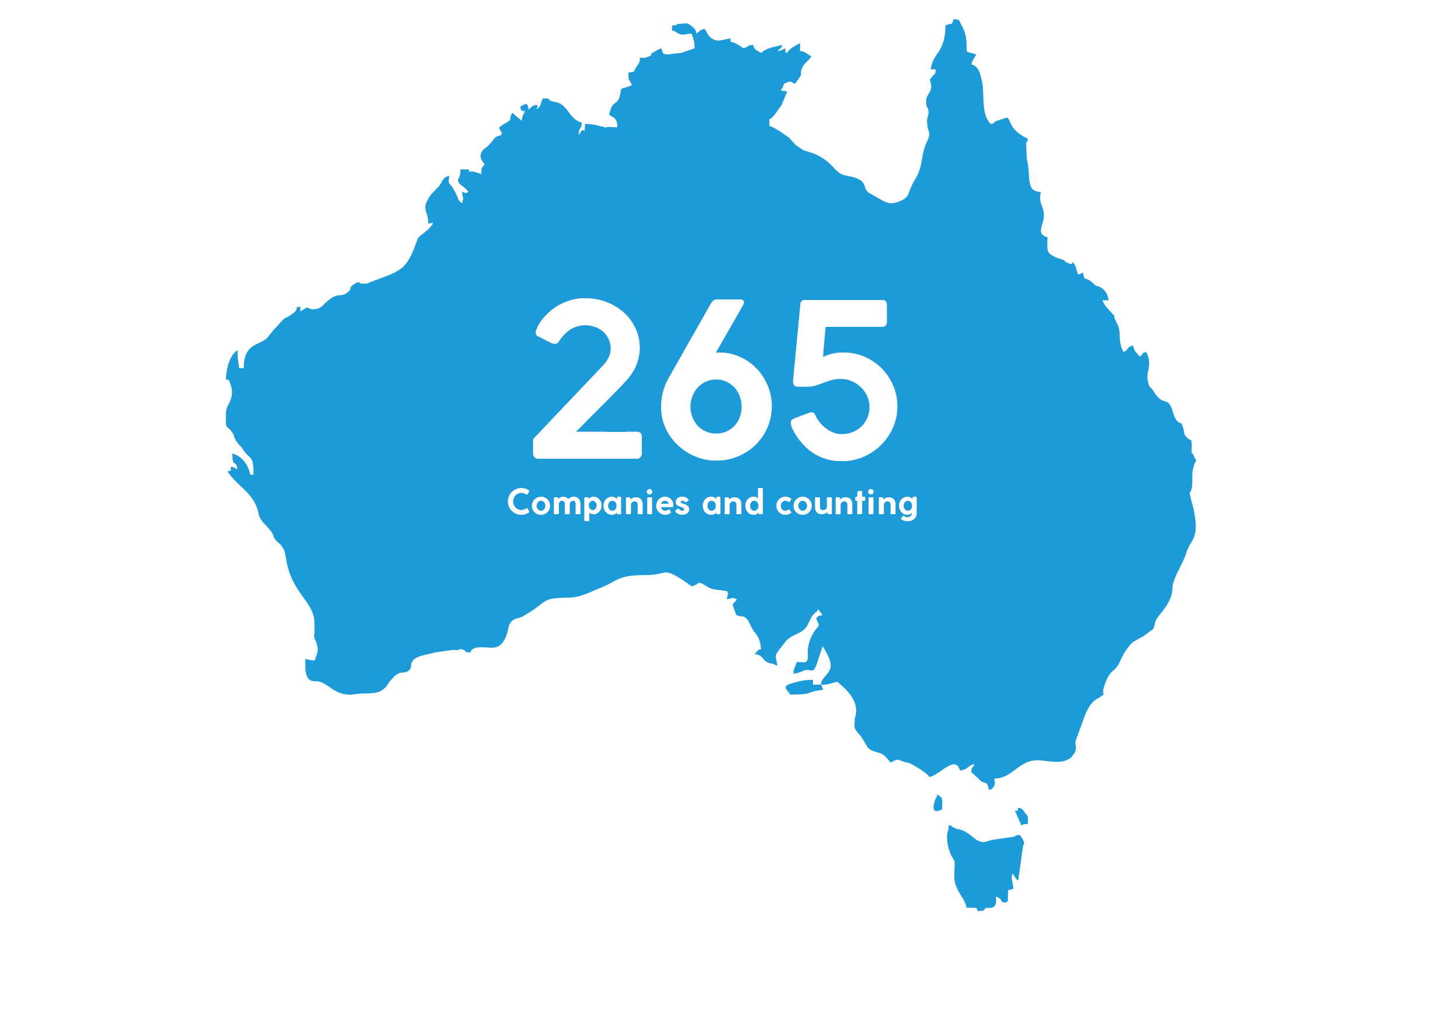
ROUND 3.
2) The outline of which country is shown above?
1

Slide 13
ROUND 4.
(10 marks)
SPORTS

Slide 14
ROUND 4.
1) Can you spot 10 differences between the pictures?
10

Slide 15
School Virtual Tour
https://www.youtube.com/watch?v=81KVtxSOyf4&safe=active

Slide 16
ROUND 1.
(6 marks)
1. Oxford Street is . . .
Pastoral Support
GREEN
ANSWERS

Slide 17
ROUND 1.
2. Logos belong to . . .
Pastoral Support
LEXUS
NASA
GOOGLE
ANSWERS
VODAPHONE

Slide 18
ROUND 1.
3. Aerial view was from. . .
Pastoral Support
ANSWERS
EIFFEL TOWER

Slide 19
ROUND 2.
(10 marks)
4) The 3 characters were . . .
3

Slide 20
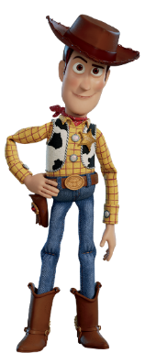
ROUND 2.
= 4
(4 x 2) + 7 = 15
= 2
= 7
5) Sum: The answer to the sum is . . .
1

Slide 21
ROUND 2.
6) The 3 movies were . . .
3

Slide 22
ROUND 2.
7) Brad Pitt / Leonardo Di Caprio / Bradley Cooper
3

Slide 23
ROUND 3.
(3 marks)
1) SWEDEN & ICELAND are the flags merged together.
2

Slide 24
ROUND 3.
2) The outline was of
AUSTRALIA.
1

Slide 25
ROUND 4.
(10 marks)
1) The 10 differences are shown above . . .
10

Slide 26
END OF QUIZ
(THANKS FOR PLAYING!)
CALCULATE SCORES
(ALL ROUNDS)

