Slide 1
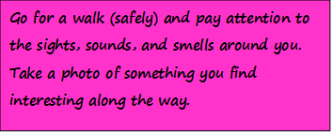
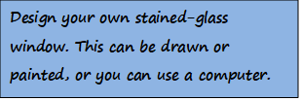
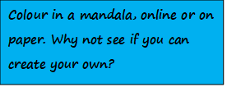
Hello, my name is Mrs Tait.
Welcome to S1 Religious and Moral Education or RME for short.
For your RME Superstar Challenge, I would like you to choose at least ONE of the following to complete. Please keep your work as I would like you to bring it to RME when you come to Largs Academy. Looking forward to meeting you all. Take care, good luck and stay safe.

