Slide 1
Welcome to Largs Academy S1 Science Transition Day
To enter the virtual classroom please start the slideshow
Press F5 on keyboard
or
Click ‘Slide Show’ tab, then ‘from Beginning’

Slide 2
Welcome to Largs Academy S1 Science Transition Day
Please click the start button below to enter the virtual classroom. Have a good look around and try some of the experiments on the shelf.

Slide 3
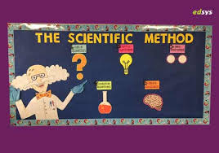
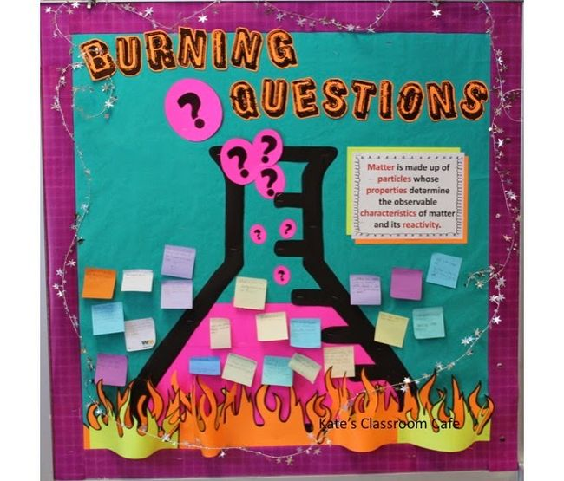
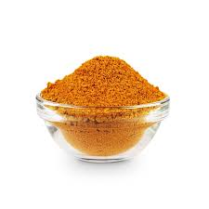
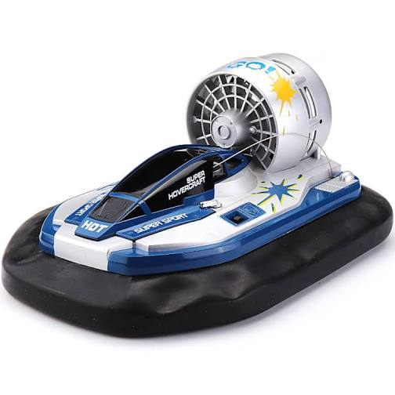
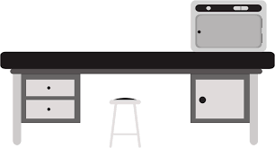
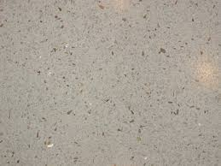
Largs Academy S1 Transition Lab
Experiment Shelf
Welcome message
Teachers

Slide 4
Largs Academy S1 Transition Lab
Teachers
Turn TV Off

Slide 5
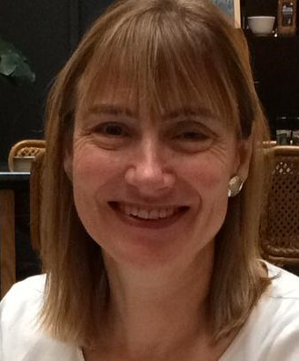
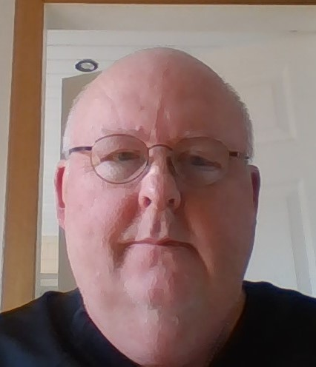
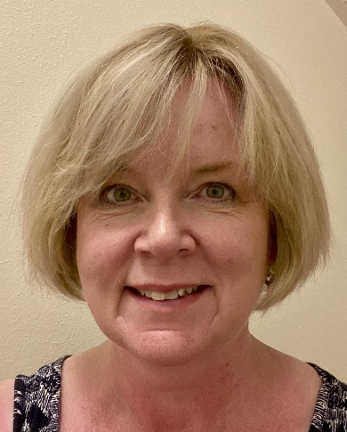
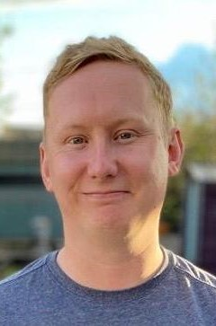
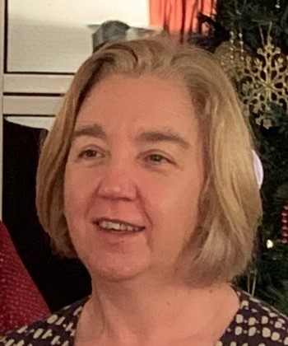
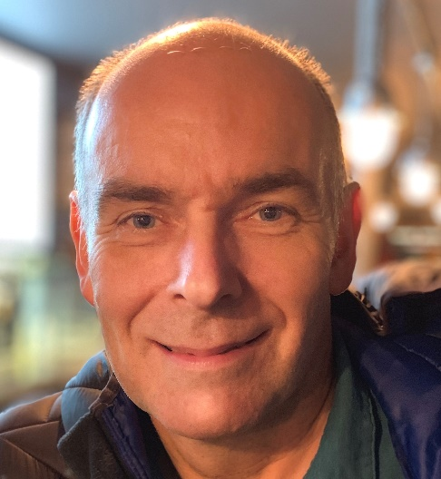
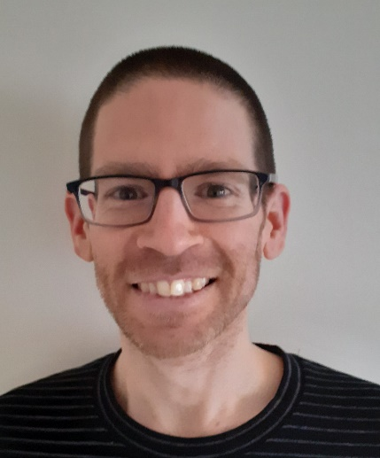
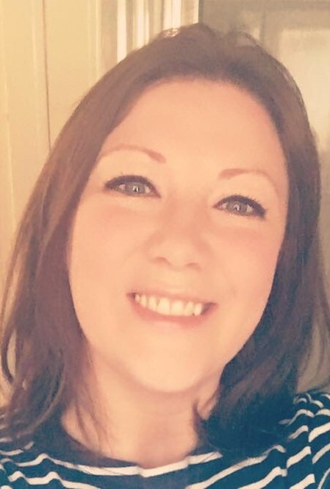
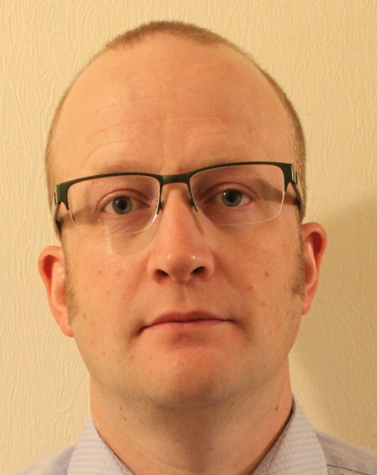
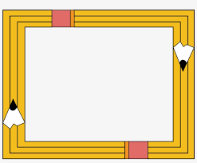
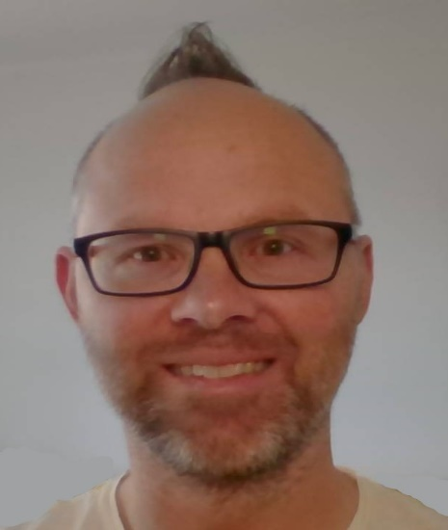
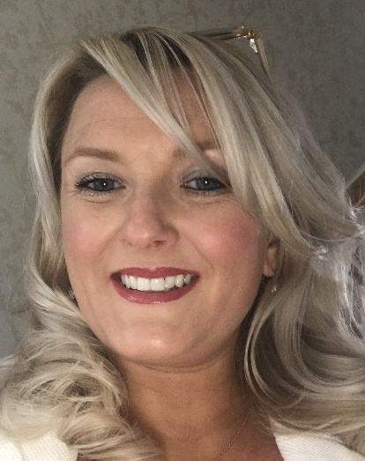
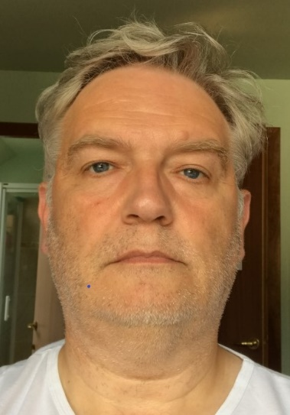
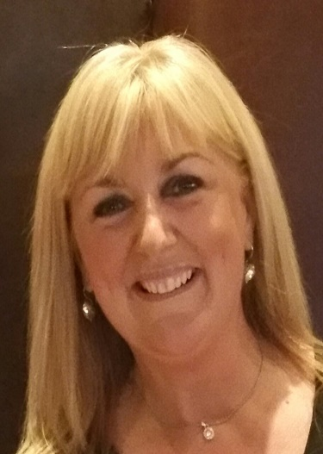
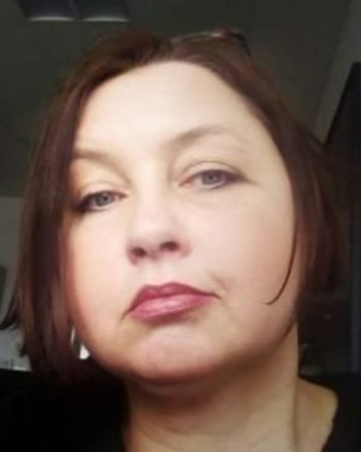
Dr Coldwell - S1-S2 Science, Biology
Mr Leishman - S1-S2 Science, Chemistry
Mrs Scott - S1-S2 Science, Physics
Mr Trainer - S1-S2 Science, Biology
Mrs Campbell - S1-S2 Science, Physics
Mr Higgins - S1-S2 Science, Chemistry
Dr Mitchell - S1-S2 Science, Biology
Mrs Furey - S1-S2 Science, Biology
Mr Usher - S1-S2 Science, Physics
Mrs Cozens - S1-S2 Science, Biology
Mr Roser - S1-S2 Science, Chemistry
Mrs Mazzoni - S1-S2 Science, Chemistry
Mr Gibson - S1-S2 Science, Physics
Mrs Duff - S1-S2 Science, Physics
The Science Team
Rollover photos for names
Back to Lab

Slide 6
We hope you enjoyed your visit to our
Virtual Classroom and look forward
to seeing you
in August!

