Slide 1
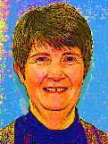
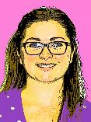
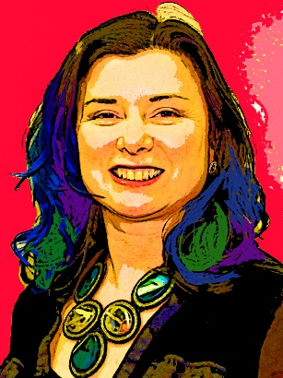
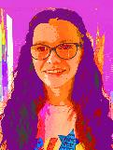
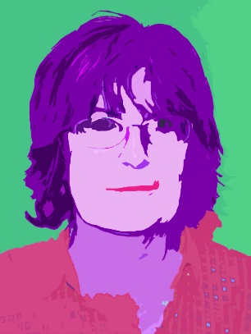
Welcome to the Faculty of Enterprise and IT
Miss r Newell
Computing Teacher
Mrs A Denim
Mrs C MACLEAN
Business Teacher
Business Teacher
Mrs C Simpson
Faculty Leader
Miss R NEWELL
Mrs E MORAN
Business Teacher
Business Teacher

Slide 2
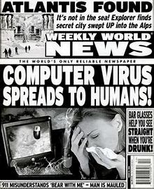
PASSWORD SAFETY & FAKE NEWS

Slide 3
Using the Internet in School
Use of the Internet should be appropriate and relevant to your education.
Only access the Internet using your own account and password.
DO NOT GIVE YOUR PASSWORD TO ANYONE ELSE

Slide 4
Password Basics
It should be something you will remember & SHOULD NOT be easy to guess.
TASK: What do you think are the 5 top most commonly used passwords?
Now use Google to check your answers.
Why would “qwerty123” be a weak password?

Slide 5
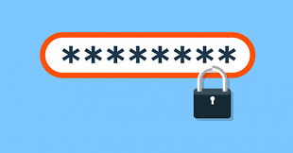
Passwords should have:
Letters with some capitals, numbers and symbols. @~#!
Minimum of 8 characters long.
Do not use easy to guess names and dates.
TASK: What type of names and dates would be easy to guess?

Slide 6
Password Checker Test
Before you finally decide on your password test how
long it would take to crack it on
“How Secure is My Password.com"
Click Here
Have a competition with others in your house to see who has the hardest to crack password.

Slide 7
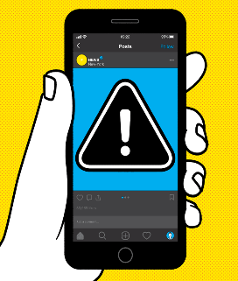
Fake news: What is it? And how to spot it . . .
Many of us like to share news and stories on social media with our friends.
Perhaps it's an interesting story, news about a celebrity that you like, or something that made you laugh. But when you see something you like online, do you check to make sure that it's true before you share it?

Slide 8
Sharing Fake news
Not everything that we read or see on the internet is true - and if it isn't, and we share it, we could be making people believe something that is actually made up.
Stories like this are called fake news and they can be a problem.

Slide 9
THERE ARE TWO KINDS OF FAKE NEWS:
1. Fake stories that are deliberately sent around, in order to make people believe something untrue or to get lots of people to visit a website.
2. Fake stories may have some truth to them, but they're not completely true. This is because the people writing them don't check all of the facts before publishing the story.

Slide 10
Fake News
It is happening a lot at the moment, with many people publishing these stories in order to get as many shares as possible.

Slide 11
Fake News
Check out this article about FAKE NEWS:
BBC Newsround
Carefully think about the consequences of using an unreliable/untruthful website – what might happen if we don’t use a reliable website? And how can we tell if a website is reliable?

Slide 12
We are looking forward to meeting you all!
See you soon – ENIT Department

