Slide 1
Largs Academy S4/5 into S5/6 Options Information Evening
Thursday 15th February 2024

Slide 2
Aims of the Meeting
Understanding the option form
Know where to find out more about the courses
Understand how college/@South-West Connects options work
Know how and when options are submitted
Understand how parents/carers can be involved

Slide 3
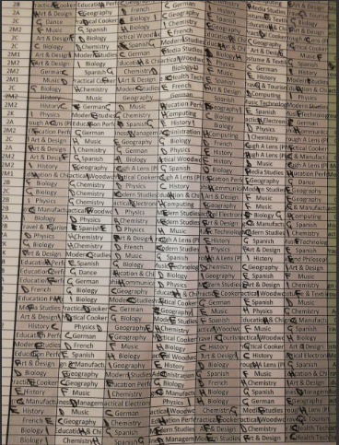
Understanding the option form and the subjects pupils can pick
Mock Options: what did they do?

Slide 4
Understanding the option form and the subjects pupils can pick
Number of subjects that need picked
S5 – Full Timetable: 5 subjects (A-E = 30 periods)
+ 1 x elective period (F) + PSE/RA = 32 periods
S6 – Full Timetable: 5 subjects (A-E = 30 periods)
+ 1 x elective period (F) + PSE/RA = 32 periods
S6 - Once SQA results are in (Aug 2024), pupils may be able to
drop a subject if they have set up volunteering/work experience

Slide 6
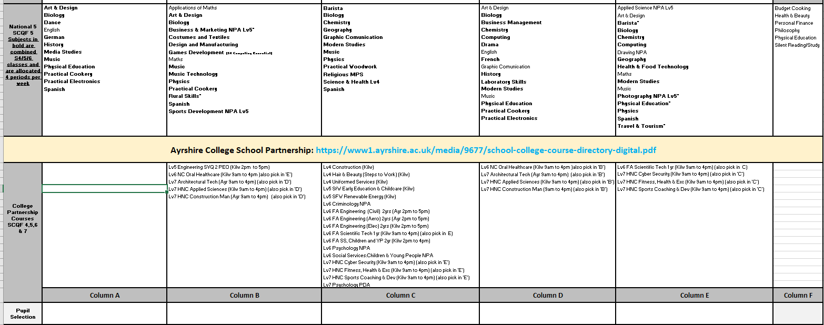

Slide 7
Specific School Courses Information including NPA’s
What is an SQA NPA?
SQA National Progression Award
Available at Level 5 and Level 6
Applied Forensic Science – NPA Lv5
Business & Marketing – NPA Lv5
Drawing NPA Lv5
Games Design – NPA Lv5 – (must be studying/studying N4/N5 computing)
Photography – NPA Lv5
Sports Coaching & Development NPA Lv5 and Lv6
Scientific Technologies NPA Lv6
Youthwork NPA 6

Slide 8
Specific School Courses Information including NPA’s
Additional Course Information
Human Biology Higher
Higher Applications of Maths
Pupils wanting to sit a Higher in S5, must have achieved an A-C pass at N5 in S4 (recommended N5 A-B pass for Higher Maths/Sciences)
S6 pupils wanting to select an Adv Higher must have achieved an A-B pass at Higher in S5

Slide 9
College Courses

Slide 10
Ayrshire College Courses: Key Qs
Have I researched the course and what I will be doing?
Am I committed enough to finish my day later than my peers?
How does this course fit into my pathway, what’s my next steps?
Ayrshire College Course Information

Slide 11
Ayrshire College Courses
Transport
Transport to college will be through public transport and pupils will be reimbursed
Selecting a Course
Options: Alternative/back up course
Selection Process

Slide 12
@South-West Connects Remote Learning Hub
Collaboration between four Local Authorities
Piloted in 2021-22 (105 presentations)
Expansion in 2022-23 (130 presentations)
Motivated and enthusiastic learners
Learners must be able to attend the 5 sessions per week
Pupils applying for Advanced Highers would be expected to have achieved an ‘A’ or ‘B’ grade for their chosen subject at Higher level in S5.

Slide 13
@South-West Connects Remote Learning Hub
Advanced Higher
English, Graphic Communication, History,
Maths & Spanish
Higher
Politics
Edinburgh College Partnership
French/German/Italian/Spanish (N5, Higher & Adv H)
Applications open on Monday 19th February
Prospectus and Application Form will be posted on Teams Page

Slide 14
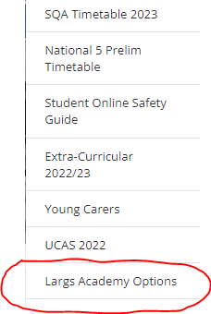
Where to find out more about the courses
All course information is in the Senior Phase Options Booklet
This can be found on your TEAMS page and also on the school website:
- Pupil Zone
- Largs Academy Options

Slide 15
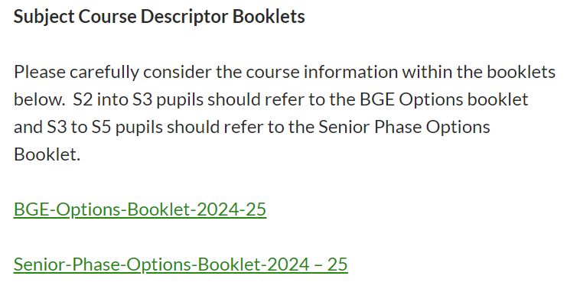
School Website: Largs Academy Options

Slide 16
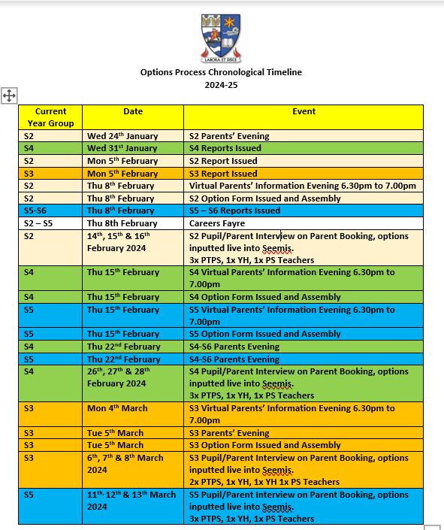

Slide 17
Options Timeline

Slide 18
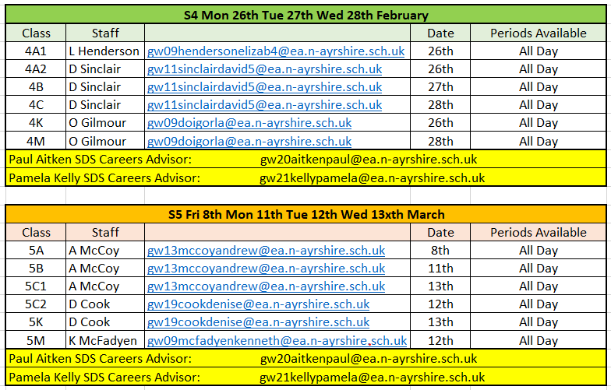
Who to turn to:

Slide 19
Options Interview Process
https://parents-booking.co.uk/largsacademy
S4 Parent/Carer booking opens 8pm tonight (closes 22nd February)
S5 Parent/Carer booking dates TBC
Parents/Carers who booked will join the meeting virtually
Pupils whose parents/carers cannot attend the meeting will be issued with an appointment slot
Pupils should come prepared with the completed paper copy of their options

Slide 20
Options Interview Process
Discussion takes place regarding the pupil’s selection, their future interests and their most recent tracking report
Options are agreed and inputted into the computer
Process completed by Friday 15th March 2024
Timetable changes at the start of May

Slide 21
Useful Links
Largs Academy Website
Largs Academy - Largs Academy Home
Ayrshire College Website
Schools (ayrshire.ac.uk)
@South West Connects
Digital Prospectus 2024-25.url

Slide 22
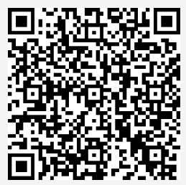
Feedback
Please scan the QR code to access the Microsoft Form. The link can also be found on the school website in the Options section.

Slide 23
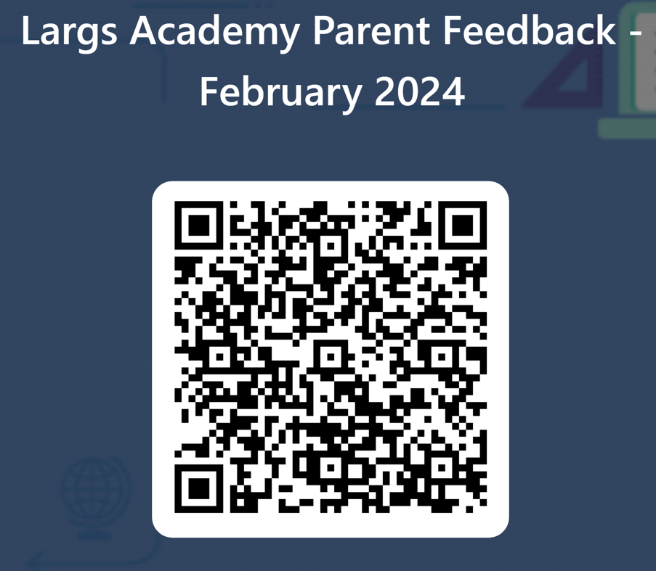
Parent/Carer Consultation

