Slide 1
Largs Academy S2 into S3 Options Information Evening
Thursday 8th February 2024

Slide 2
Aims of the Meeting
Understanding the option form
Know where to find out more about the courses
Know how and when options are submitted
Understand how parents/carers can be involved
Understand the support that can be accessed to assist

Slide 3
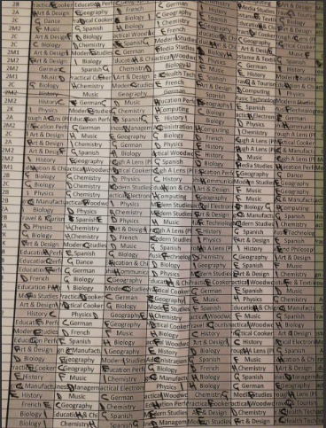
Mock Options
What did they do?

Slide 4
Requirements for S3
S3 Curriculum
English 4 Periods
Maths 4 Periods
Physical Education 2 Periods
PSE/RMPS 1 Period
7 Subjects (3 periods each) 21 periods
Total 32 Periods

Slide 5
Understanding the Option Form
Column A = English
Column B = Maths
Pupil must select one subject from each column (C to I)
Pupils are encouraged to study from each curricular area

Slide 6
Requirements for S3
Curricular Areas
Scottish Government guidelines stipulate pupils should continue to study a Broad General Education up to and including S3.
In addition to the core subjects of English, Maths, HWB and RE, pupils are strongly encouraged to study:
Expressive Arts (Ex) - Modern Languages (ML)
Sciences (Sc) - Social Subjects (SS)
Technologies (T)

Slide 7
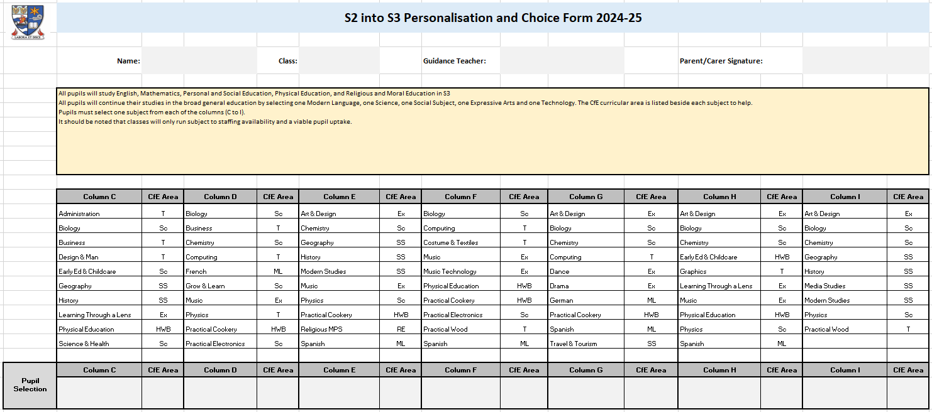

Slide 8
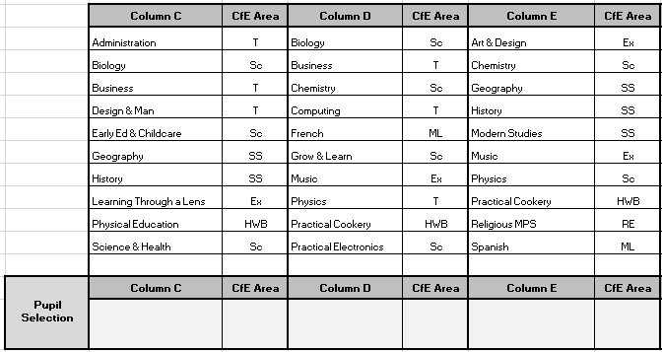

Slide 9
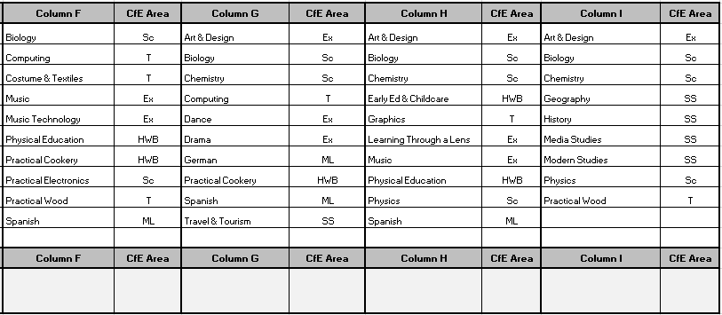

Slide 10
New Courses
New courses that you should research include:
- Design & Manufacturing - Science & Health
Graphics - Learning Through a Lens
Grow & Learn - Practical Electronics
Music Technology - Practical Woodwork
Travel & Tourism - Early Education & Childcare
- Media Studies - Dance

Slide 11
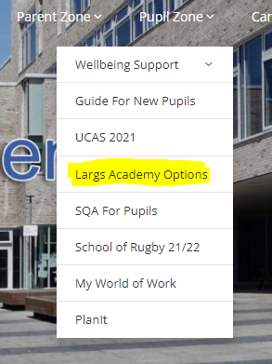
Where to find out more about the courses
All course information is in the BGE Options Booklet
This can be found on your TEAMS page and also on the school website:
- Pupil Zone
- Largs Academy Options

Slide 12
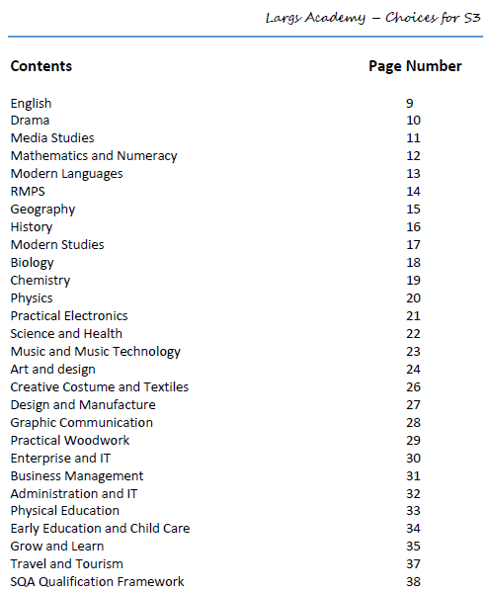
School Website: Largs Academy Options

Slide 13
Involving Parents/Carers and Submitting Options

Slide 14
Who to turn to!

Slide 15
Options Interview Process
Parent/Carer booking opens at 8pm tonight (Thu 8th Feb)
Parent/Carer booking closes at 8pm Mon 12th Feb
Parents/Carers who booked will join the meeting virtually
Pupils who’s parents/carers cannot attend the meeting will be issued with an appointment slot
Pupils come prepared with the completed paper copy of their options

Slide 16
Options Interview Process
Discussion takes place regarding the pupil’s selection, their future interests and their most recent tracking report
Options are agreed and inputted into the computer
S2 process completed by Friday 16th February
Timetable changes at the start of May

Slide 17
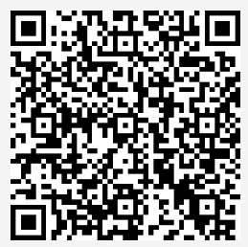
Feedback
Please scan the QR code to access the Microsoft Form. The link can also be found on the school website in the Options section.

