Slide 1

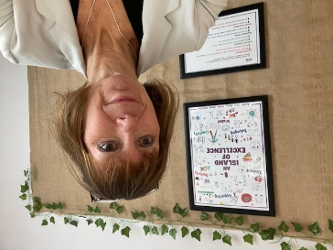
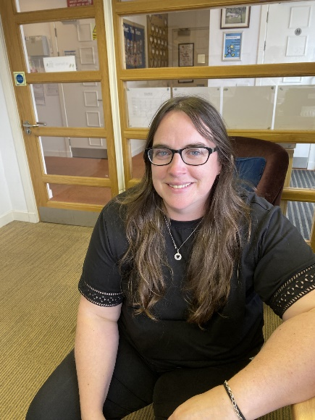
Child Protection Protocol
Education Services has a fundamental duty to contribute to the care and safety of all children and young people in North Ayrshire.
All staff, parents and visitors of Kilmory Primary School have a responsibility to protect the welfare of our young people. If you have a concern for a young person or a disclosure is made by a young person, you should report this to a school staff member immediately. This will be passed on to the Child Protection Officer.
The Arran Social Work Team is based at the Council Offices, Lamlash. They can be contacted on 01770 600742.
If you are worried about someone during the night or at the weekend an ‘out of hours’ team is available to deal with emergencies . Please contact North Ayrshire Council ‘Out of Hours’ Tel: 0800 328 7758
Child Protection Co-ordinator. Head Teacher, Allison Conner 6 Arran Schools | (in HT absence) Acting Depute Head Teacher, Claire McNally, Kilmory, Prinmill, Whiting Bay Schools

