Slide 1
Emotional Factors
Impact on Performance

Slide 2
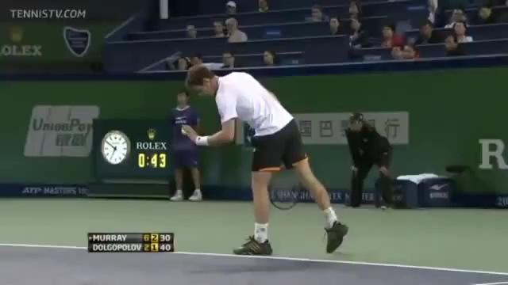
Anger
Notes:
How you control aggression
Decision making
Can you riel your opponent?
What will it do to your opponent

Slide 3

Happiness/Sadness
Notes:
Emotional state of mind
Happiness – increase in confidence & self belief
Sad – poor execution & shot avoidance, Less resilient and struggle to come from behind

Slide 4
Fear
Don’t be afraid to fail …. Be afraid to try
Notes:
Negative thoughts impact on performance
Fear of failure – poor mindset
Stay inside your comfort zone – play safe

Slide 5
Emotional Factor –
Approaches to Performance Development
Identify the triggers
Who caused the trigger?
Choose an approach (coping strategy) to help manage situation
Practice away from the competition environment
Notes:
Page 18 booklet - questionaire

Slide 6

Deep Breathing
Notes:
Helps manage anger & fear by changing the focus
Carry this out at the start of a session/set/point
Clear mind, lower HR, gets more oxygen in and will allow better decisions

Slide 7

Positive Self Talk
Notes:
Helps manage anger and fear
Negative thoughts reduce performance potential
Turn around with positive (happy words)
https://www.youtube.com/watch?v=OAs2PBL1RsA – happy gilmour
https://www.youtube.com/watch?v=LGKkmpbhv9k - caddyshack

Slide 8
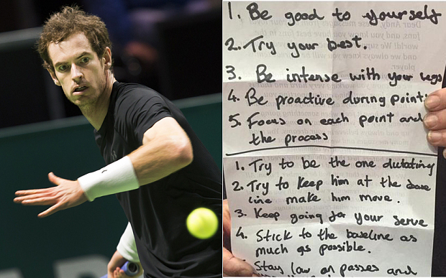
Cue Words
Notes:
A fan at the Rotterdam Open has exposed the sheet of motivating phrases and slogans used by the British No1 in crucial matches
Lynsey sharp story – injury – not enough training, illness night before ‘Get out strong, Commit’

