Slide 1
Higher PE
Physical Fitness

Slide 2
Aspects of Fitness
Aspects of Fitness
Cardio-respiratory endurance CRE
Speed
Strength
Flexibility
Local muscular endurance
Agility
Power

Slide 3
Agility – the ability to change direction at speed
Positive Impacts | Negative Impacts
Change direction quickly – to beat defenders | Easily exploited when in defence
Stop/start quickly – lose defenders | Can’t respond to opponents movements quickly
Create space – create scoring opportunities | Won’t be able to apply pressure or steal the ball
Stay tight to your marker in defence | Can’t outmanoeuvre opposition

Slide 4
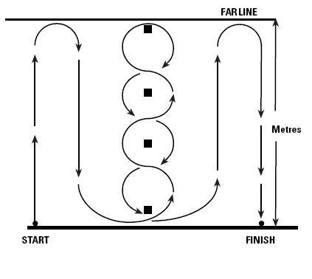
Method of Gathering Information
The Illinois agility test is a standardised test conducted as follows:
Athlete lies face down on the floor at the start point.
On the assistants command the athlete jumps to his / her feet and negotiates the course around the cones to the finish line.
The assistant records the total time taken from their command to the athlete completing the course.
GENDER | EXCELLENT | ABOVE AVERAGE | AVERAGE | BELOW AVERAGE | POOR
MALE | <15.2 secs | 15.2 – 16.1 secs | 16.2 – 18.1 secs | 18.2 – 19.3 secs | > 19.3 secs
FEMALE | <17.0 secs | 17.0 – 17.9 secs | 18.0 – 21.7 secs | 21.8 - 23.0 secs | > 23.0 secs

Slide 5
Approaches
Plyometrics
Training within the game
Interval training
Speed/Agility Circuit

Slide 6
Cardio Respiratory Endurance (CRE) – ability of heart & lungs to provide oxygenated blood
Positive Impacts | Negative Impacts
Last the duration of the game | Fatigue quickly resulting in the need for long rests
Maintain high skill levels | Opponent will be able to get away from you
Allow you to keep making good decisions | Struggle to transition between attack and defence
Fulfil your role demands | Drop in skills

Slide 7
Methods of Gathering Information
Cooper Test (12min run) – Standardised Test
Leger Test (Bleep test) – Standardised Test
Yo-Yo (rugby) – Standardised Test
Time Related Observation Schedule – game related
Hoff Test (football) – game related

Slide 8
Approaches
Continuous Training
Interval Training
Fartlek Training
Training within the game

