Slide 1
Higher PE
Analysing Information Collection Methods

Slide 2
4 Key Issues to Analyse:
Practicality – about carrying out the process which is feasible, possible to organise or put into practice
Appropriateness – about the suitability of the method. That is, is the test fit for purpose
Reliability – about gathering information which can be trusted
Validity – about gathering information that can be defended and is credible and sound

Slide 3
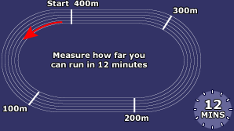
Practicality
Is it easy to set up or complex where mistakes could be made
Information collected might not be accurate, reliable or valid
E.g. Cooper test not being 25x25m square then comparisons wouldn’t be fair

Slide 4
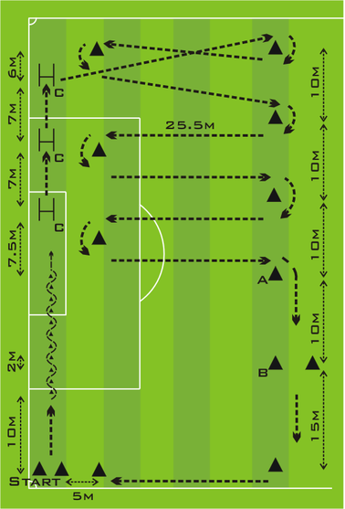
Appropriateness
Does it suit the activity and the factors you are investigating?
E.g. Illinois Agility Test would not be useful if you were wanting to work out how many passes you make in a basketball game
The Hoff Test for Stamina in football is very specific for players with a high skill level and can complete a variety of stations to a high degree. It would not be appropriate to use with participants that couldn’t dribble.
Therefore a test needs to be easy to carry out, match the needs of feature, not open to errors and tell us how weak our weakness is.
Notes:
Originally, the Hoff-test was used as a training tool and not necessarily for testing purposes (7).
The goal in this test is to cover as much distance as possible - if the distance is the desired final measure
From a practical point of view, a specific duration (i.e. 10 minutes) is used for players performing the test
Generally, the 290 m test is performed in a forward dribbling motion.
However, at points C players pass the ball under a 30-centimerter height hurdle and jump over the hurdle. From point A to point B players need to dribble backwards.

Slide 5
Reliability & Validity
If the test is carried out the same way every time it is likely that the results can be trusted
The person doing the recording must remain constant
Setting it up the same and using the same people will mean you can compare re-test easily
Things that may affect reliability or validity
Different feeders in drills
Improved performance from players around you (e.g. more accuracy in feeds or harder blocks)
Higher expectation or improved knowledge of markers being more critical

Slide 6
Mental – SCAT test
P – the availability of computers to complete online SCAT tests
A – the method may require you to work in privacy or isolation (in a class)
R – as the mental factor is affected by moods the time of the day is vital as would be pre & post testing
V – results are valid if the performer has taken time to minimise any external influences

Slide 7
Emotions – Discipline Record
P – often not easily accessed for performers. Information given after a match when emotions running high and details might not be remembered
A – might not capture the whole performance problem e.g. why you did what you did
R – who is officiating, coaching playing. If this changes then results will be hard to compare
V – results could be affected by external factors such as opposition, referee etc

Slide 8
Social – Self Reflection
P – Time must be set aside and not rushed to give honest accurate results
A – questions need to be easily understood and specific to what you want to learn
R – results need to be easily interpreted to allow comparisons to happen. Closed questions (Yes / No) are good ways to get useful information
V – results and useful if answers given aren’t honest

Slide 9
Physical – PAR
P – Equipment needs to be set out perfectly. Sometimes difficult to see without video footage
A – skills need to be broken down into manageable components that people understand and can analyse
R – use video to double check
V – recorders are not sometimes sure what they are looking for

Slide 10
Exam Questions
Describe – how you might carry out a method of gathering information
Explain – how was the method reliable and valid
Analyse – the practicality of the methods used to gather information on the impact of a particular factor
Evaluate – the reliability and the appropriateness of the methods

Slide 11
Top Tip
By being able to apply knowledge about ONE method of collecting data to make comparisons with other methods you are applying your knowledge in a different way. This shows ‘deeper’ learning and is a skill which will help you in the set question and scenario parts of the exam.

