Slide 1
Higher PE
Command Words

Slide 2
Describing
This skill ask you to tell the reader:
What a performance looks like
What strengths are demonstrated in the performance
What the development needs are
The description should include details more than just a statement.

Slide 3
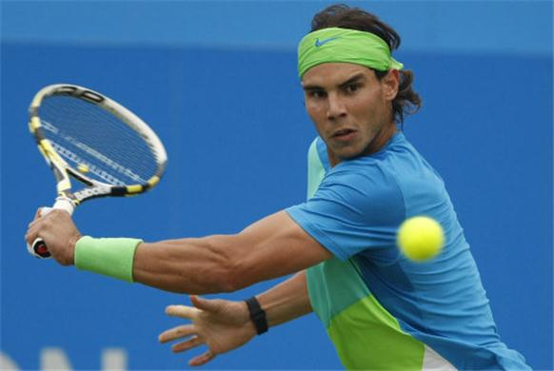
Physical Answers
I was slow to the ball.
I was slow to the ball, arriving after my opponent, who got there 9 times out of 10.
My arm was bent.
My arm was bent as I struck the ball on my backhand.
Used a slice shot.
Used a slice shot to make the ball stop quickly on the opponents side of the court

Slide 4
Mental, Emotional & Social
Mental:
I made a bad decisions
I made three bad decisions in the first four minutes of play, putting the ball out of play twice and trying to lob when the opponent was in a good position to smash
Emotional:
I panicked when I was at the net
I panicked when I was at the net getting too close and allowing my opponent easy shots in behind me
Social:
The crowd intimidated me
The crowd intimidated me and made me hesitate as I moved forward to begin serving to win the match

Slide 5
Summary
Include as much detail as possible about what it is you are describing. Try to keep in mind that you are trying to paint a picture or provide commentary for someone who has not seen the performance, method of collecting data, approach or monitoring/evaluating tool.

Slide 6
Explaining
This skill asks you to tell the reader:
Why you did what you did
The relationship between decisions you took and the difference this made
Explaining means using linking words such as, ‘I did this…
because…
So that…
In order to allow me to…
To make sure that…
To provide me with the opportunity to…
When I needed to…’

Slide 7
Cause/Effect
By adding theses details to an explanation the reader can see what was done and
why it was done. This is called cause and effect. An easy way to remember is;
Effect
I was late for school
I got 2/40
She scored a basket
I took off from the wrong place
Cause
I lost my watch
I didn’t study for my exam
I let my opponent get away from me
I was too slow with my run-up

Slide 8
Analysing
The skill asks you to tell the reader;
- What parts are important in a method, information or an approach
- If there are connections between methods, information or approaches
Analysing means using phrases like:
This shows me that…
This allowed for…
As a result…
This resulted in…
This meant that…

Slide 9
Deconstruct / Take Apart / Make Clear
Methods of data collection – allows accurate collection of information, which results in easily interpreted data… This shows strengths and weaknesses clearly…as a result you were able to start planning based on…
Approaches – the approach used resulted in improved back stroke in preparation and action stages…this meant I had longer, deeper pull…giving more propulsion…
Methods to monitor and evaluate – these show me that the weakness has reduced from 18/30 failed attempts to 6/30. This indicates that my methods gave me data…

Slide 10
Evaluating
The skill asks you to tell the reader
How successful or otherwise the method or approach you used
Evaluating means using phrases like:
Demonstrating a significant improvement
Clearly results show
Overall the preferred method would be…because…
The approach that was most useful was…because…

Slide 11
Provide a value or judgement
You need to determine how useful, appropriate or effective your methods or approaches were. Also, if you were asked to evaluate your performance it might be a good idea to try and include some evidence to back up your judgements
- Best – provided by the percentage increase in jour number of successful serves
Worst – highlighted by the lack of motivation you felt while carrying out your training
more useful – than another method based on the ease of using the method to gather information
Less productive – based on the scores of the last match where you lost
You might also want to use the following value words:
Outstanding
Excellent
Very Good
Average
Below Average

