Slide 1
Pitta Pocket

Slide 2
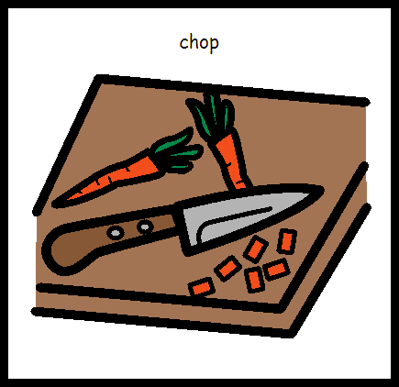
I am learning to chop food

Slide 3
I am learning to spread

Slide 4
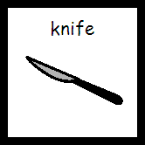
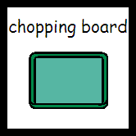
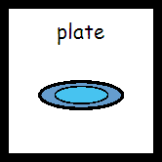
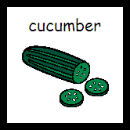
What do I need?

Slide 5
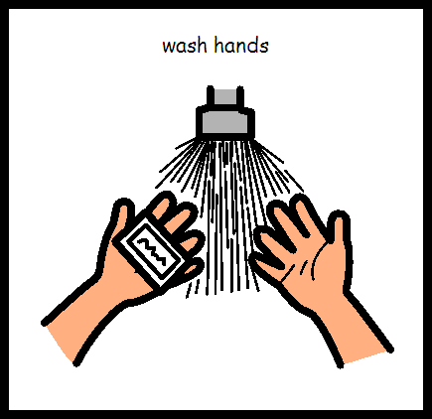
Wash hands

Slide 6
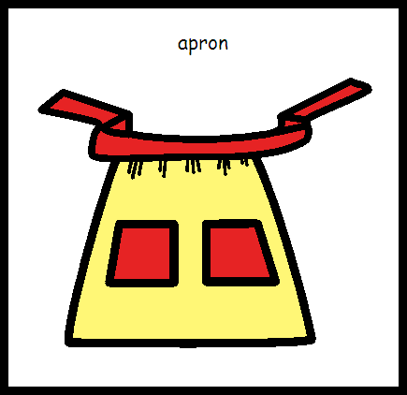
Put on apron

Slide 7
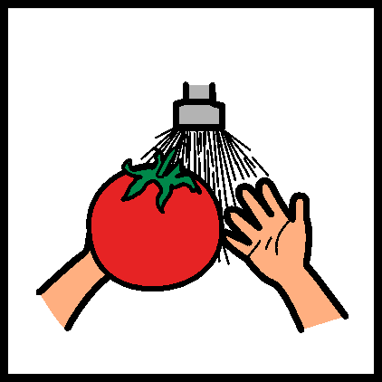
Wash tomato

Slide 8
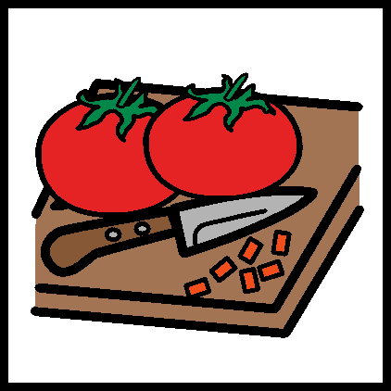
Chop tomato

Slide 9
Put tomato on plate

Slide 10
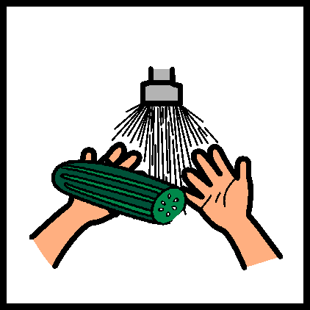
Wash cucumber

Slide 11
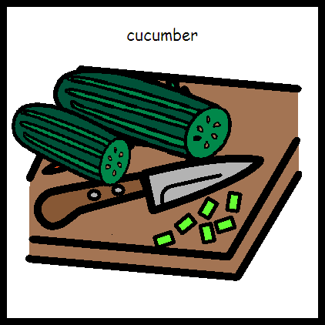
Chop cucumber

Slide 12
Put cucumber on plate

Slide 13
Open pitta bread

Slide 14
Spread cheese on pitta bread

Slide 15
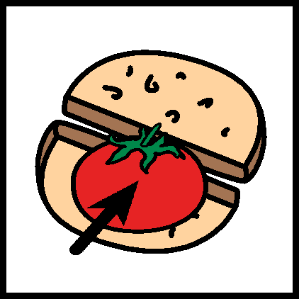
Put tomato in pitta

Slide 16
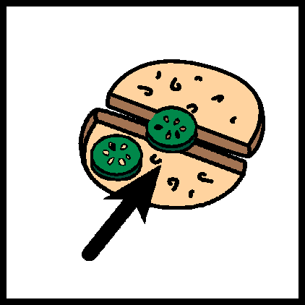
Put cucumber into pitta

Slide 17
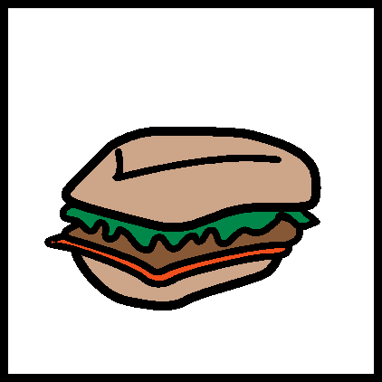
Pitta pocket is finished

Slide 18
Wash dishes

Slide 19
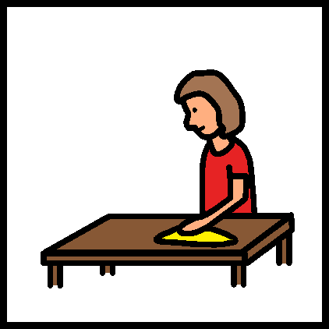
Tidy up

Slide 20
Home economics is finished

