Slide 1
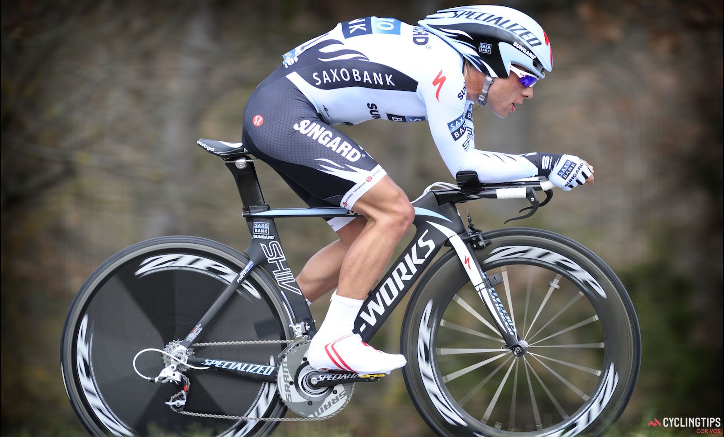
Tour De France

Slide 2
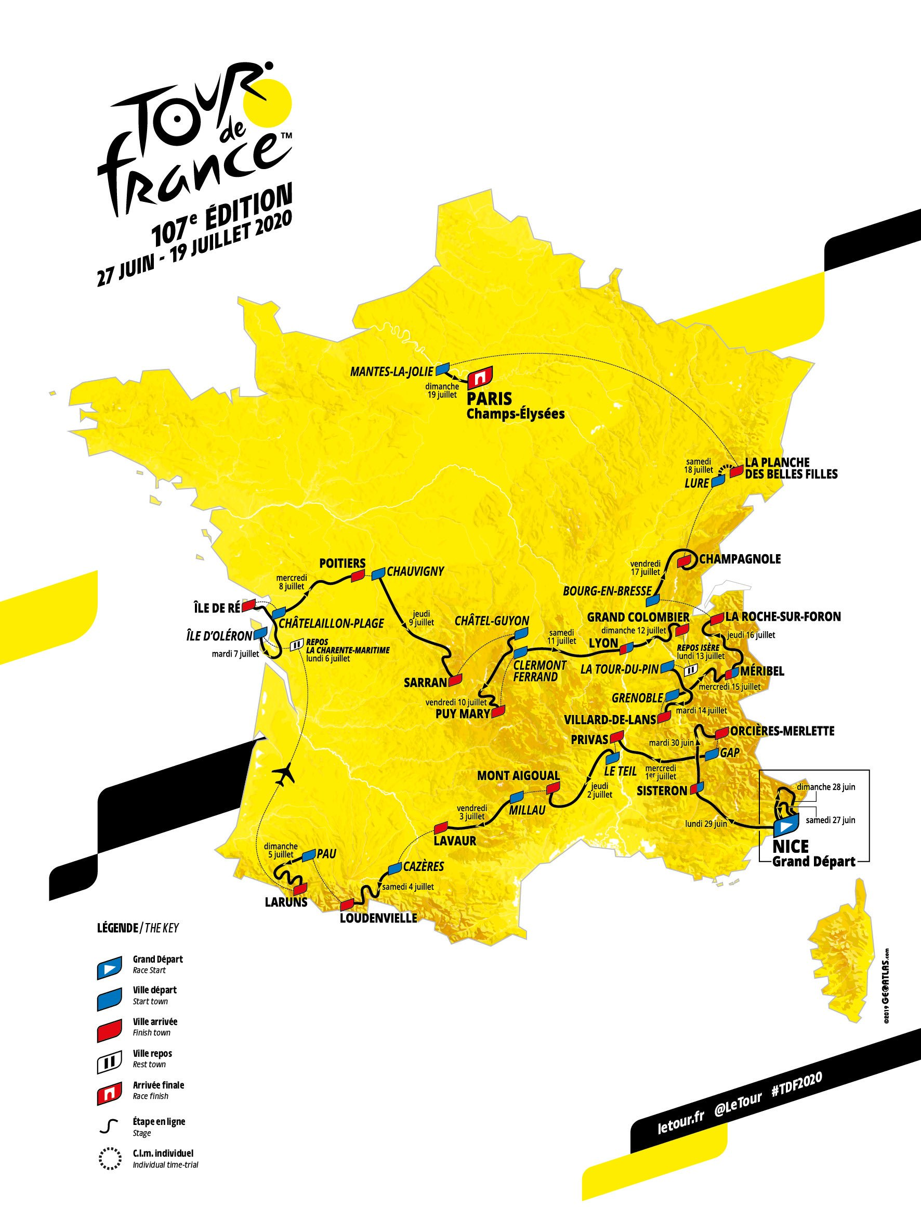
The Tour De France
The Tour de France is the worlds longest cycle race that takes place over 23 days and covers over 2,200 miles.

Slide 3
Tour De France
Click on the link to find out more about the Tour De France
https://www.youtube.com/watch?v=JMB-_7-TDwI

Slide 4
The Tour De France
There are 21 Stages in the race.
8 flat stages
5 hilly stages
6 mountain stages
2 time trial stages

Slide 5
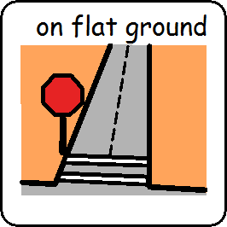
I am learning to cycle or experience travelling on flat ground

Slide 6
Tour De France Activity is finished

