Slide 1
I am learning about France

Slide 2
I am learning about the Eiffel Tower

Slide 3
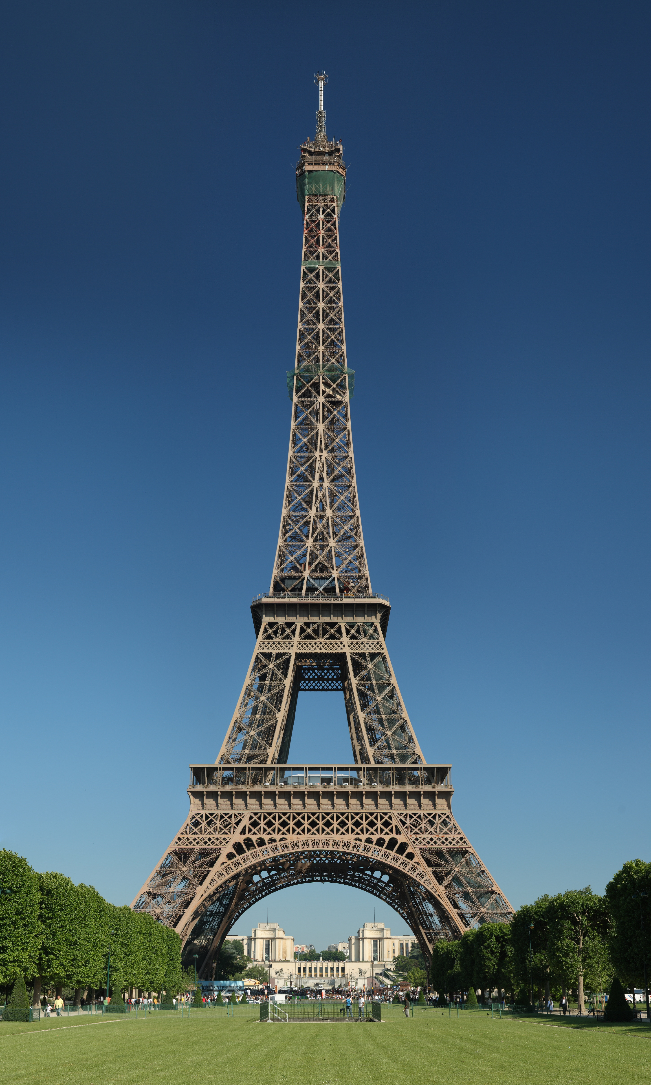
Take a virtual Tour of the Eiffel Tower in Paris
https://www.youtube.com/watch?v=nbD8XYTw23Y

Slide 4
Learning about France is finished

