Slide 1
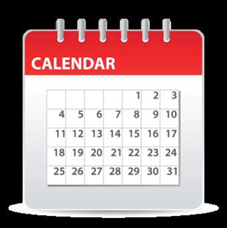
Calendar work

Slide 2
Morning
https://www.youtube.com/watch?v=U9Q7Y3t4m3g

Slide 3
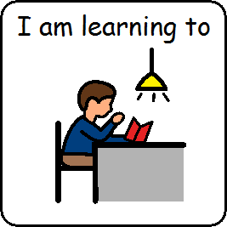
I am learning to listen

Slide 4
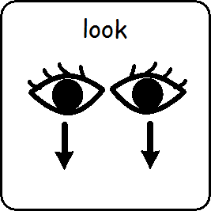
I am learning to look

Slide 5
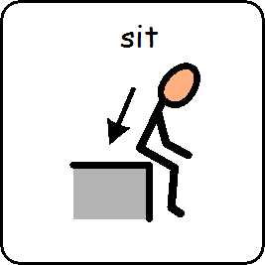
I am learning to sit

Slide 6
What day is it today?
Mondayhttps://www.youtube.com/watch?v=Nk5EUUnm7rc
Tuesdayhttps://www.youtube.com/watch?v=j_vWB2XYkaA
Wednesdayhttps://www.youtube.com/watch?v=wqfSXMzN8Hs
Thursdayhttps://www.youtube.com/watch?v=IGENkpaPkgw
Fridayhttps://www.youtube.com/watch?v=y511_AkazQQ

Slide 7
What is the date?
Monday | Tuesday | Wednesday | Thursday | Friday | Saturday | Sunday
1st | 2nd | 3rd | 4th | 5th | 6th | 7th
8th | 9th | 10th | 11th | 12th | 13th | 14th
15th | 16th | 17th | 18th | 19th | 20th | 21st
22nd | 23rd | 24th | 25th | 26th | 27th | 28th
29th | 30th

Slide 8
What is the month? https://www.youtube.com/watch?v=v608v42dKeI
January July
February August
March September
April October
May November
June December

Slide 9
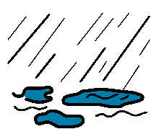
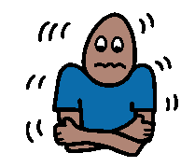
What is the weather today? https://www.youtube.com/watch?v=XcW9Ct000yY

Slide 10
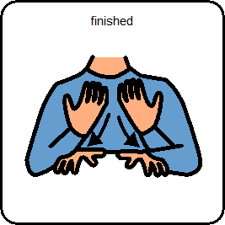
Calendar work is finished.

