Slide 1
I am learning about French Art

Slide 2
Choose a link to click on and take a virtual tour of the Musee d’Orsay in Paris.
https://www.youtube.com/watch?v=og7dr6VPl_U
https://www.youtube.com/watch?v=pAhF9o5Rzns

Slide 3
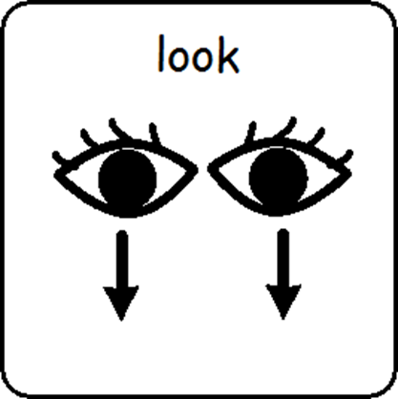
Look at the museum and the artwork.

Slide 4
Looking at French Art is finished

