Slide 1
Mull class on the bus
Amy
Cameron
Daryl
Ciaran
Coral

Slide 2
Amy
Cameron
Daryl
Ciaran
Coral

Slide 3
Amy
Cameron
Daryl
Ciaran
Coral

Slide 4
Amy
Cameron
Daryl
Ciaran
Coral

Slide 5
Learning Intentions
Next

Slide 6
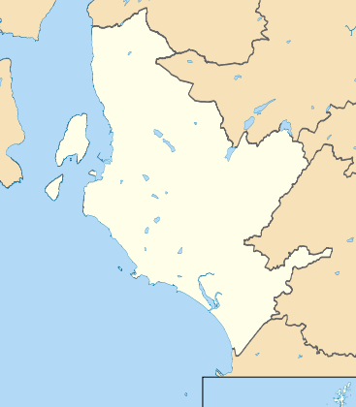
Click on icon to choose where to go

Slide 7
Welcome to
We are going to choose the same
Next

Slide 8
Welcome to
Click on the same items that are on the list
Next

Slide 9
Welcome to
When finished click on the bus to go back to the map
Next

Slide 10
Welcome to
My list
cake
butter
cheese
bread

Slide 11
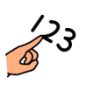
Welcome to
We are going to count the flowers
Next

Slide 12
Welcome to
Click on each flower as it appears and count along
Next

Slide 13
Welcome to
When finished click on the bus to go back to the map
Next

Slide 14
There are 6
flowers
Can you choose the same
5
Try again
6
3
4
6
Good work
1
2
7
Try again
5

Slide 15
Welcome to the
We are going to sort the items into the correct categories
Next

Slide 16
Welcome to the
Click on the category where you think the item should go
Next

Slide 17
Welcome to the
When finished click on the bus to go back to the map
Next

Slide 18
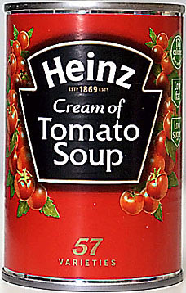
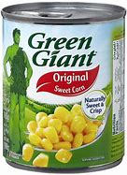
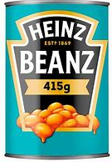
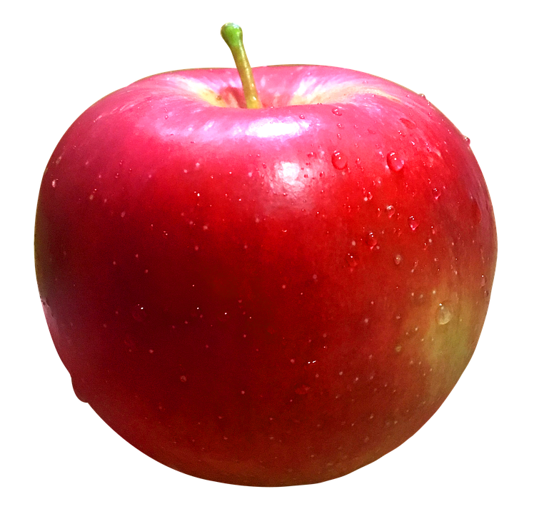
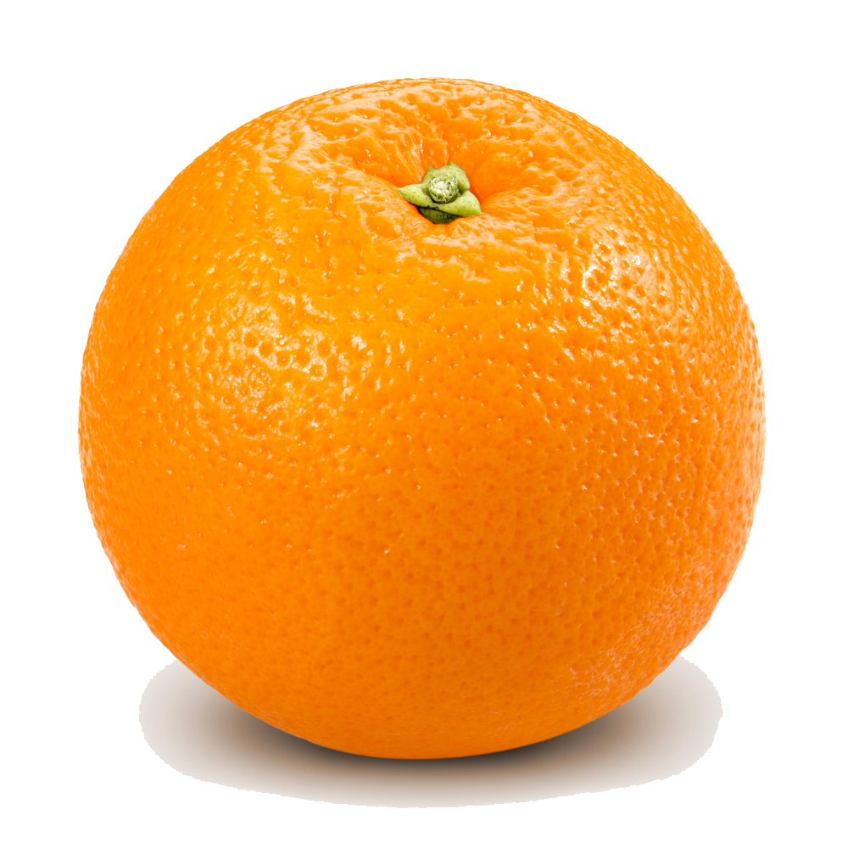
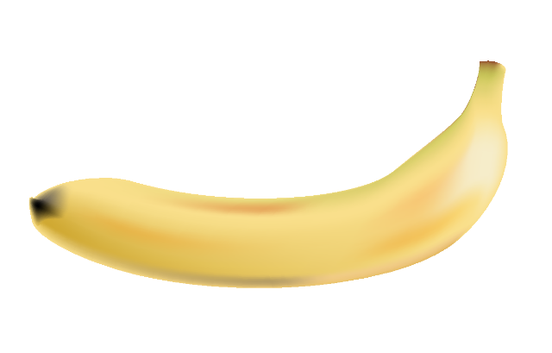
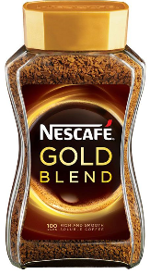
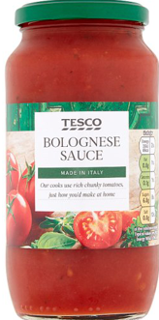
Good work
Try again
Try again
Tins
Fruit
Jars
next item

Slide 19
Try again
Good work
Try again
Tins
Fruit
Jars
next item

Slide 20
Try again
Try again
Good work
Tins
Fruit
Jars
next item

Slide 21
Good work
Try again
Try again
Tins
Fruit
Jars
next item

Slide 22
Try again
Good work
Try again
Tins
Fruit
Jars
next item

Slide 23
Try again
Good work
Try again
Tins
Fruit
Jars
next item

Slide 24
Try again
Try again
Good work
Tins
Fruit
Jars
next item

Slide 25
Good work
Try again
Try again
Tins
Fruit
Jars
next item

Slide 26
Try again
Try again
Good work
Tins
Fruit
Jars

