Slide 1
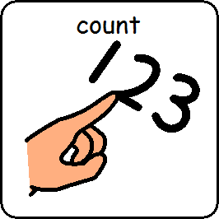
I am learning to count

Slide 2
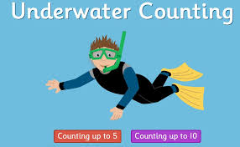
I am learning to count to 5
https://www.topmarks.co.uk/learning-to-count/underwater-counting

Slide 3
I am learning to count to 10
https://www.topmarks.co.uk/learning-to-count/underwater-counting

Slide 4
I am learning to count is finished

