Slide 1
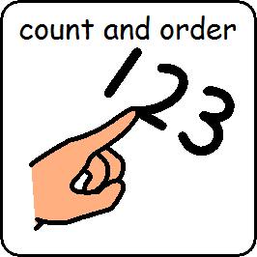
I am learning to count and order numbers

Slide 2
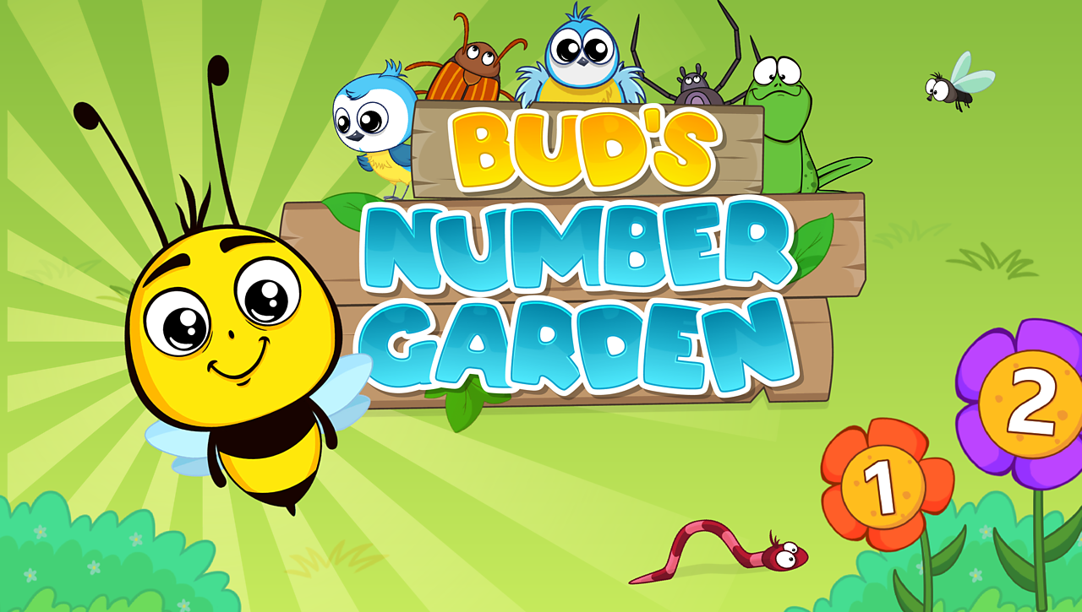
I am learning to count and order numbers
https://www.bbc.co.uk/games/embed/education-ivor-starting-school?exitGameUrl=http%3A%2F%2Fbbc.co.uk%2Fbitesize%2Farticles%2Fzd4b382

Slide 3
I am learning to count and order is finished

